Slide 1
Whosoever will…..may! How Yehovah has arranged His dealings with man from creation. The legal basis for our walk with Yehovah.
Frank Smyth
francsmyth@gmail.com
ACKNOWLEDGEMENTS AND THANKS TO :-
King James Bible(with Strong’s Numbers)
Complete Jewish Bible David H Stern
ISR for The Scriptures 2009
JOSEPH F DUMOND of www.sightedmoon.com
EDDIE CHUMNEY of www.hebroots.org
ZACHARY BOWER of www.new2torah.com

Slide 2
Overview
READ Exodus 19:3-24:11
How Yehovah deals with mankind down the generations
The timeline to Sinai from creation and how things change
The Ketubah Exodus 19:3 – 24:11 :- a four part agreement
Applications
Questions
The end,,,,of the beginning

Slide 3
How Yehovah dealt with….
With Adam in the Garden: Face to face.
From the Garden to the flood: Through the Prophet/Priest/King type leader in the lineage from Adam to Noah.
From Noah to the famine of 2237 AC: Through the Prophet/Priest/King type leader in the lineage from Noah to Jacob who died in Egypt in 2255 AC.
With the Children of Israel from Joseph’s death in 2309AC to the Exodus and arrival in Sinai in time for Shavuot 2458: in lovingkindness and faithfulness to His promises to Abraham, Isaac and Jacob.

Slide 4
Yehovah always requires trusting obedience
Hab 2:4 "Look at the proud: he is inwardly not upright; but the righteous will attain life through trusting faithfulness. (CJB)
Heb 11:7 By trusting, Noach, after receiving divine warning about things as yet unseen, was filled with holy fear and built an ark to save his household. Through this trusting, he put the world under condemnation and received the righteousness that comes from trusting. (CJB)
Gal 3:10-14 For everyone who depends on legalistic observance of Torah commands lives under a curse, since it is written, "Cursed is everyone who does not keep on doing everything written in the Scroll of the Torah." Now it is evident that no one comes to be declared righteous by God through legalism, since "The person who is righteous will attain life by trusting and being faithful." Furthermore, legalism is not based on trusting and being faithful, but on [a misuse of] the text that says, "Anyone who does these things will attain life through them.“ª The Messiah redeemed us from the curse pronounced in the Torah by becoming cursed on our behalf; for the Tanakh says, "Everyone who hangs from a stake comes under a curse." Yeshua the Messiah did this so that in union with him the Gentiles might receive the blessing announced to Avraham, so that through trusting and being faithful, we might receive what was promised, namely, the Spirit. (CJB)
A Lev 18:5

Slide 5
THE LEADERSHIP LINEAGE FROM ADAM TO NOAH (10 GENERATIONS)
Adam to Seth ………….. (130 years) (Genesis 5:3) 130 AC
Seth to Enos …………. (105 years) (Genesis 5:6) 235 AC
Enos to Cainan ………… (90 years) (Genesis 5:9) 325 AC
Cainan to Mahalaleel ….. (70 years) (Genesis 5:12) 395 AC
Mahalaleel to Jared ……. (65 years) (Genesis 5:15) 460 AC
Jared to Enoch …………. (162 years) (Genesis 5:18) 622 AC
Enoch to Methuselah …... (65 years) (Genesis 5:21) 687 AC
Methuselah to Lamech …. (187 years) (Genesis 5:25) 874 AC
Lamech to Noah ………... (182 years) (Gen 5:28-29) 1056 AC

Slide 6
THE LEADERSHIP LINEAGE FROM NOAH TO ABRAHAM (10 GENERATIONS)
Noah to Shem ……… (Noah 502) (Genesis 5:32) 1558 AC
Shem to Arphaxad ……... (Shem 100) (Genesis 11:10) 1658 AC
Arphaxad to Salah ……. (35 years) (Genesis 11:12) 1693 AC
Salah to Eber …………… (30 years) (Genesis 11:14) 1723 AC
Eber to Peleg …………… (34 years) (Genesis 11:16) 1757 AC
Peleg to Reu …………….. (30 years) (Genesis 11:18) 1787 AC
Reu to Serug ……………. (32 years) (Genesis 11:20) 1819 AC
Serug to Nahor …………. (30 years) (Genesis 11:22) 1849 AC
Nahor to Terah …………. (29 years) (Genesis 11:24) 1878 AC
Terah to Abraham ……… (70 years) (Genesis 11:26) 1948 AC

Slide 7
THE LEADERSHIP LINEAGE FROM ADAM TO JACOB (22 GENERATIONS)
Adam
Seth
Enosh
Cainan
Mahal
Jared
Enoch
Methuselah
Lamech
Noah
11. Shem
12. Arphachshad
13. Shelah
14. Eber
15. Peleg
16. Rue
17. Serug
18. Nahor
19. Terah
20. Abraham
21. Isaac 2048 AC
22. Jacob 2108 AC

Slide 8
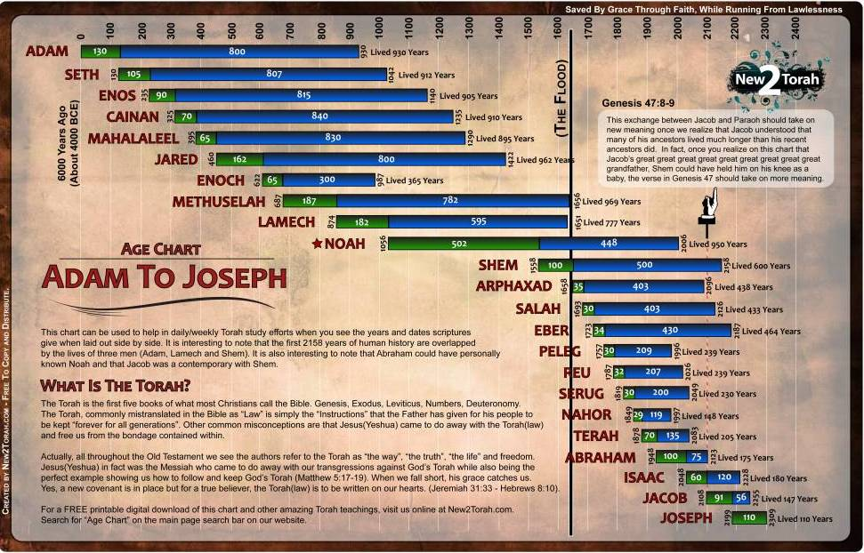
From Adam to Joseph

Slide 9
42 generations from Abraham to Yeshua
Read Matthew chapter One for yourselves.
Mat 1:17 So all the generations from Aḇraham to Dawiḏ were fourteen generations, and from Dawiḏ until the exile to Baḇel were fourteen generations, and from the exile to Baḇel until the Messiah were fourteen generations.
So all the generations from Adam until the Messiah were sixty two generations.[ using Matthew] ( 76 generations in Luke)
Yeshuah was born on Sept 11 3BC, 3834AC in the fourth millennial day. He was executed on the fourth day…….

Slide 10
Joseph(2199-2309) –The Exodus 2458
Bondage to Egyptians 2458AC -2309AC = <149 years, because it would take the Pharaohs some time to forget Joseph
The treatment was already harsh 71 years after Joseph’s death whem Moses was born in2380
Moshe (2380AC-2500AC) dies aged 120 in the year Joshua leads Israel to the land promised to Avraham, Yitzack, and Yacob.
4 Days before Shavuot up to and including Shavuot 2458AC is when the Ketubah- the marriage contract between Yehovah and His bride took place.

Slide 11
4 ELEMENTS OF A SOUZERAIN COVENANT
1 The Offer
2 The Acceptance of the Souzerain as our LORD and High King
3 Sealing the covenant with the blood of the slaughterings.
4 Celebrating the Covenant with a meal together

Slide 12
1. The Offer from our Souzerain King, Yehovah.
The Offer from our Souzerain King, Yehovah.
Exo 19:3 And Mosheh went up to Elohim, and יהוה called to him from the mountain, saying, “This is what you are to say to the house of Ya‛aqoḇ, and declare to the children of Yisra’ěl:
Exo 19:4 ‘You have seen what I did to the Mitsrites, and how I bore you on eagles’ wings and brought you to Myself.
Exo 19:5 ‘And now, if you diligently obey My voice, and shall guard My covenant, then you shall be My treasured possession above all the peoples – for all the earth is Mine –
Exo 19:6 ‘and you shall be to Me a reign of priests and a set-apart nation.’ Those are the words which you are to speak to the children of Yisra’ěl.”

Slide 13
Expanding the Offer
Yehovah did 3 things
-(i) Dealt with the Egyptians Stating who Yehovah
(ii) Bore me on eagles' wings is and what HE has done
(iii) Brought me to Himself to deserve our loyalty
If I do 2 things
Diligently obey His voice My obligations
Guard His Covenant
Yehovah will transform me into 2 things
(i) A member of a kingdom of Priests His Promise
(ii) A member of a set apart nation

Slide 14
KJV with Strong’s Numbers
(Exo 19:5) Now^{H6258} therefore, if^{H518} ye will obey my voice indeed,^{H8085} ^{H8085} ^{H6963} and keep^{H8104} ^{(H853)} my covenant,^{H1285} then ye shall be^{H1961} a peculiar treasure^{H5459} unto me above all^{H4480} ^{H3605} people:^{H5971} for^{H3588} all^{H3605} the earth^{H776} is mine:
H5459
סְגֻלָּה
s^{e}gûllâh
seg-ool-law'
Feminine passive participle of an unused root meaning to shut up; wealth (as closely shut up): - jewel, peculiar (treasure), proper good, special.
Total KJV occurrences: 8

Slide 15
2. The Acceptance by our ancestors in the faith
Exo 19:7-8 And Mosheh came and called for the elders of the people, and set before them all these words which יהוה commanded him. And all the people answered together and said, “All that יהוה has spoken we shall do.” So Mosheh brought back the words of the people to יהוה.
Exo 24:3-4 And Mosheh came and related to the people all the Words of יהוה and all the right-rulings. And all the people answered with one voice and said, “All the Words which יהוה has spoken we shall do.” And Mosheh wrote down all the Words of יהוה,
Exo 24:7 And he took the Book of the Covenant and read in the hearing of the people. And they said, “All that יהוה has spoken we shall do, and obey,”

Slide 16
3. The Blood of the Covenant
Exo 24:5 And he sent young men of the children of Yisra’ěl, and they offered ascending offerings and slaughtered slaughterings of peace offerings to יהוה of bulls.
Exo 24:6 And Mosheh took half the blood and put it in basins, and half the blood he sprinkled on the slaughter-place. …..
Exo 24:8 And Mosheh took the blood and sprinkled it on the people, and said, “See, the blood of the covenant which יהוה has made with you concerning all these Words.”
Heb 9:22 And nearly everything is purified in blood according to the Torah, and apart from the shedding of blood there is no forgiveness.

Slide 17
4. The meal of celebration
Exo 24:9 - 11 And Mosheh went up, also Aharon, Naḏaḇ, and Aḇihu, and seventy of the elders of Yisra’ěl, and they saw the Elohim of Yisra’ěl, and under His feet like a paved work of sapphire stone, and like the heavens for brightness. Yet He did not stretch out His hand against the chiefs of the children of Yisra’ěl! And they saw Elohim, and they ate and drank.
74 men ate a meal in the presence of the Elohim of Yisra’ěl. They communed with Yehovah. HE did not kill them !!!!!!!!!!!!!!!!!!

Slide 18
Applications
1 Whosoever will make Yehovah his/her Yehovah becomes Yehovah’s SEGULAH.
Rahab did it.
Jos 6:25 However, Yehoshua kept alive Raḥaḇ the whore, and her father’s household, and all that she had. And she dwelt in the midst of Yisra’ěl to this day, because she hid the messengers whom Yehoshua sent to spy out Yeriḥo.
Heb 11:31 By belief, Raḥaḇ the whore did not perish with those who did not believe, having received the spies with peace.
Jas 2:25 In the same way, was not Raḥaḇ the whore also declared right by works when she received the messengers and sent them out another way?
Ruth, the Moabitess, did it. Read her account in the book of Ruth.
These two ladies are in Yeshua’s ancestry!!!! Matt 1:5
Have I done it?????????

Slide 19
Applications continued
Our identity changes. Who we belong to is what makes us immovable
Who we live to please changes our behaviour. This is really how Yeshua gets formed in us.
Yehovah gives us a framework for what HE wants – a bride with His sign on her.
Gives us a methodology for walking together as brethren.
Solves the 43000 “ bride of Christ” problem for churchianity.
Shows how Joh 17:21-23 that they all may be one. Just as You, Father, are in Me and I am in You, so also may they be one in Us, so the world may believe that You sent Me. The glory that You have given to Me I have given to them, that they may be one just as We are one— I in them and You in Me—that they may be perfected in unity, so that the world may know that You sent Me and loved them as You loved Me.

Slide 20
Conclusion
Whosoever will make Yehovah their Elohim becomes segulah to Yehovah.
Keeping His Shabbats puts HIS sign on us. Exodus 31:17.
Trusting faithful obedience qualifies us to be part of His bride.
Whosoever will ….. May!

Slide 21
Fin
Thankyou !!

