Slide 1
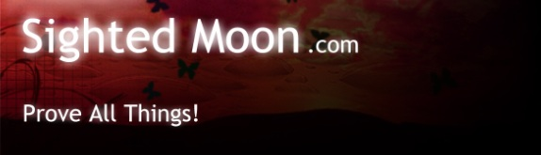
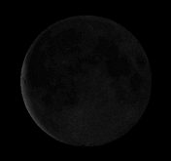
Joseph F Dumond www.sightedmoon.com
The Prophecies of Abraham

Slide 2
1Pe 3:12 For the eyes of Yehovah are on the righteous, And His ears are open to their prayers; But the face of Yehovah is against those who do evil."
Notes:
How is your prayer life. Does Yahweh hear you when you pray or is He not listening?

Slide 3
Ps 119:172
My tongue shall speak of Your word, For all Your commandments are righteousness.
Notes:
It is by doing the Commandments that we gain righteousness. So are you righteous? DO YOU KEEP THE COMMANDMENTS? ALL 10 OF THEM!!!
It is this righteousness that we are to put on.
1 John 2:3 NKJ Now by this we know that we know Him, if we keep His commandments.
1 John 2:4 NKJ He who says, "I know Him," and does not keep His commandments, is a liar, and the truth is not in him.
1 John 3:22 NKJ And whatever we ask we receive from Him, because we keep His
Commandments and do those things that are pleasing in His sight.
1 John 3:24 NKJ Now he who keeps His commandments abides in Him, and He in him. And by this we know that He abides in us, by the Spirit whom He has given us.
1 John 5:2 NKJ By this we know that we love the children of God, when we love God and keep His commandments.
1 John 5:3 NKJ For this is the love of God, that we keep His commandments. And His
Commandments are not burdensome.
Job 29:14 I put on righteousness, and it clothed me; My justice was like a robe and a turban.
Psalms 132:9 Let Your priests be clothed with righteousness, And let Your saints shout for joy.
Isaiah 61:10 I will greatly rejoice in the Lord, My soul shall be joyful in my God; For He has clothed me with the garments of salvation, He has covered me with the robe of righteousness, As a bridegroom decks himself with ornaments, And as a bride adorns herself with her jewels.
Revelation 7:9 After these things I looked, and behold, a great multitude which no one could number, of all nations, tribes, peoples, and tongues, standing before the throne and before the Lamb, clothed with white robes, with palm branches in their hands,14 "These are the ones who come out of the great tribulation, and washed their robes and made them white in the blood of the Lamb.

Slide 4
Ezekiel 14:12-23
Even though Noah, Daniel, and Job were in the land, they would save only themselves by their righteousness.
Notes:
13 "Son of man, when a land sins against Me by persistent unfaithfulness, I will stretch out My hand against it; I will cut off its supply of bread, send famine on it, and cut off man and beast from it. 14 Even if these three men, Noah, Daniel, and Job, were in it, they would deliver only themselves by their righteousness," says Yahweh. 15 "If I cause wild beasts to pass through the land, and they empty it, and make it so desolate that no man may pass through because of the beasts, 16 even though these three men were in it, as I live," says Yahweh, "they would deliver neither sons nor daughters; only they would be delivered, and the land would be desolate. 17 "Or if I bring a sword on that land, and say, 'Sword, go through the land,' and I cut off man and beast from it, 18 even though these three men were in it, as I live," says Yahweh, "they would deliver neither sons nor daughters, but only they themselves would be delivered. 19 "Or if I send a pestilence into that land and pour out My fury on it in blood, and cut off from it man and beast, 20 even though Noah, Daniel, and Job were in it, as I live," says Yahweh, "they would deliver neither son nor daughter; they would deliver only themselves by their righteousness." 21 For thus says Yahweh: "How much more it shall be when I send My four severe judgments on Jerusalem--the sword and famine and wild beasts and pestilence--to cut off man and beast from it? 22 Yet behold, there shall be left in it a remnant who will be brought out, both sons and daughters; surely they will come out to you, and you will see their ways and their doings.

Slide 5
Leviticus 26
Ezekiel 14
Notes:
These are the exact same curses Yahweh speaks about in Leviticus 26 as He has just warned you about in Ezekiel 14 only reversed;
Drought, Pestilence, Sword and Famine.
So are you righteous? And will you be protected from these curses. Lets see.

Slide 6
The Prophecies of Abraham
Notes:
Can any one here tell me what Prophecies Abraham has made. Sacrifice of Isaac.

Slide 7
Declaring the end from the beginning, And from ancient times things that are not yet done Isaiah 46:10
What does Yehovah mean when He says He has, “declared the end from the beginning”?
Where has He done this and how?
Notes:
How has Yahweh declared the end from the beginning. Where has he done this.

Slide 8
That which has been is what will be, That which is done is what will be done, And there is nothing new under the sun
Ecclesiastes1:9
Notes:
If there is nothing new under the sun then where is it written in the old times.
Is there anything of which it may be said, "See, this is new"? It has already been in ancient times before us. 11 There is no remembrance of former things, Nor will there be any remembrance of things that are to come By those who will come after.

Slide 9
Yehshua is the same yesterday, today, and forever. (Hebrews 13:8)
For I am Yehovah, I do not change; Therefore you are not consumed, O sons of Jacob.
(Malachi 3:6)
Yehovah does not change. Therefore His curses and the order in which they are meted out do not change either. He is the same as He was in the days of Adam as He is today with us.
Notes:
This is a key scripture to remember. He does not change so neither do His punishments nor the order in which He gives them out. Every one is looking for the blessings, but no one considers the curses for not obeying.

Slide 10
What is Sin?
1 John 3:4
Whoever commits sin also commits lawlessness, and sin is lawlessness.
Notes:
We are punished for our sins. What is Sin? Lawlessness!
Ezekiel 18:4, 20 The Soul that Sins will Die. Paul too tells us the wages of Sin is death. Romans 6:23 So what is sin?

Slide 11
The Law is the Ten Commandments
The 4th commandment is the one no one wants to keep
Leviticus 23:2
'The feasts of Yahweh, which you shall proclaim to be holy convocations, these are My feasts.
Notes:
In Lev 23 He list the Feasts of Yahweh. The Sabbath, Passover, Unleavened Bread, Shavuot, Yom Teruah, Day of Atonement, Feast of Sukkot and the Eighth Day Feast
These are what no one wants to keep. We all know this is where the rest of the world is sinning.

Slide 12
But Leviticus 25 is part of this law.
It includes the Sabbatical and Jubilee years
Leviticus 27:34 These are the commandments which Yahweh commanded Moses for the children of Israel on Mount Sinai.
This ends the book of Leviticus
Notes:
But what about the Brethren who claim to be obeying Yahweh? The Sabbatical Jubilee years are also part of the 4th commandment. If you are not keeping them then you too are committing sin. Think about it. Have you ever wondered why your prayers go unanswered?
James 5:16 The effective, fervent prayer of a righteous man avails much. How do we become righteous? By keeping the Law. But if you are not keeping the Sabbatical years are you then righteous?? And Are your prayers not heard?
1 John 2:3 Now by this we know that we know Him, if we keep His commandments. 4 He who says, “I know Him,” and does not keep His commandments, is a liar, and the truth is not in him.

Slide 13
What is Sin?
Lev 26 & Deut 28 give us the penalties for our sins.
Notes:
Are you committing sin by not keeping the Sabbatical and Jubilee years. If you are not keeping the Sabbatical and Jubilee years then you should know the cursse for not doing so. Here are the curses for Sin.

Slide 14
Here is now how to figure out the Chronology of Man.
Some claim this year is 2015
others 6015.
The Jews Claim it is 5776 as of Yom Teruah 2015
Notes:
Some are saying we are in the 6009th year. Who is right and how do you know?
This is all explained on the Sabbatical and Jubilee DVD.

Slide 15
Abraham born 1948 after creation
When He was 80 the covenant was made
There are 430 years from the covenant to
the exodus
There are 480 years from Exodus to Solomon’s 4th year as King
There are 36 years for the rest of Solomon’s reign
930 BC – 701 BC is 229 years
701 BC to 2015 = 2716
Notes:
Some are saying we are in the 6009th year. Who is right and how do you know?
This is all explained on the Sabbatical and Jubilee DVD.

Slide 16
2Ki 19:29 And this shall be a sign to you: you shall eat this year such things as grow of themselves, and in the second year that which springs up of the same. And in the third year, sow and reap and plant vineyards and eat the fruits of them.

Slide 17
2Ki 19:29 is our bench mark year.
It is the year 701 BC and is confirmed by both Assyian Lemmu and

Slide 18
Chronology 103
How to Reckon the Sabbatical and Jubilee years to our Chronology
Notes:
The Sabbatical and Jubilee years have no meaning unless we can reconcile them to a year in our own time period.

Slide 19

Respected Chronologist Edwin R. Thiele wrote the book The Mysterious Numbers of the Hebrew Kings
Notes:
In the Old testament no absolute dates are given, and it becomes our task to establish, if we can, some absolute date in the history of Israel that can be used as a starting place to establish other dates in the desired chronological scheme. Our only hope of doing this is to find some cardinal point of contact where Hebrew history ties in with certainty to the history of some other nation whose chronology is known.
In the early history of the Hebrew monarchies the most frequent and definite contacts were the Assyrians. And later it was the Babylonians. Fortunately, the chronologies of these two nations during the periods we are concerned about have been definitely established.

Slide 20
In it he states that there are only two dates in all of Hebrew chronology that can be confirmed by outside sources.

Slide 21
One is the battle of Qarqar in 853 BC in which Ahab dies
1 Kings 22
The only other date that ties into other chronologies is 701 BC when Sennacherib attacks Judah in the 14th year of Hezekiah
2 Kings 19:29
Notes:
Why is this important?

Slide 22
We have 4 Assyrian Chronologies called Eponym from 911 BC -701 BC
We have 7 Assyrian Chronologies called Limmu from 872 BC – 660 BC
Ptolemy’s Cannon is a Chronology of Babylonian kings from
747 BC-161 CE
Ptolemy also had over 80 Astronomical recordings.
Notes:
It is by these lists from the ruins of Nineveh of these chronologies that we are able to record the Hebrew Kings. But only by the accounts based on the battle of Qarqar and the records of Hezekiah by these Assyrian kings.
701 BC is definitely a fixed date in Assyrian history and is the year in which Sennacherib in his third campaign “went against the Hittite-land” Aram, and shut up Hezekiah the Jew...like a caged bird in Jerusalem, his royal city. That took place in the 14th year of Hezekiah ( 2King 18:13) This is the year 701 BC

Slide 23
701 BC is an absolute chronological bench mark date in history.
It is recorded in Assyrian History and Biblical history.
It is not disputable.

Slide 24
2Ki 19:29 ‘And this is the sign for you:
This year you eat what grows of itself,
and in the second year what springs from that,
and in the third year sow and reap and plant vineyards and eat their fruit.
Notes:
Explain the story of Hezekiah who thought he was dying when Sennacherib came and began to siege him.

Slide 25
2Ki 19:29 ‘And this is the sign for you:
This year you eat what grows of itself, 701 BC
and in the second year what springs from that, 700 BC
and in the third year sow and reap and plant vineyards and eat their fruit.
699 BC
Notes:
As we have said these are proven historical years which match up with other known chronological histories.
701 BC is a proven historical date that we can match with a known Assyrian date. We now can tie the Hebrew Kings into a known chronology. But what is more important we can also use this exact same date to know when a Sabbatical year was which was followed by another Sabbatical year.
This is huge information and so important yet no one wants to look at it or admit it.

Slide 26
This is the second and last year Yehovah gives you which is a Jubilee year
Notes:
The Year 2500 after Creation and now 700 B.C We have no other Jubilee years in all of history to help us sort this out.
Now all we have to do is figure out how they match up and then we will know when all Jubilee and Sabbatical years are.

Slide 27
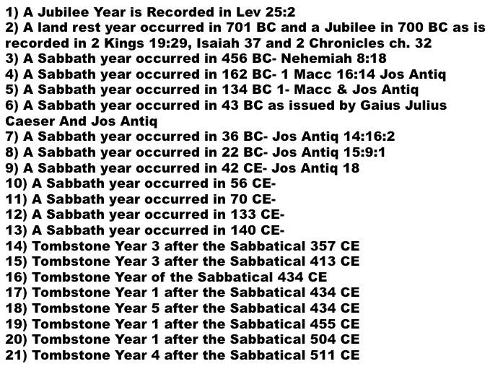
456 BC Nehemiah 8:18
162 BC 1 Maccabees 16:14 & Jo Antiq.
134 BC 1 Maccabees & Josephus Antiq.
43 BC Julius Caesar & Josephus Antiq.
36 BC Josephus Antiq 14:16:2
22 BC Josephus Antiq. 15:9:1
42 CE Josephus Antiq. 18
56 CE
70 CE
133 CE
140 CE
Notes:
Since I first made this powerpoint we have now learned of a number of Tombstones from outside the land of Israel who reckoned the date of the dead from the destruciton of the temple in 70 C.E and according to what year they were in a Sabbatical cycle.

Slide 28
1948 + 80 + 430 + 480 + 36 + 229 + 2716
All totalled we have 5919 years
Again some say it is 6015 and others 5776.
Prove all things!
Notes:
Some are saying we are in the 6009th year. Who is right and how do you know?
This is all explained on the Sabbatical and Jubilee DVD.

Slide 29
We have assumed something.
We assume the 6 days of man to be 6000 Years.
We have a total 5919 years
We can easily prove 6015 wrong because they are already in the 7th millennium
Prove all things!

Slide 30
We can also show you that 5776
is wrong just by understanding the
Sabbatical and Jubilee Cycles.
Prove all things!

Slide 31
Gen 6:3
Yehovah said
"My Spirit shall not strive with man forever, for he is indeed flesh; yet his days shall be one hundred and twenty years."
Notes:
Year here is periods of time. It can also be 120 Jubilee cycles. So right away people go 120 X 50 and they get 6000 years.

Slide 32
Gen 6:3
hundred and twenty years.
Years is the Hebrew word Shanah and means periods of time.
120 years is 120 periods of time or 120 Jubilee cycles.
Notes:
Year here is periods of time. It can also be 120 Jubilee cycles. So right away people go 120 X 50 and they get 6000 years.

Slide 33
So now you now have a simple math equation.
Our equation must add to 120 Jubilee Cycles.
Notes:
Year here is periods of time. It can also be 120 Jubilee cycles. So right away people go 120 X 50 and they get 6000 years.

Slide 34
Our equation must add to 120 Jubilee Cycles.
We have already added up the years to get 5919
But this is not correct.
Notes:
Year here is periods of time. It can also be 120 Jubilee cycles. So right away people go 120 X 50 and they get 6000 years.

Slide 35
456 BC Nehemiah 8:18
162 BC 1 Maccabees 16:14 & Jo Antiq.
134 BC 1 Maccabees & Josephus Antiq.
43 BC Julius Caesar & Josephus Antiq.
36 BC Josephus Antiq 14:16:2
22 BC Josephus Antiq. 15:9:1
42 CE Josephus Antiq. 18
56 CE
70 CE
133 CE
140 CE
Notes:
We have now 38 and possibly even 50 years we know were Sabbatical or Jubilee years but we have only two Known Jubilee years.
All of these must match each other in order to prove the whole math equation true.
All of our Sabbatical years match only one way. When you count by 7.

Slide 36
Pentecost teaches us how to know the Jubilee cycles
Lev 23:15 'And you shall count for yourselves from the day after the Sabbath, from the day that you brought the sheaf of the wave offering: seven Sabbaths shall be completed. 16 Count fifty days to the day after the seventh Sabbath; then you shall offer a new grain offering to Yahweh.
Lev 25:8 'And you shall count seven Sabbaths of years for yourself, seven times seven years; and the time of the seven Sabbaths of years shall be to you forty-nine years.
Notes:
The 50th day is also the 1st day in the count to Pentecost. Same with the Sabbatical years. The 50th year is also the first year in the next count to seven. How do we prove this?

Slide 37
: A land rest year occurred in 701 BC and a Jubilee in 700 BC as written in the Bible in 2 Kings 19:29, Isaiah 37, and 2 Chronicles 32
: A Sabbath year occurred in 456 BC Nehemiah 8:18
: A Sabbath year occurred in 162 BC 1 Macc 16:14 Jos Antiq
: A Sabbath year occurred in 134 BC 1 Macc & Jos Antiq
: A Sabbath year occurred in 43 BC as issued by Gaius Julius Caeser And Jos Antiq
: A Sabbath year occurred in 36 BC Jos Antiq 14:16:2
: A Sabbath year occurred in 22 BC Jos Antiq 15:9:1
: A Sabbath year occurred in 42 CE Jos Antiq 18:
: A Sabbath year occurred in 56 CE
: A Sabbath year occurred in 70 CE
: A Sabbath year occurred in 133 CE
: A Sabbath year occurred in 140 CE
Notes:
We have recorded in History each of these Sabbatical years and one Jubilee year. These are verifiable and non contested. The only problem arises whether the years begin with Aviv or Yom Teruah. It was only after the Bar kochba revolt that the Pagan method of Fall reckoning took over in Jewish circles. Even Josephus states this in his writings. Aviv was the first of the year for all religious activities, and tishri was for civil duties only.
All of these Year only match up when you count by 7 from one to the other. None of them match when you count 49 50 then 1. Only when you count 48,49, 1, 2 do they all work. I encourage you all to try and do it both way.

Slide 38
:
Notes:
2 King 19:29 These two dates are one of the most agreed to dates in History. When Israel is reconciled to the Assyrian Eponym and Limmu lists.
So 701 BC would be the 49th year of the Jubilee cycle.
And 700 would be the Jubilee year and the 1st year of the next Jubilee cycle.
So from here I just plotted them all out on Xcel and each and every known Sabbatical year also. They all matched.

Slide 39
:
Notes:
Sabbath year occurred in 456 BC Nehemiah 8:18

Slide 40
:
Notes:
A Sabbath year occurred in 162 BC 1 Macc 16:14 Jos Antiq
: A Sabbath year occurred in 134 BC 1 Macc & Jos Antiq

Slide 41
:
Notes:
A Sabbath year occurred in 43 BC as issued by Gaius Julius Caeser And Jos Antiq : A Sabbath year occurred in 36 BC Jos Antiq 14:16:2 : A Sabbath year occurred in 22 BC Jos Antiq 15:9:1 : A Sabbath year occurred in 42 CE Jos Antiq 18: : A Sabbath year occurred in 56 CE : A Sabbath year occurred in 70 CE
28 C.E. Is when Yahshua read the scroll of Isaiah which says that this is the acceptable year.

Slide 42
:
Notes:
A Sabbath year occurred in 133 CE : A Sabbath year occurred in 140 CE

Slide 43
Now that we know when the Sabbatical years are and the Jubilee years because of 2 King 19:29 and because we also understand Gen 6:3 being 120 Jubilee cycles
Our math equation is now this.
120 X 49 = 5880 years

Slide 44
120 X 49 = 5880 years
But our first addition of chronology added up to 5919 years.
So we are over by 39 years already and we have not gone to the next Jubilee year.

Slide 45
Our Math only went to the year 2015. The next Jubilee year is 2045. That is 30 years from now. This makes our chronology out by that much more. A total of 69 years out
Notes:
Once we know from History when the Sabbatical years are then we can know where we are in a Sabbatical cycle. Once we know how many years there are in history then we know there are too many and that we are in the last Sabbatical cycle. This chart shows us today in that last cycle. All of this explained on the DVD. We just added up 5919 years since creation, but 49 x 120 = 5880 This means we are 39 years past the end of the sixth day.
So either we have too many years recorded, or Yahweh has lied to us when He said we would have 120 Jubilee Cycles.

Slide 46
Then if 2045 is the Next Jubilee year and there are only 5880 years in 120 Jubilee cycles….
2045 being the first year of the next cycle is 5881
That means we are in the year 5851 right now.

Slide 47
We know this first section to be true from the creation of Adam to the exodus.
1948 + 80 + 430
+ 480
+ 36 + 229 + 2716

Slide 48
1948 + 80 + 430
+ 480
We also know the chronology from Solomon down to our time with accuracy because of multiple chronologies we can compare to.
+ 36 + 229 + 2716

Slide 49
1948 + 80 + 430
When we look at the period of the judges there is a great deal of confusion about this time.
+ 480
+ 36 + 229 + 2716

Slide 50
The Book of Acts 13:19-20 claims this period of the judges was 450 years from the entry into the land to Samuel.
1 Kings 6:1 says it is 480 years from the Exodus to the 4th year of Solomon.
Josephus says it was 592 years.

Slide 51
The Septuagint says it was 440
Glycas says 330 years
Melchoir Canus says it was 590 years
Sulpicius Severus 588 Years
Clemens Alexandrinus 570 years
Cedrinus 672 Years
Codomanus 598 years
Vossius & Capella 580 Years
Serarius 680 Years
Nicolas Abraham 527 years
Maestlinus 592 years
Petavious & Valtherus 520
K.A. Kitchen about 300 years.
Notes:
Which one is right and where is our second witness for the 480 years years.

Slide 52
1948 + 80 + 430 + X + 36 + 229 + 2716 + 30 = 5881
2458 + X + 3011 = 5881
5881 – 3011- 2458 = X
412 = X

Slide 53
How do we prove 412 is correct?
We already know one Jubilee was in 700 BC.
And we also know that Lev 25:2 was the only other Jubilee year mentioned in the bible. The year they entered the land which was 2500 years after creation.

Slide 54
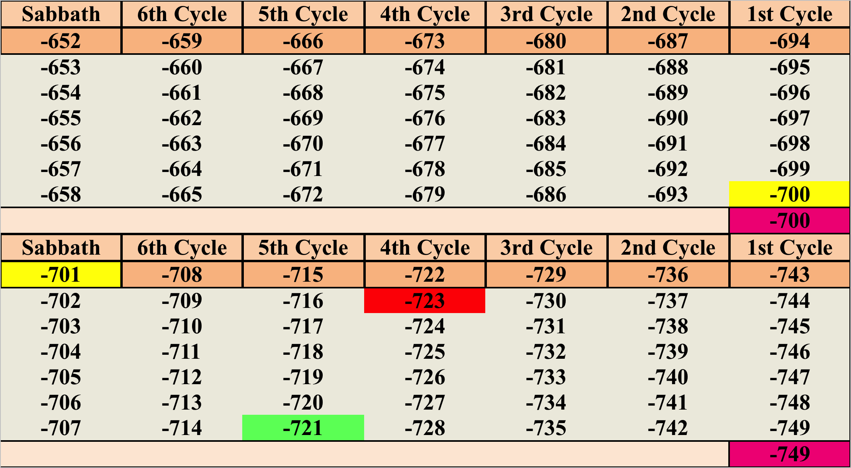
Notes:
When we plot the Jubilee year of 700 BC and the 49th year of 701 BC it looks like this.
Now we must count backwards to the time of Entry into the promised land which was 2500 Years after the creation of Adam

Slide 55
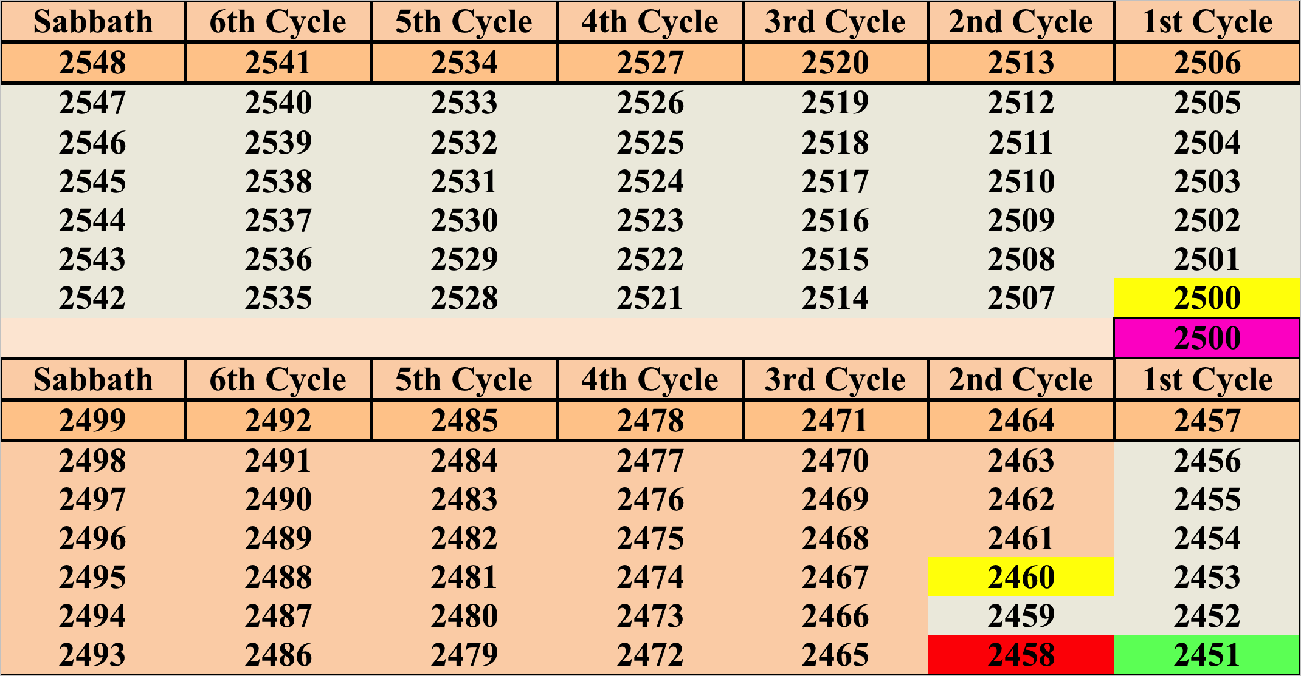
Notes:
I then created another chart starting from the creation of Adam and went forward counting the Jubilee cycles. I also entered each event in Genesis as I went along. Sure enough the year they entered the promised land was a Jubilee year and it was 2500 after creation.
Now all I had to do was match the BC and CE years with the after Creation chronology.
I know there is only 5880 years for man. Again back to our equation.

Slide 56
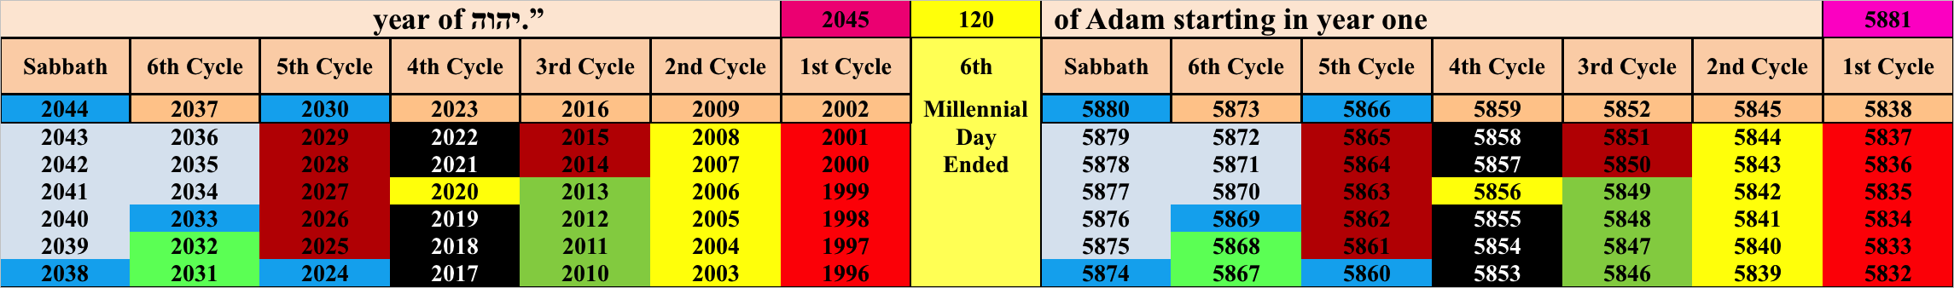
BC CE Years Jubilee cycle Creation Years
Notes:
There are only 120 Jubilee cycles.

Slide 57
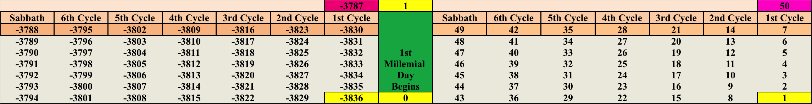
BC CE Years Jubilee cycle Creation Years
Notes:
The year Adam was created then was 3836 BC.

Slide 58
Having now matched up our two chronologies by using the Sabbatical and Jubilee cycles to do it, we now can plainly see that the year of the Exodus was 1379 BC and Solomon's 4th year of his reign was 967 BC.
A total of 412 years.
Notes:
The year Adam was created then was 3836 BC.

Slide 59
This current year is 5776 according to the Jewish calendar.
I am saying that this Aviv in 2016 will be 5852
A difference of 76 years.
Notes:
Why??
The answer comes in Math 1:8 where Mathew left out the names of 4 kings.

Slide 60
Mathew 1:8 has the answer
Mat 1:7 Solomon begot Rehoboam, Rehoboam begot Abijah, and Abijah begot Asa.
Mat 1:8 Asa begot Jehoshaphat, Jehoshaphat begot Joram, and Joram begot Uzziah.
Mat 1:9 Uzziah begot Jotham, Jotham begot Ahaz, and Ahaz begot Hezekiah.
Notes:
So do you see the answer???
It is right there in Mat 1:8
Actually it is what is not there that is the answer.

Slide 61
Mathew 1:8 leaves off the names of Ahaziah, who reigned 1 year, and Athaliah who reigned 6, and Jehhoash who reigned 40 and Amaziah who reigned 29, are all missing from the chronology. 76 years in total.
Notes:
Deuteronomy 5:9 NKJ
you shall not bow down to them nor serve them. For I, Yahweh, am a jealous Eloim, visiting the iniquity of the fathers upon the children to the third and fourth generations of those who hate Me,
De 29:20 – Yahweh would not spare him; for then the anger of Yahweh and His jealousy would burn against that man, and every curse that is written in this book would settle on him, and Yahweh would blot out his name from under heaven.

Slide 62
Deu 29:20 “יהוה would not forgive him, but rather, the displeasure of יהוה and His jealousy shall burn against that man, and every curse that is written in this book shall settle on him, and יהוה shall blot out his name from under the heavens.
Notes:
What was it that these kings did to anger Yahweh so? We can read in Duet. 29:20 where Yahweh threatened to blot out the names of those who served other gods.

Slide 63
Exo 20:5 you do not bow down to them nor serve them. For I, יהוה your Elohim am a jealous Ěl, visiting the crookedness of the fathers on the children to the third and fourth generations of those who hate Me,
Exo 20:6 but showing kindness to thousands, to those who love Me and guard My commands.
Notes:
And in Exodus 20:5 it says that the sins of the people will be visited to the 3rd and 4th generations of those who hate Him. What wicked King could this be?

Slide 64
2Ch 24:7 For the sons of Athalyahu, that wrong woman, had broken into the House of Elohim, and had also prepared all the set-apart vessels of the House of יהוה to the Baʽals.
Notes:
2 Chron 24:7 For the sons of Athalyahu, that wrong woman, had broken into the house of Yahweh; and had also all the dedicated vessels of the house of Yahweh bestowed upon Baalim.
Because of this blasphemy, the city of Libnah revolted against Joram (2 Kings 8:22). Libnah was one of the cities of the Aaronic Preists (Joshua 21:13). Obviously they objected violently to Joram’s desecration of the Solomon’s temple. For Joram’s blasphemy, Yahweh judged not only his wife Athaliah, but his son Ahaziah, and grandson Jehash, and great grandson Amazaih.
You can read of these events in your own bible
This Azariah was also called Uzziah in 2 Kings 15:13 and is the Ozias of Mathew 1:8.

Slide 65
5776 + 76 = 5852
At Aviv this year we will be at 5852
There is a ½ year difference because they start at tishri and not aviv.
Notes:
Keep in mind the Jews have started their year at Tishri and not Aviv. This half year makes the difference between 5847 and 5848 which begins at Aviv in 2012.
When you add the missing kings that were blotted out to the current Jewish year of 5774, you end up what I am saying is the current year of 5849 and is 5850 at Aviv this coming spring.

Slide 66
Notes:
We are currently in the last jubilee Cycle. The 120th Jubilee Cycle. 1996 was the last Jubilee year that we have had. We are currently in 2015.

Slide 67
Notes:
In a Sabbatical Cycle once the curse have been handed out then we are still left with a number of years in the Sabbatical Cycle that we have to account for. These are the year that the Fall Holy Days deal with.
The 8th Day is tied into the Jubilee year. It is also tied into the Celebrations of Pentecost. This is how I was able to apply them to the Jubilee cycle as I have.
So now we just count backwards from the 8th day.
8 days before this is when the Wedding of Sukkot takes place. 5 days before this is Atonement when Satan is locked away. 10 Days before this is Trumpets when judgment begins on the rest of mankind. And sure enough when we plot this out on the chart Judgment comes right after the house of Israel is given its last punishment.

Slide 68
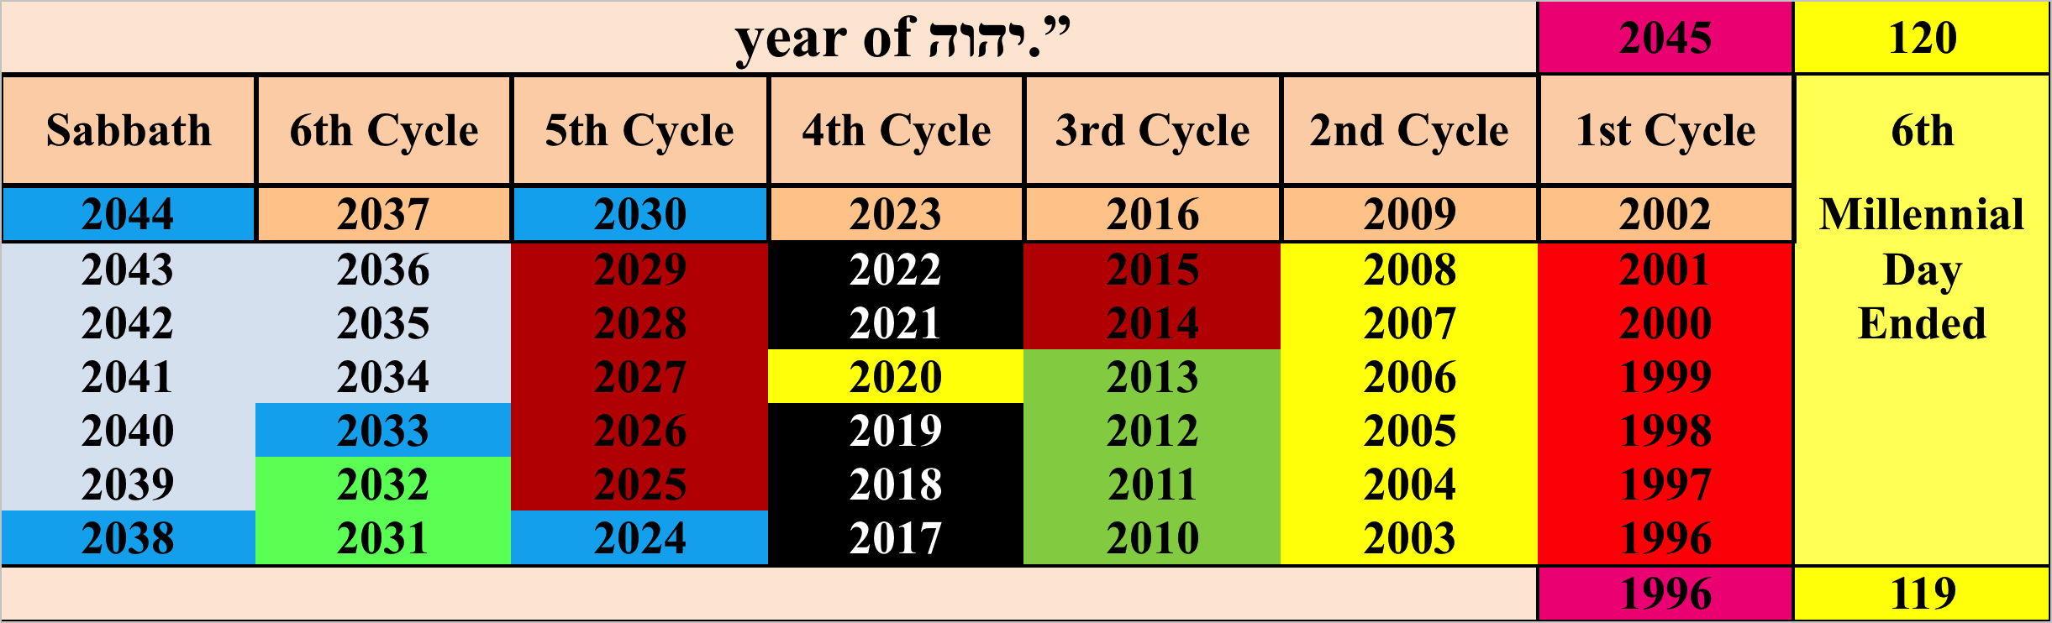
Notes:
Explain the blue areas of our current cycle. Trumpets Judgement at beginning of Captivity. Shabbat Shuva later in our presentation. 2033 Satan is locked away. 2038 Sukkot Wedding. 2045 8th day
The 8th Day is tied into the Jubilee year. It is also tied into the Celebrations of Pentecost. This is how I was able to apply them to the Jubilee cycle as I have.
So now we just count backwards from the 8th day.
8 days before this is when the Wedding of Sukkot takes place. 5 days before this is Atonement when Satan is locked away. 10 Days before this is Trumpets when judgment begins on the rest of mankind. And sure enough when we plot this out on the chart Judgment comes right after the house of Israel is given its last punishment.

Slide 69
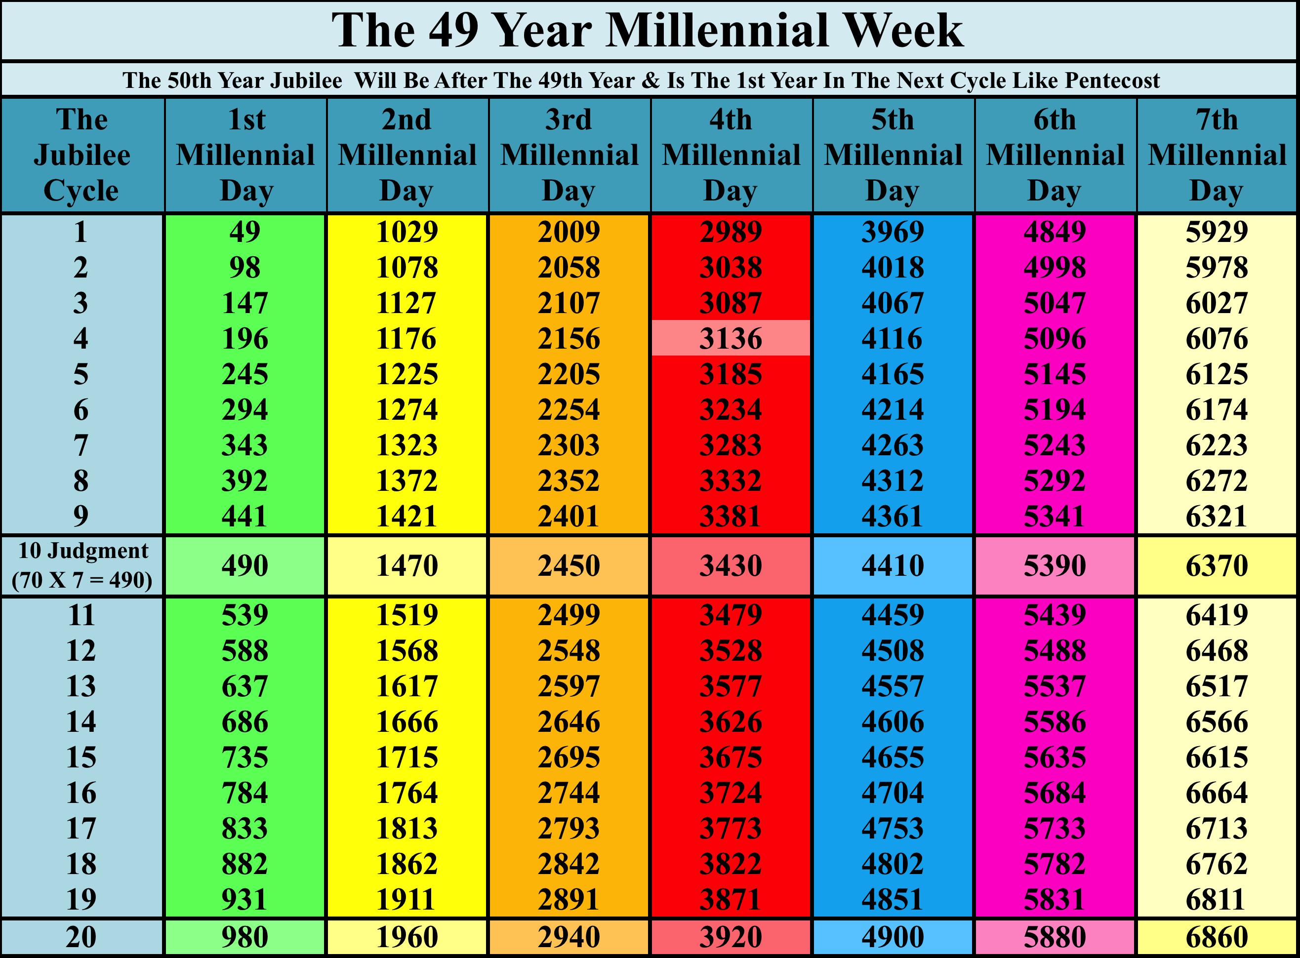
Notes:
Explain the 6 Millennial days having 20 jubilee cycles of 49 year each. This current year in 2009 is 5845 since creation
When we count by 7 we end up with each Jubilee Cycle being 49 years.
We have counted by 49 up to 20 times as one Millennial day.
Solomon began to build the temple in the year 2870 AC
Yahshua was killed in 3867 AC Just before the end of the fourth Millennial day. What is the sign of Jonah?
John 2:19 Yahshua answered and said to them, "Destroy this temple, and in three days I will raise it up.“
3906 AC is equal to when the temple was destroyed in 70 CE Just before the end of the fourth day.
When we count three millennial days we come down to 3867 + 980 + 980 + 980 = 6810 which is at the end of the 7th Millennium just like Yahshua rose from the dead on Shabbat. This is another whole study that can wait a millennium to look at.

Slide 70
Notes:
Yehshua was killed on the 4th day of the week. Notice that the temple was destroyed on the 4th millennial day. At the end of the 4th day as Yehshua was at the end of Wednesday.

Slide 71
We are in the last Jubilee Cycle before the messiah returns.
2015 = 5851 from the creation of Adam
This leaves just 35 years until the 120th Jubilee year in 2045 CE
Mathew 24:22 And unless those days were shortened, no flesh would be saved; but for the elect's sake those days will be shortened.
Notes:
I am saying that the end comes in 2033. Just 23 years from now and 12 years before the 120th Jubilee year. This is exactly what Mat 24:22 is telling us.

Slide 72
In the fourth generation your descendants will come back here, for the sin of the Amorites has not yet reached its full measure.”
(Genesis 15:13-16)
In the fourth generation in verse 16, that word is Dowr and it means the following: period, generation, habitation, and dwelling
Notes:
The Fourth period of time actually means the fourth millennial day.

Slide 73
Notes:
This word generation can also mean period of time. If we apply this to what Yahweh is telling Abraham, he is saying that in four periods of time or in the Fourth Millennial Day, your descendants will come back here. That Fourth Millennial Day is right now from the time of Abraham. When Yahweh made this promise to Abraham, it was 2,028 years after the Creation of Adam near the beginning of the third millennial day. One Millennial Day is 980 years; the Second Millennial day would end at 1960 years. Abraham lived at the beginning of the Third Millennial Day which ended at 2,940 years. The Fourth Millennial Day ends at 3,920 years, the Fifth Millennial Day ends at 4,900 years and the Sixth Millennial Day of the Millennial Week, ends at 5,880 years. This year of 2015 CE is the 5,851th year since the Creation of Adam. Each Millennial Day is 980 years or 20 Jubilee Cycles of 49 years each. This is the fourth period of time as Yahweh told Abraham it would be, when his descendants would return home to the Land of Israel.
When Ezekiel and Peter both say that a day is as a thousand years, all I can say is that they have rounded up. I too could say that one Sabbatical day is as a thousand years. It is easier to say a thousand years than it is to say 980 years. So this is your one excuse which you can use not to obey any of the things I am sharing with you.
But weigh all the evidence I am about to put before you and then deicde.

Slide 74
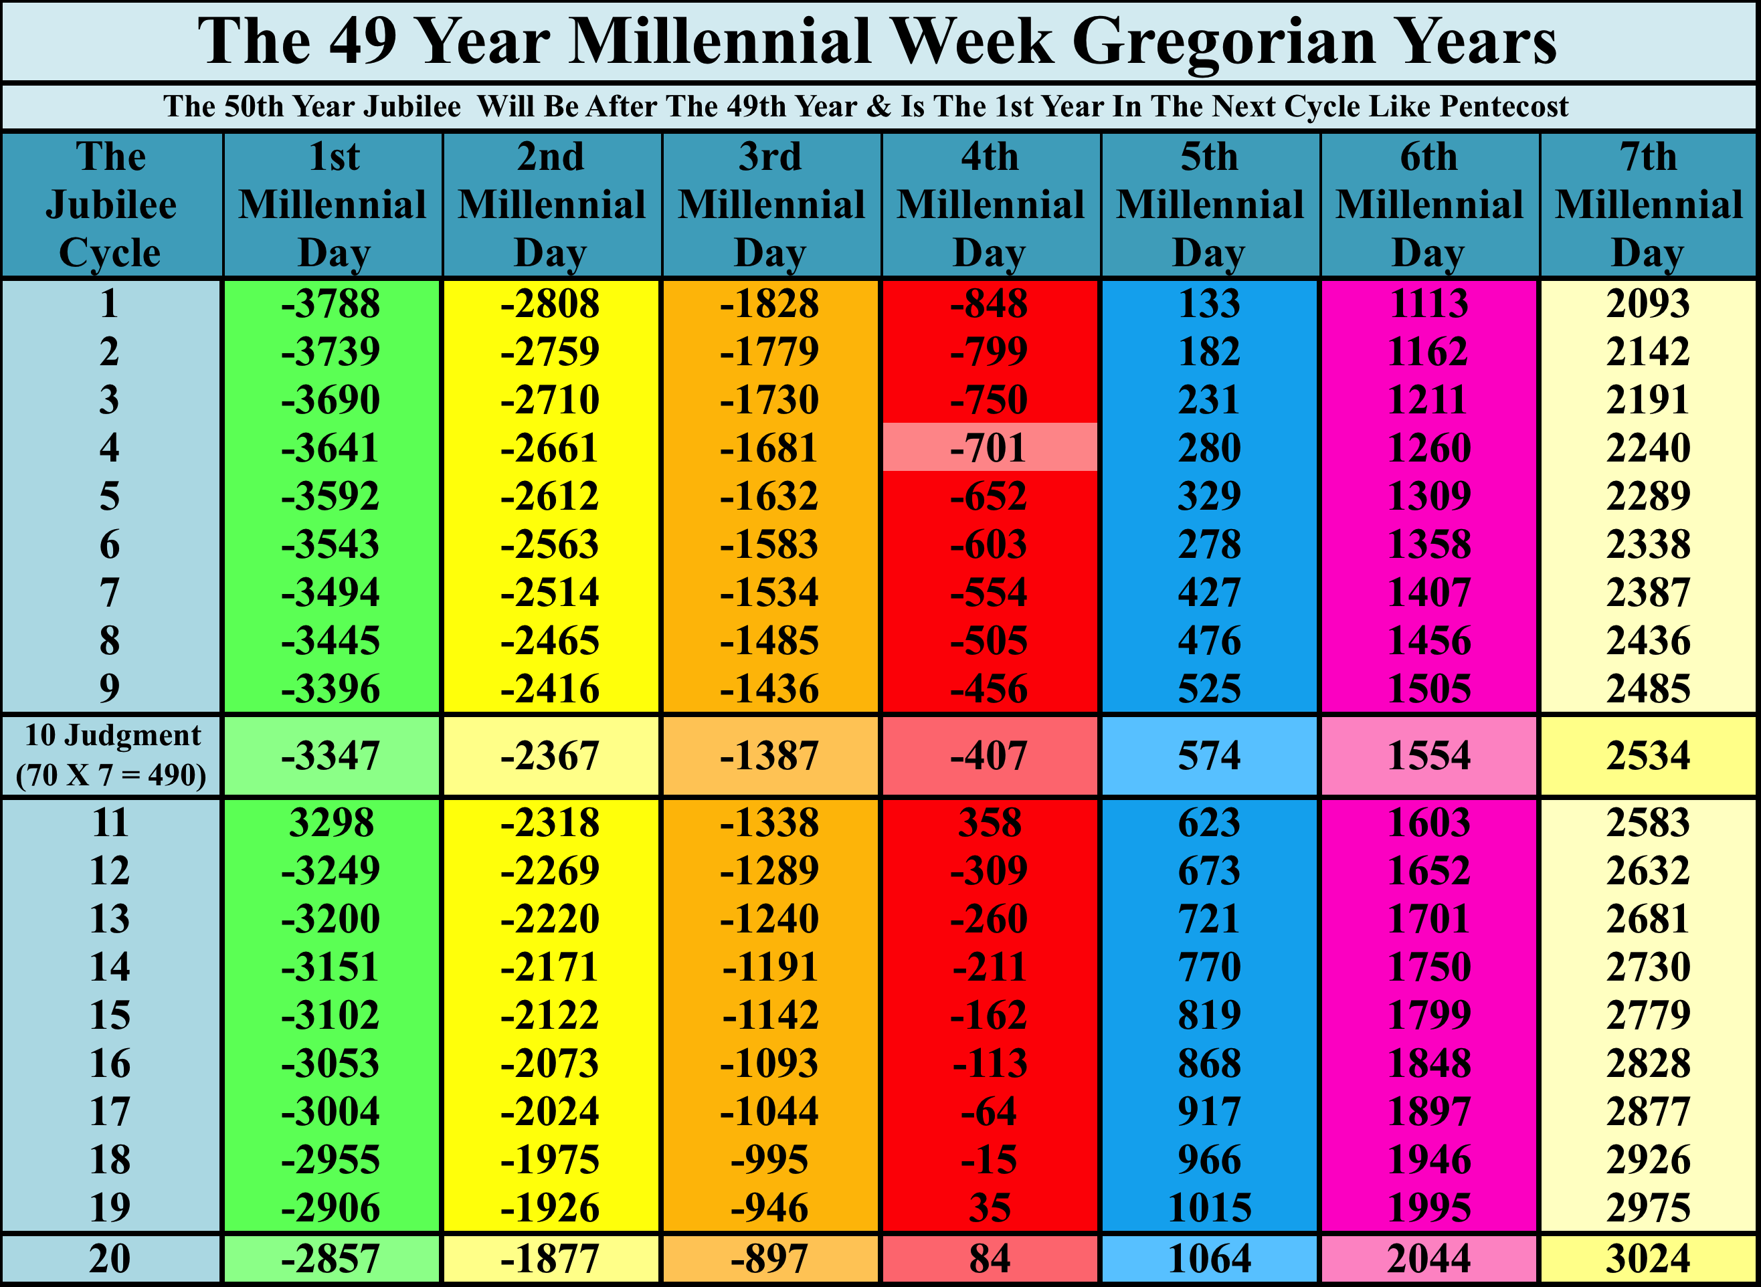
Notes:
The Year Abraham was given this 4th generation prophecy was in the year 2028 after Creation. That same year is 1809 B.C.
We are today in the year 2015 CE near the end of the 6th millennial day which is the 4th day since Yehovah spoke to Abraham.
We are near the time to be brought home.

Slide 75
Declaring the end from the beginning, And from ancient times things that are not yet done Isaiah 46:10
That which has been is what will be, That which is done is what will be done, And there is nothing new under the sun 10 Is there anything of which it may be said, “See, this is new?” It has already been in ancient times before us.
Ecclesiastes1:9
Notes:
When Solomon says there is nothing new, tell me where in ancient times has all of the events that are about to happen in our day taken place? Tell me where if there is nothing new
Edmund Burke, who first coined the term, “Those who don’t know history are destined to repeat it,” Where has Yahweh done this? Where has He shown us in ancient times things that are to come in our time? We have a clue in Genesis when Yahweh speaks to Abimelech concerning Abraham.

Slide 76
Gen 20:7 Now therefore, restore his wife to the man. For he is a prophet, and he shall pray for you, and you shall live. And if you do not restore her, know that you shall surely die, you, and all that are yours.
For he Abraham is a Prophet7)
Notes:
So what did Abraham Prophecy. Name them. Sacrifice of Isaac. Name another.
THESE ARE WHAT I WANT TO SHOW YOU. THEY WILL ROCK YOUR BIBLICAL UNDERSTANDING BIG TIME!!
Everything up to this point has been review. Stuff you all should know by now.

Slide 77
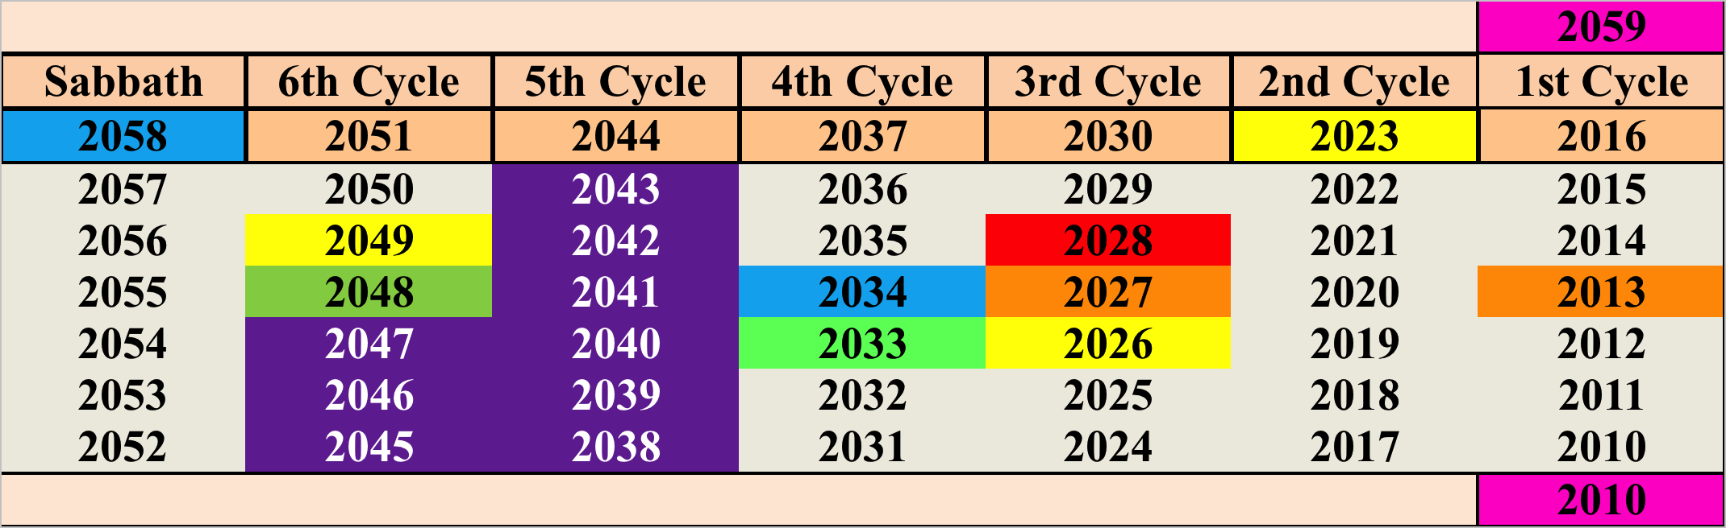
Sabbatical Cycle of Abrahams Life A.C.
Notes:
Here are the major events in Abrahams life during the Sabbatical cycle that he lived in. 2013 the tongues are confused at Babylon.
Gen 12 takes place in 2023 After creation Abraham leaves Haran.
Gen 13 happens during 2024-2026 Lot splits from Abraham.
Gen 14 happens 2026-2027 King of the North comes and captures Lot.
Gen 15 takes place in 2028 The Covenant is made with Abraham.
Gen 16 takes place from 2033-2034 Conception and Birth of Ishmael.
Genesis Chapter 17-21 is when Sodom is destroyed and the Birth of Isaac 2047 -2048.

Slide 78
Sabbatical Cycle of Abrahams Life A.C.
Notes:
All Roman, Greek, Persian, Babylonian and Egyptian mythology is based on some facts. Alexander Hislop shows in his book the two Babylon's that Shem as Melchezidek takes Nimrod to a court of law and over the course of 10 years finds him guilty .
If “Sem,” then, was the primitive Hercules, who overcame the Giants, and that not by mere physical force, but by “the power of Yahweh,” or the influence of the Holy Spirit, that entirely agrees with his character; and more than that, it remarkably agrees with the Egyptian account of the death of Osiris. The Egyptians say, that the grand enemy of their god overcame him, not by open violence, but that, having entered into a conspiracy with seventy-two of the leading men of Egypt, he got him into his power, put him to death, and then cut his dead body into pieces, and sent the different parts to so many different cities throughout the country. * The real meaning of this statement will appear, if we glance at the judicial institutions of Egypt. Seventy-two was just the number of the judges, both civil and sacred, who, according to the Egyptian law, were required to determine what was to be the punishment of one guilty of so high an offence as that of Osiris, supposing this to have become a matter of judicial inquiry.
In determining such a case, there were necessarily two tribunals concerned. First, there were the ordinary judges, who had power of life and death, and who amounted to thirty, * then there was, over and above, a tribunal consisting of forty-two judges, who, if Osiris was condemned to die, had to determine whether his body should be buried or not, for before burial, every one after death had to pass the ordeal of this tribunal. * As burial was refused him, both tribunals would necessarily be concerned; and thus there would be exactly seventy-two persons, under Typho the president, to condemn Osiris to die and to be cut in pieces.
In connection with this character of Shem, the myth that makes Adonis, who is identified with Osiris, perish by the tusks of a wild boar, is easily unravelled. * The tusk of a wild boar was a symbol. In Scripture, a tusk is called “a horn;” * among many of the Classic Greeks it was regarded in the very same light. * When once it is known that a tusk is regarded as a “horn” according to the symbolism of idolatry, the meaning of the boar’s tusks, by which Adonis perished, is not far to seek. The bull’s horns that Nimrod wore were the symbol of physical power. The boar’s tusks were the symbol of spiritual power. As a “horn” means power, so a tusk, that is, a horn in the mouth, means “power in the mouth;” in other words, the power of persuasion; the very power with which “Sem,” the primitive Hercules, was so signally endowed. Even from the ancient traditions of the Gael, we get an item of evidence that at once illustrates this idea of power in the mouth, and connects it with that great son of Noah, on whom the blessing of the Highest, as recorded in Scripture, did especially rest.
The Celtic Hercules was called Hercules Ogmius, which, in Chaldee, is “Hercules the Lamenter.” * No name could be more appropriate, none more descriptive of the history of Shem, than this. Except our first parent, Adam, there was, perhaps, never a mere man that saw so much grief as he. Not only did he see a vast apostasy, which, with his righteous feelings, and witness as he had been of the awful catastrophe of the flood, must have deeply grieved him; but he lived to bury SEVEN GENERATIONS of his descendants. He lived 502 years after the flood, and as the lives of men were rapidly shortened after that event, no less than SEVEN generations of his lineal descendants died before him (Gen. xi. 10-32). How appropriate a name Ogmius, “The Lamenter or Mourner,” for one who had such a history!
Now, how is this “Mourning” Hercules represented as putting down enormities and redressing wrongs? Not by his club, like the Hercules of the Greeks, but by the force of persuasion. Multitudes were represented as following him, drawn by fine chains of gold and amber inserted into their ears, and which chains proceeded from his mouth. * There is a great difference between the two symbols—the tusks of a boar and the golden chains issuing from the mouth, that draw willing crows by the ears; but both very beautifully illustrate the same idea—the might of that persuasive power that enabled Shem for a time to withstand the tide of evil that came rapidly rushing in upon the world.
Now when Shem had so powerfully wrought upon the minds of men as to induce them to make a terrible example of the great Apostate, and when that Apostate’s dismembered limbs were sent to the chief cities, were no doubt his system had been established, it will be readily perceived that, in these circumstances, if idolatry was to continue—if, above all, it was to take a step in advance, it was indispensable that it should operate in secret. The terror of an execution, inflicted on one so mighty as Nimrod, made it needful that, for some time to come at least, the extreme of caution should be used. In these circumstances, then, began, there can hardly be a doubt, that system of “Mystery,” which, having Babylon for its centre, has spread over the world. In these Mysteries, under the seal of secrecy and the sanction of an oath, and by means of all the fertile resources of magic, men were gradually led back to all the idolatry that had been publicly suppressed, while new features were added to that idolatry that made it still more blasphemous than before. That magic and idolatry were twin sisters, and came into the world together, we have abundant evidence.
At some point, Nimrod was captured by Shem who is also known to be the Melchizedek of Salem. Jeru means city. So Jerusalem means City of Peace. Salem is peace.
Nimrod was tried and found guilty in a court of law, executed and had his body cut apart and sent to the other nations as a warning not to follow in Nimrod’s rebellious ways. This led to the Babylonian religion and worship of Nimrod becoming secretive and hidden from Shem. Hence, the Mysterious Babylonian Religion was born.
The important thing in all of this is to know and understand that Shem fought with Nimrod for ten years in a court of law. according to these myths, which are based on truths long forgotten.
Shem was called Typho by the people after this. The meaning of Typho the President was changed to Typho the evil one, because Shem had destroyed the system that the people liked. Wow to those that call evil good and good evil.
Even today in the pyramid of Giza there has been found written on one of the inner chambers an expression written by one of the workers on the pyramid. It is written much like what would be found in any modern construction site. It begins with a superlative blankety blank Typho the Evil one.
This battle is an example of what will happen when Yahshua returns. The people will fight against Him wanting to keep the Babylonian system instead as we are told in revelations.

Slide 79
Sabbatical Cycle of Abrahams Life A.C.
Notes:
The Ten years that Shem prosecuted Nimrod are represented in purple. How do I know this is when this took place. Thematic Analysis.

Slide 80
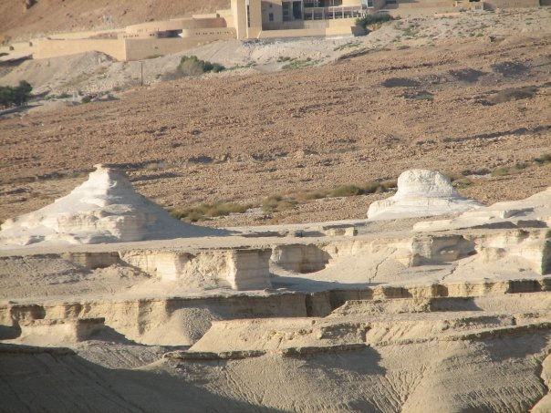
Temple and Sphinx Sodom and Gomorrah
Notes:
The remains of temple and sphinx at Gomorrah. Destroyed 2047 after Creation.

Slide 81
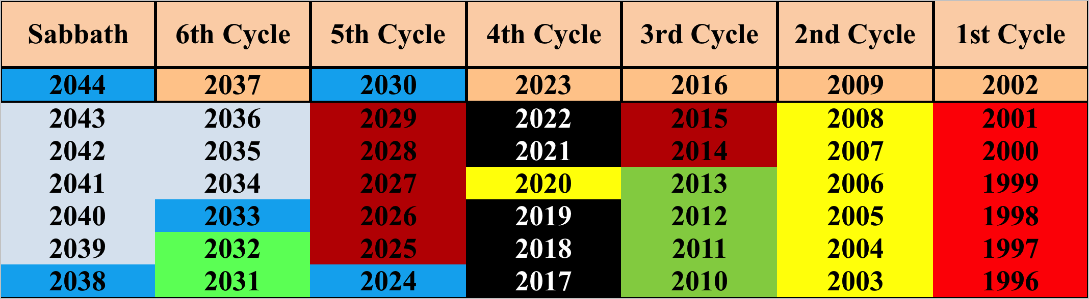
Notes:
We compare Our Modern Day of 2033 matching it with 2047 in Abrahams day. 2047 was the day Sodom and Gomorrah were destroyed. We know this because Isaac was born the year after Sodom and Gomorrah were destroyed.
Also note that the Ten Days of Awe from the Feast of Trumpets to the Day of Atonement match the ten years during which Nimrod was on trial. This is when the world was held captive and finally freed when Nimrod who represents Satan is executed. In the same manner Yahshua will put Satan away on the Day of Atonement in 2033.
Abraham writes about Sodom and Gomorrah. It was a huge event in his life. We know this because he wrote three chapters on it which is huge compared to the other chapters. On the other hand the trial of Nimrod dragged out over ten years. It would have been anti climatic in comparison to the fire and brimstone falling from the sky on Sodom and Gomorrah where thousands lost their lives in one day.

Slide 82
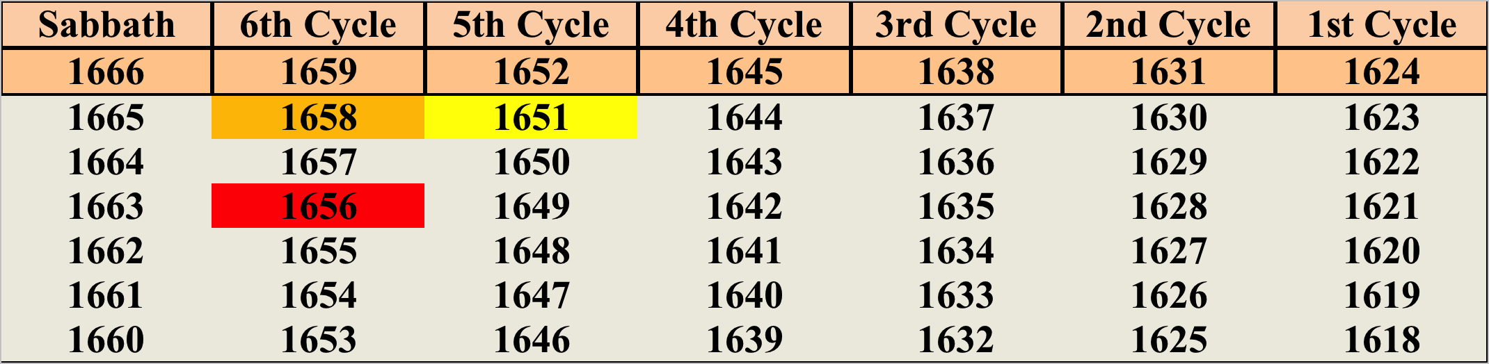
Notes:
Our Modern Day with 2033 matching 2047 in Abrahams day. 2047 was the day Sodom and Gomorrah were destroyed. Notice that the year of Noah’s Flood is1656 AC and not 1655.
The flood came in the second month on the 17th day. Why? Because Noah’s Grandfather died. Noah was told by Yahweh that when this one dies then shall the flood come. He died around the feast of Passover in 1656 AC. Thus Noah was unclean and had to wait until the second Passover. Once the Passover was done and the wave sheaf offering made then on the 17th day of the second month the flood came. This shows you how patient Yahweh is. He waited as long as possible for men to repent. They did not and when He could wait no longer, Yahweh executed His punishments.
Do we have any other times in history when punishment was in the 6th cycle?
.

Slide 83
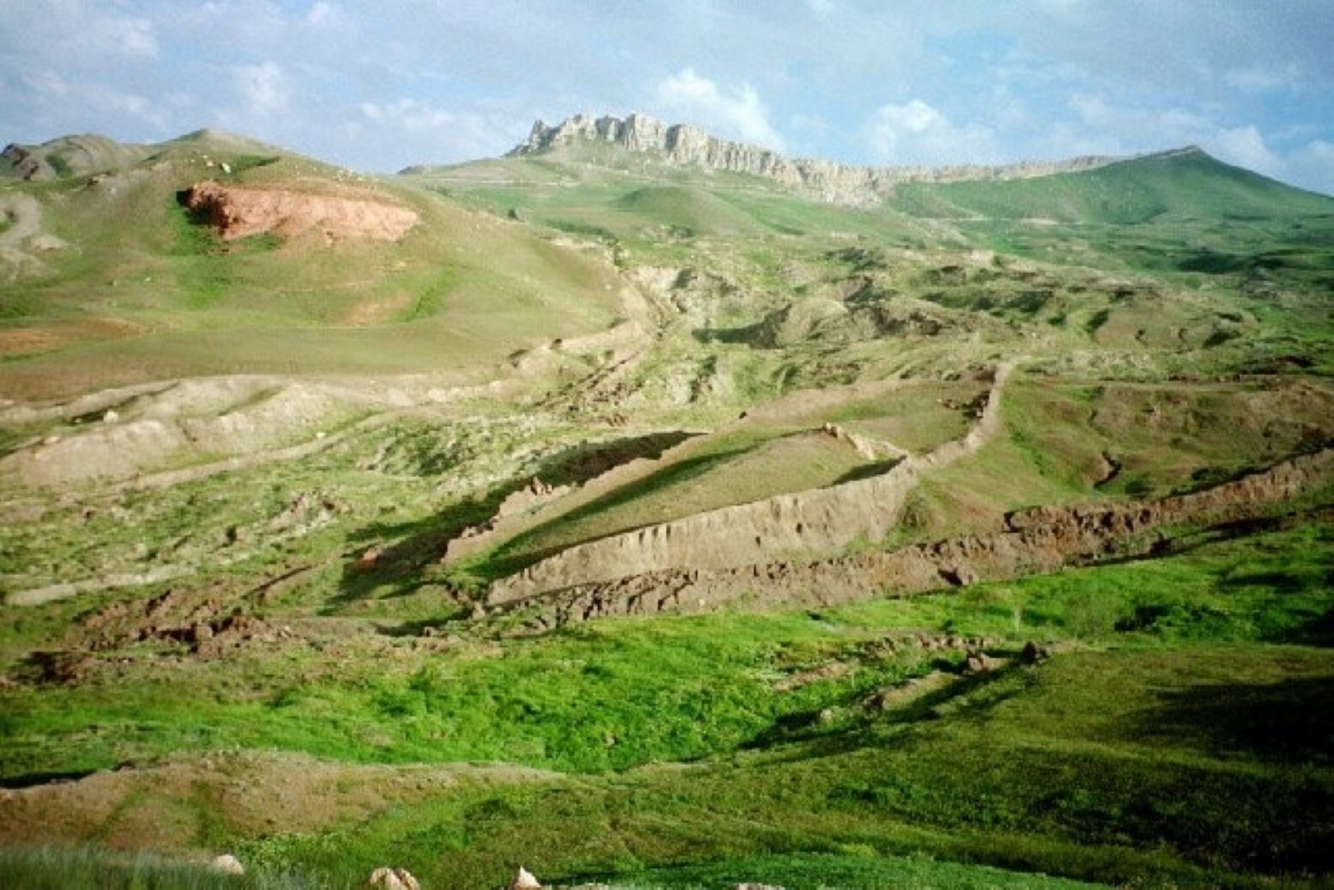
Notes:
I visited Noahs Ark in 2007 at Shavuot.

Slide 84
Yehovah is the same yesterday and today and forever
He does not change
Therefore His punishments will also be the same and given out in the same order

Slide 85
Notes:
Notice that all of these final judgement events took place in the 3rd and 4th year of the 6th Sabbatical Cycle.

Slide 86
2033 is the year Satan is locked away, The year of Atonement after 3 ½ years Tribulation and after 7 Years captivity starting in 2024
Notes:
From 2033 to 2024 are the ten years of Judgment which is represented by the 10 Days of Awe annually from the Feast of Trumpets up to the day of Atonement. This fifth cycle is when the fifth curse Lev. 26 takes place and Israel (The USA & UK) are sent into captivity. They are in captivity for 7 years before they are brought back to the Land of Israel by 2030. We shall explain this later with the two witnesses. In 2033 at the end of the 10 days of awe is the day of Atonement. This is when Satan is locked away after 3 ½ years of tribulation.
Now having briefly skimming the 5th cycle and the fifth curse of Captivity with the 3 ½ years of tribulation we are not going to look at the 4th cycle of war.

Slide 87
Luk 17:26 And as it was in the days of Noah, so it also shall be in the days of the Son of Man.
Luk 17:27 They ate, they drank, they married wives, they were given in marriage, until the day that Noah entered into the ark; and the flood came and destroyed them all.
Luk 17:28 So also as it was in the days of Lot: they ate, they drank, they bought, they sold, they planted, they built;
Luk 17:29 but the day Lot went out of Sodom, it rained fire and brimstone from the heaven and destroyed them all.
Luk 17:30 Even so it shall be in the day when the Son of Man is revealed.
Notes:
He is revealed on the day of Atonement. The two goats that you cannot tell them apart. This is the day Yehshua will be separated from Satan who has come as an angel of light looking like the Messiah and deceiving everyone.

Slide 88
Notes:
When I then compared 2033 to the life cycle of Joseph and his 7 years of plenty and 7 years of famine I again saw the pattern developing.
When Sarah was taken by Pharaoh who did Sarah represent and who did Pharaoh represent. Israel and Satan.
Then Israel was held captive by the Egyptians.
Egypt in this prophecy is the Satanic Kingdom that is going to hold prisoner The remnant of Israel.

Slide 89
Notes:
These two charts tell us a ton of things and I almost missed it all because the 7 years of plenty and 7 years of famine did not fit the normal Sabbatical cycle.
So let me now explain.
2027 to 2033 are the years of famine. Why?
What happens to cause this?
If Satan is locked away in 2033 that mean the end of the tribulation. It was to be 3 ½ years. He is locked away on the day of Atonement in 2033.

Slide 90
Notes:
3 ½ years before 2033 is Passover 2030. Yet this is the middle of this famine time. Note it is the famine or hard times for the Beast power.

Slide 91
Rev 11:3 And I will give power to My two witnesses, and they will prophesy a thousand, two hundred and sixty days, clothed in sackcloth.

Slide 92
Rev 11:6 These have authority to shut up the heaven, that it may not rain in the days of their prophecy. And they have authority over waters to turn them to blood, and to strike the earth with every plague, as often as they desire.
Rev 11:7 And when they complete their testimony, the beast coming up out of the abyss will make war against them and will overcome them and kill them.

Slide 93
Notes:
3 ½ years before 2030 when the two witnesses are killed at Passover is the Feast of Trumpets 2026. This is when the two witnesses begin their work.
Daniel 8 talks about the saints that are going to trampled under foot. That is slaughtered. Rev 6 asks who will avenge the death of those Saints.
They are avenged during the time of the 2 witnesses and then finally during the tribulation.

Slide 94
Notes:
We are also told that there will be 2300 mornings and evenings when the Saints will not be able to keep the sacrifices. Why? Again Daniel 8 tells us they will be hunted and killed. Along with Daniel 9.
This 2300 Days is 6 ¼ years and ends on the Feast of Trumpets 2026. The exact same time the Two witnesses begin to avenge them.
2300 days before Feast of Trumpets 2026 brings you to Shavuot 2020. But this is suppose to be the year of plenty. Ahh it is for the Beast. It is for Egypt. On the backs of Israel who will be hunted and slaughtered during this time.
All their possessions and property and gold and silver will be taken for the Beast power and they will be slaughtered for 6 ¼ years.

Slide 95
Notes:
When we compare the life cycle of Jacob now we learn something else.
In the second year of the famine in Josephs time Israel learns of the identity of Joseph. The family is united.
The two witnesses represent Moses and Aaron. They asked Pharaoh for Israel to go to worship Yehovah.
The two witnesses will do the same only for them to do so in Jerusalem.
The beast power will agree only after ¼ of the worlds population dies from the famine caused by the two witnesses. Rev 6:7
jacob thought he was about to marry Rachel when he was decieved at the end of 7 year tenure and he got Leah instead.
When people gather in Jerusalem for the Feast of Passover they will think it is over. But Satan is gathering those who remain there from around the world to slaughter them once and for all.
The two witnesses are first and the women flees into the wilderness. So why then does it say the Beast then turns and makes war on the Saints who keep the commandments. Why did they not flee with the women? Two calendars.

Slide 96
The 4th Curse
And if by these things you are not reformed by Me, but walk contrary to Me, 24 then I also will walk contrary to you, and I will punish you yet seven times for your sins. 25 And I will bring a sword against you that will execute the vengeance of the covenant; when you are gathered together within your cities I will send pestilence among you; and you shall be delivered into the hand of the enemy. 26 When I have cut off your supply of bread, ten women shall bake your bread in one oven, and they shall bring back your bread by weight, and you shall eat and not be satisfied.
(Leviticus 26:23-26)
Notes:
Yahweh is going to bring a sword as the fourth Curse. A sword is war. Before you can come out of captivity you have to go into captivity which means you have to loose in war. The curse of captivity is what we just showed you.
This curse of captivity is the first 7 (6 ½) years of the 10 years of Awe. They are followed by the 3 ½ years of the great tribulation.

Slide 97
Notes:
The fourth cycle is the fourth curse of war. See black area.

Slide 98
Why the yellow box in the middle of this 4th cycle of war?
Notes:
How is this tied into any Prophecies of Abraham?
Always be asking yourself why or how does this tie into the Prophecies of Abraham? What is the connection?

Slide 99
Notes:
When we look at Abrahams day we see that in the 4th cycle we have the birth of Ishmael in 2034 AC which matches up to our day of 2020. We also know from Abraham that he went into Hagar the year before in 2033 AC.

Slide 100
Notes:
So what are we to make of this? Where is the prophetic lessons here? I showed you at the start how Abrahams sabbatical cycle is related to ours. We kind of saw how the years of captivity and the 3 ½ years matched the 10 years of Abraham
This yellow year of 2020 is the middle of the 4th cycle of war. This yellow year in this black cycle of 2020 is also the middle the Jubilee cycle. And it matches the year when Ishmael was born.

Slide 101
Notes:
In Daniel 9 we read of the 70 weeks prophecy.
24 "Seventy weeks are determined For your people and for your holy city, To finish the transgression, To make an end of sins, To make reconciliation for iniquity, To bring in everlasting righteousness, To seal up vision and prophecy, And to anoint the Most Holy. 25 "Know therefore and understand, That from the going forth of the command To restore and build Jerusalem Until Messiah the Prince, There shall be seven weeks and sixty-two weeks; The street shall be built again, and the wall, Even in troublesome times. 26 "And after the sixty-two weeks Messiah shall be cut off, but not for Himself; And the people of the prince who is to come Shall destroy the city and the sanctuary. The end of it shall be with a flood, And till the end of the war desolations are determined. 27 Then he shall confirm a covenant with many for one week; But in the middle of the week He shall bring an end to sacrifice and offering. And on the wing of abominations shall be one who makes desolate, Even until the consummation, which is determined, Is poured out on the desolate."
The only place in the bible that this word Anointed is translated as Mashiyach is the two times in Daniel. The rest of time this word that is used for Mashiach means Annointed. So this verse in Daniel 9 is actually talking about the 70 Shabuwa (or Weeks, The feast of weeks is Pentecost. It is also 49 days. A Shabuwa is 49 days or years.) of Israel His anointed ones as we read in Leviticus 7. Israel is also the anointed of Yahweh. It is Israel the Anointed of Yahweh that shall live under His shadow. This verse is talking about His Anointed who are Israel and not the Messiah.
I have never been able to figure this scripture out to be when Yahshua comes at His first coming. It does not work any way I try it. But when you understand that the word for Messiah is anointed and means Israel then it makes perfect sense and it works out mathematically precisely.
Here we have the Sabbatical cycle when the Exodus began in 1379 BC. The actual Exodus was 1379 BC But we begin with the start of the Sabbatical cycle of 1386 BC.
70 Shabuwa are determined for your people. Daniels people are Israel , not just Judah. But Israel. One Shabuwa is 49 days. Shabuwa means weeks. Pentecost is the feast of weeks. 70 X 49 =3430 years So from 1386 BC + 3430 year = 2045 Remember there is no year “0”
2045 is our 120th Jubilee year since Adam.
The time for Israel is over when the 70th Shabuwa is over in 2045.
MAKE SURE THEY UNDERSTAND THIS POINT. ASK THEM AND THEN EXPLAIN IT AGAIN.

Slide 102
In the Middle of the last Shabuwa is 2020
Notes:
In the middle of the 70 and the last Shabuwa. And after the sixty-two weeks Messiah shall be cut off, This word Messiah is translated anointed in every other place but these two times in Daniel. The Anointed when you study it out can also mean Israel.
So in the middle the last Shabuwa Israel will be cut off. That time for Israel to be cut off is 2020 the middle of the last Shabuwa. Israel is the USA and the UK. Ephraim and Manasseh.
In the middle of this 4th cycle which is the war cycle.
But what does Abraham show us about this middle of the last Shabuwa.

Slide 103
In the Middle Abraham’s Sabbatical Cycle is 2034
Notes:
This is when Ishmael is born.
3 Then Sarai, Abram's wife, took Hagar her maid, the Egyptian, and gave her to her husband Abram to be his wife, after Abram had dwelt ten years in the land of Canaan. 4 So he went in to Hagar, and she conceived. And when she saw that she had conceived, her mistress became despised in her eyes. (Genesis 16:3-4)
Rabbi Yose had a principle that he repeated in his teachings from the Seder Olam, “Scriptures does not come to hide but to explain.”
Where is the prophecy when Abraham goes into Hagar?? When I read something like that I always ask why does Yahweh include this little bit of information. Why do we need to know that Abraham went into Hagar? Do we need to know this?
When a man makes love to woman it is done behind closed doors, in secret, so to speak. No one needs to know. It is private. The prophecy Abraham is showing us reveals how the creation of Ishmael was done in secret, behind closed doors, in the dark, and under the sheets. Sarah knew; in this case Sarah represents Israel. Ishmael’s conception is what is important. And it was done the year before he was born and with an Egyptian Princess. Ishmael was born in 2034 as we have just proven, but he was conceived in 2033.
What does this mean?
Who does Ishmael represent? The Arabs. This is when they will be born as a group of people.

Slide 104
Notes:
Now, when we transpose the life cycle of Abraham and the events that took place in his time, to our modern days as we have done in the other slides, we get a glimpse of an event that is soon to take place in secret. But first, let’s look at the birth of Ishmael.
Ishmael was born in the year 2034 after the Creation of Adam. This correlates to our current cycle as the year 2020 C.E., and the year of Hagar’s conception being 2033 AC, matches in our time as 2019 C.E.
I have already shown you that the year 2020 C.E. is the year Israel, (the USA and UK) are to be destroyed or the beginning of their destruction. 2020 is the middle of the last Shabuwa. Daniel shows us that a European Union with Islam is to be the End Time Beast. So how does the Prophecy of Abraham’s conception with Hagar and the birth of Ishmael fit in here? You can see how they are both in the middle of a Shabuwa and during the Fourth Curse of the Sword. But first, let’s look at a passage in Isaiah:
5 Woe to Assyria, the rod of My anger And the staff in whose hand is My indignation. (Isaiah 10:5-7)
32 And concerning the tithe of the herd or the flock, of whatever passes under the rod, the tenth one shall be holy to Yahweh (Leviticus 27:32)
. 37 “I will make you pass under the rod, and I will bring you into the bond of the covenant; 38 I will purge the rebels from among you, and those who transgress against Me; I will bring them out of the country where they dwell, but they shall not enter the land of Israel. Then you will know that I am Yahweh” (Ezekiel 20:30, 31, 32 or 33-38)

Slide 105
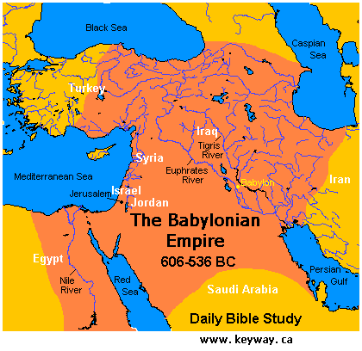
The Babylonian Empire. Daniels 1st Beast and Gold section of Great Image
Notes:
When Isaiah wrote his Prophecies Israel was about to go into captivity with Assyria.
When Daniel wrote he was a captive in Babylon and Assyria was gone from the world scene.

Slide 106
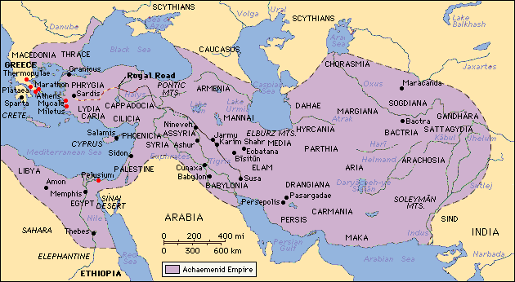
The Medo-Persian empire. Daniels 2nd Beast and Silver section of Great Image

Slide 107
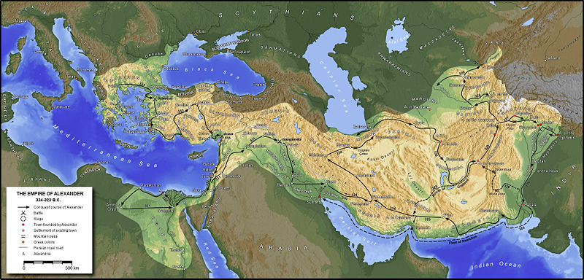
The Macedonian empire. Daniels 3rd Beast and Brass section of Great Image

Slide 108
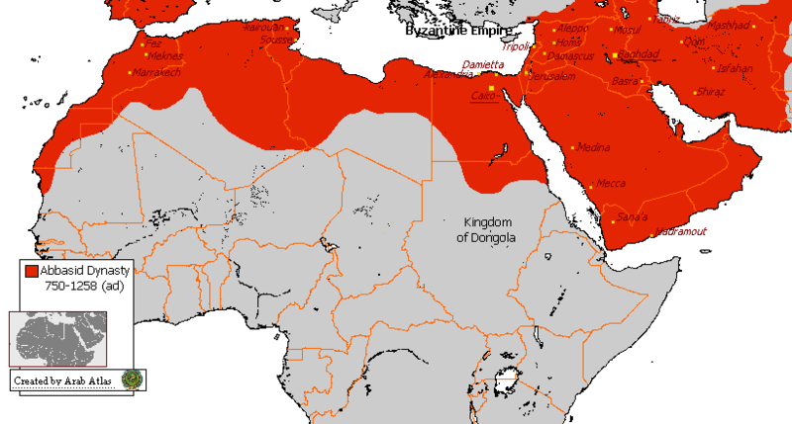
The Abbasid Dynasty 750-1258 CE
Notes:
Abbasid Dynasty 750-1258

Slide 109
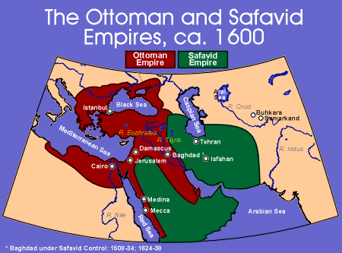
Notes:
Notice that each of these empires overlaps the previous one.

Slide 110
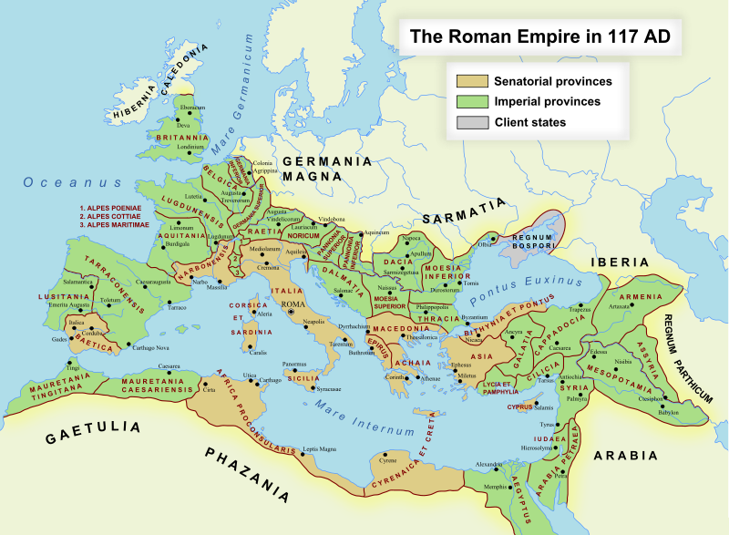

Slide 111
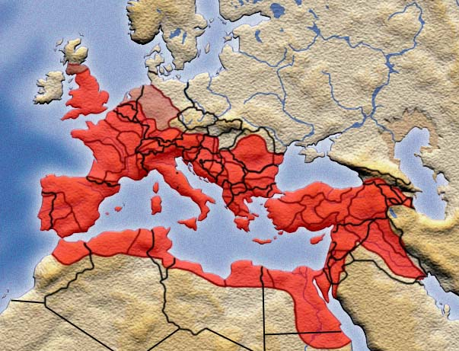
A United Europe and Combined Muslim forces make up the end time Beast
Notes:
Yahweh is going to have Israel pass under the rod. That Rod is Germany and once Germany has passed over Israel, only a tenth of Israel will be left. In other words, after the War, after the Captivity and after the punishment of the nations, only a tenth of Israel will be left standing. Yahweh will have purged out all those who are lawless by having them killed by war, starvation, cannibalism, or slavery, but no matter how they die only 10% will remain. Compare that to the hairs that Ezekiel is talking about and then shudder.
Ezekiel is told to shave his hair with a razor.
Then Isaiah tells us that Assyria is a hired razor.
Please consider what is being said here very carefully. This is about to happen in your lifetime. Take each of the Anglo Saxon nation’s populations today and calculate 10% of that. Of the 300 million Americans there are, this means that only 30 million will survive. This means that 270 million Americans are about to die in the years that are soon to come.
18 And it shall come to pass in that day That Yahweh will whistle for the fly That is in the farthest part of the rivers of Egypt, And for the bee that is in the land of Assyria. . (Isaiah 7:17-20)
Notice from this verse that it is Assyria and Egypt that come against you, the German-European and the Islamic forces. And you will go into Captivity. We know this because of what Isaiah writes;
11 It shall come to pass in that day That Yahweh shall set His hand again the second time To recover the remnant of His people who are left, From Assyria and Egypt, From Pathros and Cush, From Elam and Shinar, From Hamath and the islands of the sea. (Isaiah 11:11)
A second time... Yahweh is going to recover His people a second time from Assyria, which is Germany, and from Egypt which includes Pathros. Cush is Ethiopia, and Elam and Shinar are Iran and Syria. But only a remnant will be left. Only a remnant!
What we are reading here is the uniting of the Beasts of the King of the North, Germany which is the head of Europe, and the King of the South-which is Egypt and the Islamic nations.
The Image of toes made from Iron –Germanys Iron Fist and efficiency- and the clay – Muslim inability to unite.

Slide 112

A United Europe Combined with Muslim forces. This is what Hitler was already at work with the Muslim Brother hood in 1938

Slide 113
In the Middle Abraham’s Sabbatical Cycle is 2034
Notes:
I have shown you all this about Germany and Egypt for one reason. That reason is to explain the Prophecy of Abraham. But we have one more piece of information to look at first:
1 A Song. A Psalm of Asaph. Do not keep silent, Yahweh! Do not hold Your peace, And do not be still, Yahweh! 2 For behold, Your enemies make a tumult; And those who hate You have lifted up their head. 3 They have taken crafty counsel against Your people, And consulted together against Your sheltered ones. 4 They have said, "Come, and let us cut them off from being a nation, That the name of Israel may be remembered no more." 5 For they have consulted together with one consent; They form a confederacy against You: 6 The tents of Edom and the Ishmaelites; Moab and the Hagrites; 7 Gebal, Ammon, and Amalek; Philistia with the inhabitants of Tyre; 8 Assyria also has joined with them; They have helped the children of Lot. Selah (Psalms 83:1-8)
Tell me why would the psalmist tell us that with regard to this conspiracy, that Assyria or Germany, the King of the North, will be involved with all these Islamic countries?
Abraham went into Hagar in private, behind closed doors so that the world could not see the conception of what would later become Ishmael. That year in our modern day Shabuwa Cycle is 2019 C.E. Ishmael was born a year later and this also matches our cycle of years as 2020, the same year the prophecy of Daniel’s Shabuwa said that the anointed would be cut off in the middle of the Shabuwa or the middle of the 49 years. The Anointed is Israel-The USA and the UK
This is when Ishmael, or the Islamic nations, would be born in unity and the conquered land divided amongst the spoilers. This is when the King of the North and the King of the South would be joined together to form one force and would overcome and destroy the Northern 10 Lost Tribes of Israel who are now known as the USA, the UK and her commonwealth.
This is when the ten toes of iron, Germany and clay, the Islamic nations come together and rule as we are told in the Book of Daniel:
39 Thus he shall act against the strongest fortresses with a foreign god, which he shall acknowledge, and advance its glory; and he shall cause them to rule over many, and divide the land for gain. (Daniel 11:39)
Explain the god of fortresses, and this foreign god. The Muslims agree to do this in order to get rid of the great Satan, the USA. They hope to take over Europe after, which is what scriptures say.
Show how Persia is to shoot arrows at Babylon. Rome.
Jeremiah 50:4 In those days, and in that time, saith Yahweh, the children of Israel shall come , they and the children of Judah together, going and weeping : they shall go , and seek Yahweh.
14 Put yourselves in array against Babylon round about: all ye that bend the bow, shoot at her, spare no arrows16 Cut off the sower from Babylon, and him that handleth the sickle in the time of harvest: 29 Call together the archers against Babylon:30 Therefore shall her young men fall in the streets, and all her men of war shall be cut off in that day 46 At the noise of the taking of Babylon the earth is moved , and the cry is heard among the nations.
Isaiah 13:17 Behold, I will stir up the Medes against them, which shall not regard silver; and as for gold, they shall not delight in it. 18 Their bows also shall dash the young men to pieces ; and they shall have no pity on the fruit of the womb; their eye shall not spare children. 19 And Babylon, the glory of kingdoms, the beauty of the Chaldees' excellency, shall be as when Yahweh overthrew Sodom and Gomorrah. 20 It shall never be inhabited , neither shall it be dwelt in from generation to generation:
The Medes today are Iran. The Chaldeans and Babylonians are today the Italians. The arrows are Nuclear rockets, which shall move the earth when the hit Rome.

Slide 114
In the Middle of the last Shabuwa is 2020
Notes:
So when we read in the Book of Revelation of the saints being beheaded, what group of people can you think of who do this today as a terror tactic? Islam!
4 And I saw thrones, and they sat on them, and judgment was committed to them. Then I saw the souls of those who had been beheaded for their witness to Yahshua and for the word of Yahweh, who had not worshiped the beast or his image, and had not received his mark on their foreheads or on their hands. And they lived and reigned with Messiah for a thousand years. (Revelation 20:4)
The conception of Ishmael is represented in this secret agreement between Assyria and the Arab nations. The birth of Ishmael is represented in the Arab nations being allowed to take control of the land after they, along with Germany–Europe, have defeated the USA and the UK, in 2020.
Consider also the following prophecy of Isaiah. The only way for Assyria, Germany, to be broken on the mountains of Israel, in Yahweh’s land is for them to be in the Land of Israel imposing their yoke of bondage upon the shoulders of Israelites. In Isaiah we read:
24 Yahweh has sworn, saying, “Surely, as I have thought, so it shall come to pass, And as I have purposed, so it shall stand: 25 That I will break the Assyrian in My land, And on My mountains tread him underfoot. Then his yoke shall be removed from them, And his burden removed from their shoulders.
22 “Joseph is a fruitful bough, A fruitful bough by a well; His branches run over the wall. 23 The archers have bitterly grieved him, Shot at him and hated him. (Genesis 49:22-23) Joseph is the USA and it is the USA that is shot at and it the USA that is bitterly grieved.
The Arrows are the Nuclear rockets that are now in the world.
5 Moreover the multitude of your foes Shall be like fine dust, And the multitude of the terrible ones Like chaff that passes away; Yes, it shall be in an instant, suddenly(Isaiah 29:1-8)
14 Therefore Yahweh will cut off head and tail from Israel, Palm branch and bulrush in one day. (Isaiah 9:13-17)
Do we have another time in history to show when Yahweh has done this before Next slide

Slide 115
Here is another example of Yahweh enforcing his curse of the Sword in the 4th sabbatical cycle
Notes:
. 5 Now the king of Assyria went throughout all the land, and went up to Samaria and besieged it for three years. 6 In the ninth year of Hoshea, the king of Assyria took Samaria and carried Israel away to Assyria, and placed them in Halah and by the Habor, the River of Gozan, and in the cities of the Medes.
In 723 BC Israel fell to the Asyrians. Notice it is again the 4th Cycle. That year of the siege was three years before 723 and is725 BC and this again matches our day of 2020 CE and Abrahams day of 2034 AC
Yahweh does not change. Nor do His punishments or the order in which they come.
Brethren be not deceived, Yahweh is not mocked. He will execute His punishments and Judgments exactly as He has in the past according to the same Sabbatical cycle.
10 Declaring the end from the beginning, And from ancient times things that are not yet done (Isaiah 46:10)
The USA is going to enter into war and it will be because of Jerusalem. The USA will loose this war. The people of the USA and the UK will then be taken into captivity where they will be beheaded, and sexually abused and turned into slave labour just as the Jews were in WWII.
How do I know this war is a result of something that happens in Jerusalem? Again we must look to the Prophecies of Abraham.

Slide 116
Hunters and Fishers
Notes:
Jer 16:16 - "Behold, I will send for many fishermen," says Yahweh, "and they shall fish them; and afterward I will send for many hunters, and they shall hunt them from every mountain and every hill, and out of the holes of the rocks.
The Fishermen are us today as we try to reason with people to follow Torah.
Mt 4:19 - Then He said to them, "Follow Me, and I will make you fishers of men."
And after the time we are now in is up, then He sends the Hunters. Who are the Hunters.
Ge 10:9 - He was a mighty hunter before Yahweh; therefore it is said, "Like Nimrod the mighty hunter before Yahweh." The Babylonian System is the Hunters
Ge 25:27 - So the boys grew. And Esau was a skillful hunter, a man of the field; but Jacob was a mild man, dwelling in tents. The Muslim Religion is the Hunter
Pr 6:5 - Deliver yourself like a gazelle from the hand of the hunter, And like a bird from the hand of the fowler.
Ezekiel 13:21 KJV
Your kerchiefs also will I tear , and deliver my people out of your hand, and they shall be no more in your hand to be hunted; We are the hunted and we are Israel
These Hunters come during this 4th cycle of war when the sword goes through the land. They shoot first and ask questions later.

Slide 117
We now move to the 3rd Sabbatical Cycle of Pestilence
Notes:
This is the green area on the chart. It goes from 2010 to 2016.
This is the Sabbatical Cycle for Pestilence and Famines and according to Matthew 24 earthquakes.
Heard of Swine Flu or Bird Flu lately
You will hear of much more during the next 7 years.

Slide 118
We are comparing the green area of our time with Abraham’s 3rd cycle

Slide 119
Abraham’s 3rd Sabbatical Cycle. The year of 2027
Notes:
In genesis 15 we read of the covenant being made with Abraham. This occurs in 2028 AC. And it corresponds to our day of 2014. I have no idea what is to happen at this time. I have nothing to compare the meeting of Yahweh with Abraham to some other time. But this is the one year I do not want to miss the appointed time to meet with our creator. Keep in mind the covenant was made at Passover time.
The year before the Covenant was made we read in Gen 14 of the Kings of the North coming down and taking all the cities of the plain of Siddim. And Lot too goes into captivity.
The Yellow cell here of 2026 is just when Reu dies.
In Genesis 12:10 we are told of the severe famine to hit the land. This causes Abram to leave Canaan and go to Egypt for food. Even at this time Abram feared for his life from the Egyptians. We read in verse 17 how Egypt was plagued because of Sarai.
Sound familiar? Sarai represented Israel when they would go down to Egypt and it was during the Exodus that Egypt received those plagues. Egypt, on a grander scale, represents the world and the greater Babylon with the plagues that are going to come upon it in the Last Days.
Each time you read of Egypt or Babylon in Genesis interacting with Abraham, or Isaac, or Jacob, or the descendants of Israel, it is in actual fact a prophetic message for us today in the Last Days. I will be showing you this in the coming slides.
When you read about Abraham with the Egyptians, Abraham with the Kings of the North, Isaac with Abimelech, Jacob with Laban, Joseph with Pharaoh, Moses with Pharaoh and the escape of Israel from Egypt, you are in actual fact reading a cryptic message to us today about what is about to happen in relation to Israel (the USA and the UK and the State of Israel) and with Babylon (the King of the North and South or the United European Union and the Muslim nations). Keep this in mind as we continue to study the Prophecies of Abraham.
In Genisis chapter 13, Abram leaves Egypt with great wealth; much like Israel would during the Exodus, 433 years later. In this chapter the flocks of Lot and Abram grew and the herdsmen began to clash. So they separated and Lot left and chose to dwell in the Plain of Jordan which was as the Garden of Eden at that time.

Slide 120
Notes:
Then we come to the 14th chapter of Genesis, and we begin to read about the war in the land.
1 And it came to pass in the days of Amraphel king of Shinar, Arioch king of Ellasar, Chedorlaomer king of Elam, and Tidal king of nations,* 2 that they made war with Bera king of Sodom, Birsha king of Gomorrah, Shinab king of Admah, Shemeber king of Zeboiim, and the king of Bela (that is, Zoar). 3 All these joined together in the Valley of Siddim (that is, the Salt Sea). (Genesis 14:1-3)
we are told that in the Midrash and the later Rabbinical literature, Amraphel was identified with Nimrod. The Sayer of Darkness and the fall of the Sayer are perfect names for Nimrod who did speak dark things and later fell by the hand of Shem.
Now we have to look at this as a Prophecy of Abraham. What is being said here? In Isaiah we find the answer:
. 9 Unless Yahweh Had left to us a very small remnant, We would have become like Sodom, We would have been made like Gomorrah. (Isaiah 1:2-9)
10 Hear the word of Yahweh, You rulers of Sodom; Give ear to the law of Yahweh, You people of Gomorrah:
Isaiah has just shown us that Jerusalem, where the sacrifices were made, is like Sodom—that Judah and Israel are as Sodom and Gomorrah.
Again in Isaiah we read:
8 For Jerusalem stumbled, And Judah is fallen, Because their tongue and their doings Are against Yahweh, To provoke the eyes of His glory. 9 The look on their countenance witnesses against them, And they declare their sin as Sodom; They do not hide it. Woe to their soul! For they have brought evil upon themselves. (Isaiah 3:8-9)
Also, in Jeremiah we read:
11 “For both prophet and priest are profane; Yes, in My house I have found their wickedness,” says Yahweh. 12 “Therefore their way shall be to them Like slippery ways; In the darkness they shall be driven on And fall in them; For I will bring disaster on them, The year of their punishment,” says Yahweh. 13 “And I have seen folly in the prophets of Samaria: They prophesied by Baal And caused My people Israel to err. 14 Also I have seen a horrible thing in the prophets of Jerusalem: They commit adultery and walk in lies; They also strengthen the hands of evildoers, So that no one turns back from his wickedness. All of them are like Sodom to Me, And her inhabitants like Gomorrah.” 15 “Therefore thus says Yahweh concerning the prophets: ‘Behold, I will feed them with wormwood, And make them drink the water of gall; For from the prophets of Jerusalem Profaneness has gone out into all the land.’” (Jeremiah 23:11-15)
This is how Yahweh sees Jerusalem and its inhabitants-as Sodom and Gomorrah. In Ezekiel we see where Yahweh says Judah is even worse than Sodom:
44 “Indeed everyone who quotes proverbs will use this proverb against you: ‘Like mother, like daughter!’ 45 You are your mother’s daughter, loathing husband and children; and you are the sister of your sisters, who loathed their husbands and children; your mother was a Hittite and your father an Amorite. 46 Your elder sister is Samaria, who dwells with her daughters to the north of you; and your younger sister, who dwells to the south of you, is Sodom and her daughters. 47 You did not walk in their ways nor act according to their abominations; but, as if that were too little, you became more corrupt than they in all your ways. 48 As I live,” says Yahweh, “neither your sister Sodom nor her daughters have done as you and your daughters have done.” 49 Look, this was the iniquity of your sister Sodom: She and her daughter had pride, fullness of food, and abundance of idleness; neither did she strengthen the hand of the poor and needy. 50 And they were haughty and committed abominations before Me; therefore I took them away as I saw fit. (Ezekiel 16:44-50)
11 “I overthrew some of you, As Yahweh overthrew Sodom and Gomorrah, And you were like a firebrand plucked from the burning; Yet you have not returned to Me,” Says Yahweh. 12 “Therefore thus will I do to you, O Israel; Because I will do this to you, Prepare to meet Yahweh, O Israel!” 13 For behold, He who forms mountains, And creates the wind, Who declares to man what his thought is, And makes the morning darkness, Who treads the high places of the earth—Yahweh is His name. (Amos 4:6-13)
Israel and Judah have been likened to Sodom and Gomorrah. In Revelation we read:
“and their dead bodies shall lie in the street of the great city, which spiritually is called Sodom and Egypt, where also Yahshua was crucified.” (Jerusalem) (Revelation 11:8)
In this prophecy of Abraham we can see that Sodom is equivalent to Jerusalem and Judah and will be taken captive.
We spoke previously of Yahweh whistling to the fly and the bee in the Book of Isaiah:
18 And it shall come to pass in that day That Yahweh will whistle for the fly That is in the farthest part of the rivers of Egypt, And for the bee that is in the land of Assyria. (Isaiah 7:18)
, And will whistle to them from the end of the earth; Surely they shall come with speed, swiftly. 27 No one will be weary or stumble among them, No one will slumber or sleep; Nor will the belt on their loins be loosed, Nor the strap of their sandals be broken; 28 Whose arrows are sharp, And all their bows bent; Their horses’ hooves will seem like flint, And their wheels like a whirlwind. 29 Their roaring will be like a lion, They will roar like young lions; Yes, they will roar And lay hold of the prey; They will carry it away safely, And no one will deliver. 30 In that day they will roar against them Like the roaring of the sea. And if one looks to the land, Behold, darkness and sorrow; And the light is darkened by the clouds. (Isaiah 5:18-30)
Jeremiah warns of this whirlwind from the North that is coming:
13 “Behold, he shall come up like clouds, And his chariots like a whirlwind. His horses are swifter than eagles. Woe to us, for we are plundered!” 14 O Jerusalem, wash your heart from wickedness, That you may be saved. How long shall your evil thoughts lodge within you? 15 For a voice declares from Dan And proclaims affliction from Mount Ephraim: 16 “Make mention to the nations, Yes, proclaim against Jerusalem, That watchers come from a far country And raise their voice against the cities of Judah. 17 Like keepers of a field they are against her all around, Because she has been rebellious against Me,” says Yahweh. 18 “Your ways and your doings Have procured these things for you. This is your wickedness, Because it is bitter, Because it reaches to your heart.” (Jeremiah 4:5-18)
19 Behold, a whirlwind of Yahweh has gone forth in fury—A violent whirlwind! It will fall violently on the head of the wicked. 20 The anger of Yahweh will not turn back Until He has executed and performed the thoughts of His heart. In the latter days you will understand it perfectly. 21 “I have not sent these prophets, yet they ran. I have not spoken to them, yet they prophesied. 22 But if they had stood in My counsel, And had caused My people to hear My words, Then they would have turned them from their evil way And from the evil of their doings. 23 “Am I a elohim near at hand,” says Yahweh, “And not an Elohim afar off? 24 Can anyone hide himself in secret places, So I shall not see him?” says Yahweh; “Do I not fill heaven and earth?” says Yahweh. (Jeremiah 23:16-23)
32 Thus says Yahweh: “Behold, disaster shall go forth From nation to nation, And a great whirlwind shall be raised up From the farthest parts of the earth.” 33 And at that day the slain of Yahweh shall be from one end of the earth even to the other end of the earth. They shall not be lamented, or gathered, or buried; they shall become refuse on the ground. 34 “Wail, shepherds, and cry! Roll about in the ashes, You leaders of the flock! For the days of your slaughter and your dispersions are fulfilled; You shall fall like a precious vessel. 35 And the shepherds will have no way to flee, Nor the leaders of the flock to escape. 36 A voice of the cry of the shepherds, And a wailing of the leaders to the flock will be heard. For Yahweh has plundered their pasture, 37 And the peaceful dwellings are cut down Because of the fierce anger of Yahweh. 38 He has left His lair like the lion; For their land is desolate Because of the fierceness of the Oppressor, And because of His fierce anger.” (Jeremiah 25:30-38)
Who is this whirlwind that we have been talking about here? Remember what is written in the Book of Daniel & in the Book of Zechariah:
40 “At the time of the end the king of the South shall attack him; and the king of the North shall come against him like a whirlwind, with chariots, horsemen, and with many ships; and he shall enter the countries, overwhelm them, and pass through. 41 He shall also enter the Glorious Land, and many countries shall be overthrown; but these shall escape from his hand: Edom, Moab, and the prominent people of Ammon. 42 He shall stretch out his hand against the countries, and the land of Egypt shall not escape. 43 He shall have power over the treasures of gold and silver, and over all the precious things of Egypt; also the Libyans and Ethiopians shall follow at his heels.” (Daniel 11:40-43)
12 “Yes, they made their hearts like flint, refusing to hear the law and the words which Yahweh had sent by His Spirit through the former prophets. Thus great wrath came from Yahweh. 13 Therefore it happened, that just as He proclaimed and they would not hear, so they called out and I would not listen,” says Yahweh. 14 “But I scattered them with a whirlwind among all the nations which they had not known. Thus the land became desolate after them, so that no one passed through or returned; for they made the pleasant land desolate.” (Zechariah 7:12-14)
That whirlwind is Germany. Germany is known for the blitzkrieg. Lightening fast attacks, like a whirlwind.

Slide 121
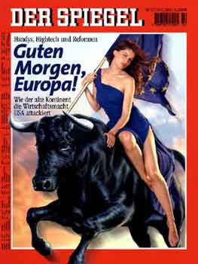
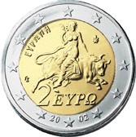
Europa Rides the Beast
Notes:
The Greek coin which depicts Europa riding the Beast.
Again when europe was uniting the east and the west Der Spiegel had this as the front cover.
Europe knows who they are.
The Beast is the same system of Government that Nimrod had. Europa is the religion that rides the Beast.
Rev 17:1Then one of the seven angels who had the seven bowls came and talked with me, saying to me,* "Come, I will show you the judgment of the great harlot who sits on many waters, 2 with whom the kings of the earth committed fornication, and the inhabitants of the earth were made drunk with the wine of her fornication." 3 So he carried me away in the Spirit into the wilderness. And I saw a woman sitting on a scarlet beast which was full of names of blasphemy, having seven heads and ten horns. 4 The woman was arrayed in purple and scarlet, and adorned with gold and precious stones and pearls, having in her hand a golden cup full of abominations and the filthiness of her fornication. 5 And on her forehead a name was written: MYSTERY, BABYLON THE GREAT, THE MOTHER OF HARLOTS AND OF THE ABOMINATIONS OF THE EARTH. 6 I saw the woman, drunk with the blood of the saints and with the blood of the martyrs of Yahshua. And when I saw her, I marveled with great amazement. 7 But the angel said to me, "Why did you marvel? I will tell you the mystery of the woman and of the beast that carries her, which has the seven heads and the ten horns.

Slide 122
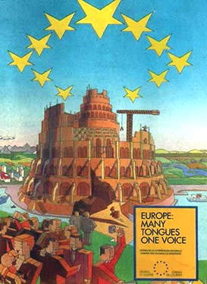
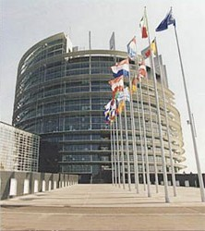
European Parliament They Know!!
Notes:
On October 27, 2009 I received information that Ireland had voted yes to this Lisbon treaty thus clearing the way for this European Union to form.
Here are just some of the highlights.
McAleese’s ( Prime Minister of Ireland) signature completes the ratification process, removing almost the last barrier to what critics warn will be the installation of a mega-state in place of the present 27-member European Union: a continent-wide federated state centrally ruled from Brussels, with a full-time appointed president and a foreign policy minister authorized to sign treaties, its own judicial and law-enforcement systems, military presence, eventual power to tax the citizenry directly, increased regulatory powers, and the removal of any vestiges of national sovereignty.
Schachtschneider: “The Charter of Fundamental Rights of the European Union, in its ‘explanations’ and ‘negative definitions’ accompanying the fundamental rights, allows a reintroduction of the death penalty in case of war or imminent war, but also the killing of humans to suppress insurgency or riot. This is in contradiction to the abolishment of the death penalty in Germany (Article 102 of the German Constitution), in Austria and elsewhere which results from the principle of dignity. …
This new Super Power has it written right in the Charter that if you stand up against them they have the right to kill you. This super power is getting ready for the Martyrdom of a large group of people. YOU ARE THAT GROUP OF PEOPLE!!! Are you getting ready for them?
Explain the poster. The tower of Babylon. The upside down star represent Satan in witch craft.
The Lisbon Treaty commits this unwieldy imperialist institution to consolidating its industries to produce armaments for the raising of a European army. In addition, the cost attached to supporting the EU’s sizable new Foreign Service is astronomical. This must be added to the cost of other initiatives embedded in the federalist EU constitution (Lisbon Treaty) which will be progressively enacted from 2010 on. All this amounts to additional costs that a European Union struggling to revive from the ongoing great global economic and financial crisis simply cannot afford without imposing an extra tax burden on its constituents.
Enter Herman Van Rompuy, raiser of taxes and ultimate EU fall guy. The Times reports (November 17, emphasis mine throughout): “The man tipped to be Europe’s first president is already considering new EU taxes to fund the rising cost of Brussels and the welfare state.
“Herman Van Rompuy, the Belgian prime minister, broke his silence before Thursday’s summit to choose the president—but only at a meeting of the secretive Bilderberg group of top politicians, bankers and businessmen.
Van Rompuy’s office “released parts of his speech in which he talked of funding social welfare from new green taxes and went on to discuss ‘financing levies at European level’ …. Mr. Van Rompuy added: ‘… [T]he possibility of financial levies at European level needs to be seriously reviewed and for the first time ever, the big countries in the Union are open to this’” (ibid.). For “the big countries,” substitute the reality: Germany and France!
Stating a truism, Andrew Duff, Liberal Democrat member of the European Parliament and president of the Union of European Federalists, said of Van Rompuy: “He is a federalist, and federalists believe in that approach. We have got to have a reform of the financial system. We have also got to grow the size of the EU budget to reflect the growth of competences that are in the Lisbon Treaty, such as foreign and security policy, a common energy policy and climate change measures” (ibid.). That all takes money that is simply not in EU coffers. Hence the appointment of a tax gatherer as the EU’s first Council president.
Yet, Mr. Van Rompuy may be in for a short term in office.
“Let’s turn to the Bible to see where all this is leading. Antiochus Epiphanes came to the Jerusalem temple in 167 b.c. From the spring of 167 b.c. to the autumn of 164 b.c. it was a terror-filled time for Palestine—3½ years of tribulation.
“It was only a type, however, of the end-time Great Tribulation, also to last 3½ years, to be inflicted on America, Britain and Palestine.
“‘Then shall stand up in his estate a raiser of taxes in the Glory of the kingdom: but within few days he shall be destroyed, neither in anger, nor in battle. And in his estate shall stand up a vile person, to whom they shall not give the honour of the kingdom: but he shall come in peaceably, and obtain the kingdom by flatteries’ (Daniel 11:20-21).
The Companion Bible states that the historical portion ends with verse 20. Verse 21 ‘passes on to the time which is still (1912) future to us.’ And it is still future to us now in 2009.”
On Thursday evening, Nov. 19, 2009, a man was appointed to the chief presidential post in the European Union whose first promise, even prior to gaining that office is to be a “raiser of taxes”!
Brethren you need to begin to Join the dots and you need to do it quickly!

Slide 123
Notes:
When we compare this time period of Abraham to our day with the Sabbatical and Jubilee Years we can see that these years in Abraham’s day are the years 2012 C.E. and 2013 C.E. This is the time when Egypt will rebel against and attack European forces. Europe, in turn, will quickly and like a blitzkrieg (whirlwind) attack Egypt and lead her away naked. At the same time, European forces, under the guise of NATO, will “infiltrate” or “filter in” and take over the state of Israel in order to maintain peace in the area, between Jew and Muslim.
Just as the kings of the North came and sacked Sodom and the other cities of the plain, so shall an army of the North, a German led European Army such as NATO, will come in the year 2013 to put down an uprising in Egypt and settle the rest of the Middle East at this time.
It was Abraham who rescued Lot from this king of the North. Abraham represents Yahweh. I do not think Yahweh is going to rescue Judah at this time. Lot does represent the Nation of Jordan and it is Jordan who escapes out of the hand of the this King of the North.
I do believe the USA will come to the aid of Israel. But Israel will think they are safe at first. They will be under the UN flag. As the screws get tighter it will be approaching 2017 before the USA comes to aid Judah who is now in trouble. And this will be what causes the USA to go to war and loose to the European and Muslim nations all around the Mediterranean sea.

Slide 124
Notes:
Do we have any historical dates to compare to?
586 BC when Judah went into captivity. I am saying that in 2012 and or 2013 Judah the modern state of Israel will go into captivity. They will come under the United Nations or European Union forces during this time. It may happen for the protection of Jerusalem. To keep it out of Muslim control. But it will no longer be in Jewish control.
From this point onwards things will deteriorate.

Slide 125
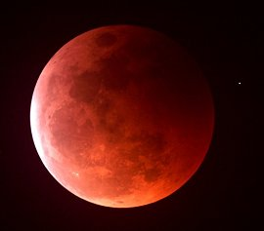
Notes:
At Passover and Sukkot in both 2014, and 2015 there will be a blood moon during both Feasts in both years.
A Time For Judgment
By Hillel ben David (Greg Killian)
If the eclipses fall at regular intervals, how can we relate them to our behaviour and our responsibilities? It would seem they are celestial events that are entirely unrelated to our behaviour. So, how can we KNOW they are indeed related to our behaviour and are sent by Yahweh to convey a specific message to us?
The fact they are a specific message from Yahweh can be proven in the Torah in the Book of Genesis:
14 And Yahweh said, Let there be lights in the firmament of the heaven to divide the day from the night; and let them be for signs, and for seasons, and for days, and years: 15 And let them be for lights in the firmament of the heaven to give light upon the earth: and it was so. (Genesis 1:14-15)
We know these eclipses are related to our behaviour from the oral Torah, Mechilta to Parshat Bo as well as in the Talmud:
Succah 29a:
Our Rabbis taught that when the sun is in eclipse, it is a bad omen for the entire world. This may be illustrated by a parable. To what can this be compared? To a human being who made a banquet for his servants and put up for them a lamp. When he became wroth with them he said to his servant, ‘Take away the lamp from them, and let them sit in the dark.’ It was taught: R. Meir said, whenever the luminaries are in eclipse, it is a bad omen for Israel since they are injured to blows.
This may be compared to a schoolteacher who comes to school with a strap in his hand.
Who becomes apprehensive? He who is accustomed to being punished daily. Our Rabbis taught, when the sun is in eclipse it is a bad omen for idolaters; when the moon is in eclipse, it is a bad omen for Israel, since Israel reckons by the moon and idolaters by the sun. If it is in eclipse in the East it is a bad omen for those who dwell in the East; if it is in eclipse in the West, it is a bad omen for those who dwell in the West; if in the midst of heaven it is bad omen for the whole world.
If its face is red as blood, it is a sign that the Sword is coming to the world; if it is like sackcloth, the arrows of Famine are coming to the world ; if it resembles both, the Sword and the arrows of Famine are coming to the world.
If the eclipse is at sunset, calamity will tarry in its coming; if it is at dawn, it hastens on its way: but some say the order is to be reversed. And there is no nation which is smitten that its gods are not smitten together with it, as it is said, and against all the gods of Egypt Yahweh will execute judgments.
But when Israel fulfills the will of the Omnipresent One, they need have no fear of all these omens as it is written, “Thus saith the HaShem, ‘Learn not the way of the nations, and be not dismayed at the signs of heaven , for the nations are dismayed at them, the idolaters will be dismayed, but Israel will not be dismayed.’”
You can get all eclipses for the future at NASA
During the year 2009 C.E., two solar and four lunar eclipses occur as follows:
2009 January 26th: Annular Solar Eclipse
2009 February 9th: Penumbral Lunar Eclipse
2009 July 7th: Penumbral Lunar Eclipse
2009 July 22nd: Total Solar Eclipse
2009 August 6th: Penumbral Lunar Eclipse
2009 December 31st: Partial Lunar Eclipse
We have just read above that if it is like sackcloth, the arrows of Famine, are coming to the world:
in the first Prophecy of Abraham, Famine is expected in 2010 C.E. In 2010 C.E., there are two solar and two lunar eclipses:
2010 January 15th: Annular Solar Eclipse
2010 June 26th: Partial Lunar Eclipse
2010 July 11th: Total Solar Eclipse
2010 December 21st: Total Lunar Eclipse
In 1996 C.E., there were two very significant moons over Jerusalem falling precisely on major feast-days of the Jewish calendar.
One “sack-cloth” moon (a dark eclipse, some said it was red) appeared on the Passover Sabbath, April 3rd, 1996, and one blood-red moon occurred on September 26th, exactly on the eve of the Feast of Tabernacles.
1996 was the last Jubilee Year and the first year in this last cycle of 49 years. This is when Osama bin Laden made his declaration of war on the USA in August of 1996. The beginning of the Curse of Terror.
A Time For Judgment
Josephus foretells a lunar eclipse after Herod kills Matthias. It was an omen of his impending death. (Antiquity of the Jews XVII, Chapter 4)
The Book of Isaiah alludes to this:
1 Thus says Yahweh: “Where is the certificate of your mother’s divorce, Whom I have put away? Or which of My creditors is it to whom I have sold you? For your iniquities you have sold yourselves, And for your transgressions your mother has been put away. 2 Why, when I came, was there no man? Why, when I called, was there none to answer? Is My hand shortened at all that it cannot redeem? Or have I no power to deliver? Indeed with My rebuke I dry up the sea, I make the rivers a wilderness; Their fish stink because there is no water, And die of thirst. 3 I clothe the heavens with blackness, And I make sackcloth their covering.” (Isaiah 50:1-3)
Brethren, do you not see what is going on? Have I not been showing you the Sabbatical Cycle and the order of the Curses? First comes Terror, followed by Drought and severe weather. The Third Curse is Pestilence or epidemics (heard of the swine or bird flu lately?) and it includes Famines. Famines are followed by the Sword and Captivity.
The Redemption spoken of in Isaiah is that which takes place at the end of the Jubilee, when all things are redeemed by Yahshua. Isaiah goes on to say that it is Yahweh’s rebuke that dries up the rivers, which results in Drought. Next, the heavens give way to blackness as a result of lunar and solar eclipses.
In the Book of Joel we are given a Prophecy, for the Day of Yahweh is close at hand in the Valley of Decision:
1 “For behold, in those days and at that time, When I bring back the captives of Judah and Jerusalem, 2 I will also gather all nations, And bring them down to the Valley of Jehoshaphat; And I will enter into judgment with them there On account of My people, My heritage Israel, Whom they have scattered among the nations; They have also divided up My land. 3 They have cast lots for My people, Have given a boy as payment for a harlot, And sold a girl for wine, that they may drink...” 15 The sun and moon will grow dark, And the stars will diminish their brightness. (Joel 3:1-3, 15)
Before Yahweh can bring us back from Captivity we MUST FIRST GO INTO CAPTIVITY! This means we must go to war and lose that war.
This is confirmed when we read further in the Book of Joel:
28 “And it shall come to pass afterward That I will pour out My Spirit on all flesh; Your sons and your daughters shall prophesy, Your old men shall dream dreams, Your young men shall see visions. 29 And also on My menservants and on My maidservants I will pour out My Spirit in those days. 30 And I will show wonders in the heavens and in the earth: Blood and fire and pillars of smoke. 31 The sun shall be turned into darkness, And the moon into blood, Before the coming of the great and awesome day of Yahweh. 32 And it shall come to pass That whoever calls on the name of Yahweh Shall be saved. For in Mount Zion and in Jerusalem there shall be deliverance, As Yahweh has said, Among the remnant whom Yahweh calls.” (Joel 2:28-32)
In 2008 there was a solar eclipse over Asia. Later we heard of earth quakes and cyclones devastating the area. In 2009 there was another solar eclipse over Asia and the Pacific Rim countries. We are now reading reports of how the Philippines and Samoan Islands are being flooded by Typhoons and Tsunamis and earth quakes.
In 2017 & 2024 the entire North American continent will experience a complete solar eclipse. Watch for extreme weather to follow in the form of hurricanes and earth quakes. It has also been reported that the world is just one crop failure away from a famine. If these disasters affect us from planting or harvesting our crops the world will experience a famine in 2010 and beyond. Are you ready?

Slide 126
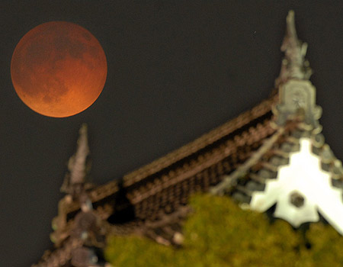
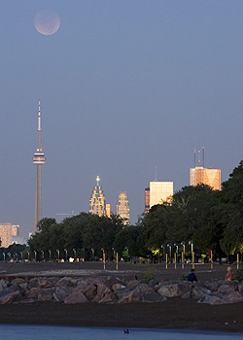
Notes:
30 “If his sons forsake My law And do not walk in My judgments, 31 If they break My statutes And do not keep My commandments, 32 Then I will punish their transgression with the rod, And their iniquity with stripes.” (Psalms 89:30-32)
That Rod is Germany
Isaiah the Prophet also speaks of Yahweh’s righteous judgments:
1“Woe to those who decree unrighteous decrees, Who write misfortune, Which they have prescribed 2 To rob the needy of justice, And to take what is right from the poor of My people, That widows may be their prey, And that they may rob the fatherless. 3 What will you do in the day of punishment, And in the desolation which will come from afar? To whom will you flee for help? And where will you leave your glory? 4 Without Me they shall bow down among the prisoners, And they shall fall among the slain.” For all this His anger is not turned away, but His hand is stretched out still. 5 “Woe to Assyria, the rod of My anger And the staff in whose hand is My indignation. 6 I will send him against an ungodly nation, And against the people of My wrath I will give him charge, To seize the spoil, to take the prey, And to tread them down like the mire of the streets.” (Isaiah 10:1-6)
It is Assyria (Germany) that is the ROD with which Yahweh shall chastise Israel, the ungodly nation, and the people of His wrath—both the USA and the UK. Assyria shall invade and destroy all of this land.
Yahweh declares to us in Ezekiel:
33 “As I live,” says Yahweh, “surely with a mighty hand, with an outstretched arm, and with fury poured out, I will rule over you. 34 I will bring you out from the peoples and gather you out of the countries where you are scattered, with a mighty hand, with an outstretched arm, and with fury poured out. 35 And I will bring you into the wilderness of the peoples, and there I will plead My case with you face to face. 36 Just as I pleaded My case with your fathers in the wilderness of the land of Egypt, so I will plead My case with you,” says the Lord God. 37 “I will make you pass under the rod, and I will bring you into the bond of the covenant; 38 I will purge the rebels from among you, and those who transgress against Me; I will bring them out of the country where they dwell, but they shall not enter the land of Israel. Then you will know that I am Yahweh” (Ezekiel 20:33-38)
Yahweh is going to once again plead with us face to face. Is this in 2014 as we talked about earlier.
After all is said and done only a remnant shall remain—10% to be exact. In Leviticus we read:
32 And concerning the tithe of the herd or the flock, of whatever passes under the rod, the tenth one shall be holy to Yahweh. (Leviticus 27:32)
In Amos and Ezekiel we read:
3 For thus says Yahweh: “The city that goes out by a thousand Shall have a hundred left, And that which goes out by a hundred Shall have ten left to the house of Israel.” (Amos 5:3)
3 “I will make you pass under the rod, and I will bring you into the bond of the covenant…” (Ezekiel 20:3)
These blood moons and eclipses are a sign for us to repent while we still can and there is still time—before the Rod is used on us to correct us. They are a warning of impending doom— or bad omens.

Slide 127
Notes:
During the Sabbatical cycle of the Life of Isaac we can see that the years when Isaac contended with Abimelech. I could not determine which were the exact years. But it was after they became of age and before Esau was married in 2148.
I also noted that Isaac was offered as a sacrifice in the fourth cycle. This is when Yahshua was killed in the middle of the week. It is also when the ten Tribes of Israel went into captivity. Do you see a patern.
And it is also near the same time as 2020 in our day when the USA will go to war.

Slide 128
Notes:
This time of Isaac also matched the time in Abrahams day when Shem contended with Nimrod.
Both Abimelech and Nimrod represent in our day when Israel will contend with Satan.
Abimelech and Nimrod are the same as Satan. Abraham and Isaac are the same as the ten tribes of Israel today. Notice that the contention of Isaac covers the exact same period as war and captivity and the last 3 ½ years of tribulation as we have been showing you.

Slide 129
Notes:
Isaacs time of trial covers the 4th cycle of war and the 5th cycle of captivity and the 6th cycle of tribulation.

Slide 130
Notes:
This the Sabbatical cycle of Jacob. The Orange area is when Jacob works for Laban for 7 year and at the end of this time He is Decieved by Laban and marries Leah.
Jacob fled Esau just before he arrives at Labans door.
Notice how this same time period represents in our time the period of captivity. Jacob was a slave to Laban. At the end of the 7 years Laban decieves Jacob. Once Israel goes into captivity they will be brought back to the land of Israel under a false premise. Israel will think they are going home to the land. In actual fact they are going home to be slaughtered by the beast. They are sent home to appease the two witnesses.
Notice also that the 6th cycle in purple is when each of the sons of Jacob is born. It represents when Israel is born or reborn in the land. Notice also that Joseph is born in 2199 which is the year of the Feast of Sukkot or the wedding. Joseph is represented by a sheaf of wheat which is what the this feast is about.

Slide 131
Notes:
This is the Sabbatical Cycle of Joseph and it includes the seven year of famine and the seven years of Plenty.
When I looked at this at first I could not see anything that matched. The seven years did not match the Sabbatical cycles. It was not until I plotted this out on these charts that I saw what was happening.
Once the Kings of the North and the Kings of The South have defeated the USA in 2020, then there will be 7 years of Plenty as the beast power experiences tremendous prosperity just as Egypt did under Josephs rule. See green area. Then in the middle of the captivity the prosperity turns to severe famine. This coincides with the two witnesses demanding that the Beast power release all the Israelites back to the land of Israel. He refuses just like in the Exodus.
The two witnesses declare that it will not rain for three years.
It is at this time that 25% of mankind dies. It is because of this that the whole world goes out and seeks all the Israelites and brings them back to the land by 2030. They will be hunted down. They begin to build the Temple. But at Passover the Beast power plans on slaughtering them all. This is Shabbat Shuva the year of return. Return Oh Israel and bring the Torah scrolls. This is the half torah reading on Shabbat Shuva during the Days of Awe.
This is when the two witnesses are killed. This is also going to be when there will be two Passovers. One according to the sighted moon and another according to the Hebrew calendar. You need to know which one is the right one. At one will be beginning of the count of the 1290 days. The 1260 days is the count of the second time period which is one month later. This is the Passover according to the Hebrew Calendar it is the slaughter of the sheep. This is the time of the Martyrdom of the Saints
The famine ends when Satan is locked away in 2033. Do you see how they match up precisely.
The beginning of the years of plenty for Egypt, which symbolizes Babylon, is to start when Esau throws off the bonds of Jacob, (Genesis 27:39-40) which is the whole house of Israel. Notice that the years of plenty for the Beast Power start in the middle of the period for the years of war and when the USA is to be destroyed. Esau will have broken the yoke of Jacob at that time in 2020 C.E.

Slide 132
Notes:
When I read this I did another chronological check and I plotted out the periods of time when the Saints were martyred in history. From 64 to 68 C.E. we have the first persecution of the Saints by Nero when Peter and Paul were killed.
We also have the second persecution of the saints in 95 and 96 C.E. and the third persecution of the saints from 109 C.E. to 111 C.E. Notice that the persecution of the saints matches our current Sabbatical Cycle of the fourth and fifth days when we have war and captivity. Starting in 2020 C.E. and ending in 2028 C.E.
Do not fear any of those things which you are about to suffer. Indeed, the devil is about to throw some of you into prison, that you may be tested, and you will have tribulation ten days. Be faithful until death, and I will give you the crown of life. (Revelation 2:10)
And I have just seen this as I prepared to come to Michigan. The Year the Temple of Yahweh is detsroyed in 70 AD matches the time of the Martydom of the Saints at the year of Shuva in 2030 CE.

Slide 133
Notes:
Notice in this chart the time of the Martyrdom of the saints is during the fifth seal which is at the beginning of the time when the woman goes into hiding. Why because Satan seeks to kill her.
Do not fear any of those things which you are about to suffer. Indeed, the devil is about to throw some of you into prison, that you may be tested, and you will have tribulation ten days. Be faithful until death, and I will give you the crown of life. (Revelation 2:10)
9 When He opened the fifth seal, I saw under the altar the souls of those who had been slain for the word of God and for the testimony which they held. 10 And they cried with a loud voice, saying, "How long, O Lord, holy and true, until You judge and avenge our blood on those who dwell on the earth?" 11 Then a white robe was given to each of them; and it was said to them that they should rest a little while longer, until both the number of their fellow servants and their brethren, who would be killed as they were, was completed. (Revelation 6:9-17)

Slide 134
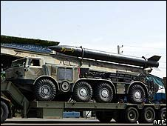
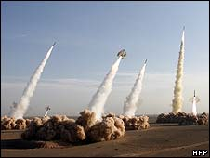
Iran is to attack Rome with arrows
Notes:
Isaiah 13:6-181 The burden against Babylon which Isaiah the son of Amoz saw
13 Therefore I will shake the heavens, And the earth will move out of her place, In the wrath of Yahweh of hosts And in the day of His fierce anger. 14 It shall be as the hunted gazelle, And as a sheep that no man takes up; Every man will turn to his own people, And everyone will flee to his own land. 15 Everyone who is found will be thrust through, And everyone who is captured will fall by the sword. 16 Their children also will be dashed to pieces before their eyes; Their houses will be plundered And their wives ravished. 17 "Behold, I will stir up the Medes against them, Who will not regard silver; And as for gold, they will not delight in it. 18 Also their bows will dash the young men to pieces, And they will have no pity on the fruit of the womb; Their eye will not spare children.
Rev 17:15 And he saith unto me, The waters which thou sawest, where the whore sitteth, are peoples, and multitudes, and nations, and tongues. 16 And the ten horns which thou sawest upon the beast, these shall hate the whore, and shall make her desolate and naked, and shall eat her flesh, and burn her with fire.
These ten horns are the ten nations of Islam which divided the land of the USA . The USA tried to divide the land of the State of Israel and after being defeated thier land was divided by the Muslim alliance under German leadership.
Zechariah5:1 Then I turned and raised my eyes, and saw there a flying scroll. 2 And he said to me, "What do you see?" So I answered, "I see a flying scroll. Its length is twenty cubits and its width ten cubits." 3 Then he said to me, "This is the curse that goes out over the face of the whole earth: 'Every thief shall be expelled,' according to this side of the scroll; and, 'Every perjurer shall be expelled,' according to that side of it." 4 "I will send out the curse," says the Yahweh of hosts; "It shall enter the house of the thief And the house of the one who swears falsely by My name. It shall remain in the midst of his house And consume it, with its timber and stones."
5 Then the angel who talked with me came out and said to me, "Lift your eyes now, and see what this is that goes forth." 6 So I asked, "What is it?" And he said, "It is a basket* that is going forth." He also said, "This is their resemblance throughout the earth: 7 Here is a lead disc lifted up, and this is a woman sitting inside the basket"; 8 then he said, "This is Wickedness!" And he thrust her down into the basket, and threw the lead cover* over its mouth. 9 Then I raised my eyes and looked, and there were two women, coming with the wind in their wings; for they had wings like the wings of a stork, and they lifted up the basket between earth and heaven. 10 So I said to the angel who talked with me, "Where are they carrying the basket?" 11 And he said to me, "To build a house for it in the land of Shinar;* when it is ready, the basket will be set there on its base."
When you mess around with a woman you are playing with fire. In Hebrew the difference between these evil woman and the two woman carrying this scroll is a dot below one of the letters. You replace the dot and you instead of women you now have fires. This evil fire is Nuclear and the two women carrying are two fires, two rockets propelling the scroll or missile.
Rev 18:8 Therefore her plagues will come in one day--death and mourning and famine. And she will be utterly burned with fire, for strong is Yahweh who judges
The Ten Horns mentioned above are the ten Kingdoms that are formed after the league of Nations defeats the USA and UK. Again from Psalm 83
Iran are the Medes here.

Slide 135
Where does Israel go to hide? And when?
Notes:
In Genesis Abraham is told to leave Haran. He does. This is when he was 75 years old. This was in the year 2023 A.C. and matches our time of 2009. By going to the land of Israel when he did Abraham was protected from all the other things going on around him.
If we were to go now we too will be protected from all these other things that are coming.
Show how the Euro mathces the Confusion of the tongues

Slide 136
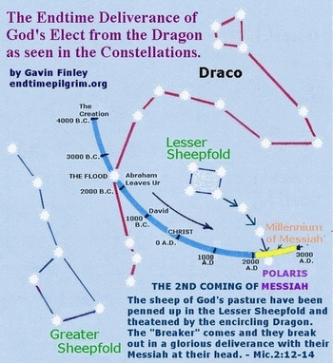
Notes:
Here below is the Scripture. This Scripture is in the Old Testament. So its prophetic significance is missed. It is rarely, if ever, mentioned by today’s teachers of Bible prophecy.
Micah 2
Hebrew Names Version of World English Bible
12. “I will surely assemble, Ya’akov, all of you;
I will surely gather the remnant of Yisra’el;
I will put them together as the sheep of Botzrah,
As a flock in the midst of their pasture;
They will throng with people.
13. He who breaks open the way goes up before them.
They break through the gate, and go out.
And their king passes on before them,
With Yahshua at their head.”
Micah 2
King James Version
12. I will surely assemble, O Jacob, all of thee;
I will surely gather the remnant of Israel;
I will put them together as the sheep of Bozrah,
As the flock in the midst of their fold:
they shall make great noise
by reason of the multitude of men.
13. The breaker is come up before them:
they have broken up,
and have passed through the gate,
and are gone out by it:
and their king shall pass before them,
and Yahshua on the head of them.
(Micah 2:12-13 | KJV)

Slide 137
The Government of Ephraim
Notes:
The Fourth cycle is the servant Lamp of the Menorah. It is when we must have a Government in place to support the two witnesses which will be going to work in the next Sabbatical Cycle. This also means we must begin now to set up a Council to bring this about.
When you read each of the messages to the seven assemblies you have a message to us now as we enter each Sabbatical cycle. Read them and look at the chart as we do this.

Slide 138
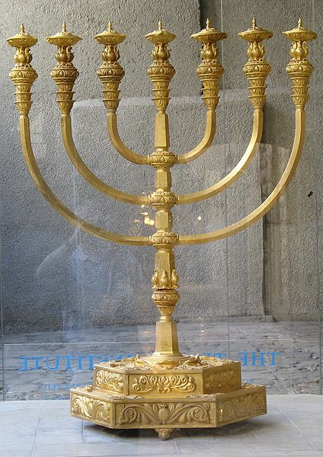

Slide 139
1961-1975 | 1960’s Cholera called El Tor
Notes:
For all those doubting Thomas’s

Slide 140
1912-1926 | 1899-1923 Cholera and 1918-1920 Avian Flu

Slide 141
1863-1877 Cholera

Slide 142
1814-1828 | 1816-1826 | 1829-1851 Cholera

Slide 143
1765-1779 | 1775-1776 Influenza

Slide 144
1716-1730 | 1732-1733 Influenza

Slide 145
Do you See a Pattern?
The Third Cycle is now here.

Slide 147
The end Is Actually the New Beginning
Questions?

