Slide 1
The Levitical Priesthood Jer 33:19-22

Slide 2
The Levitical Priesthood
Government
Court Policies
Judges

Slide 3
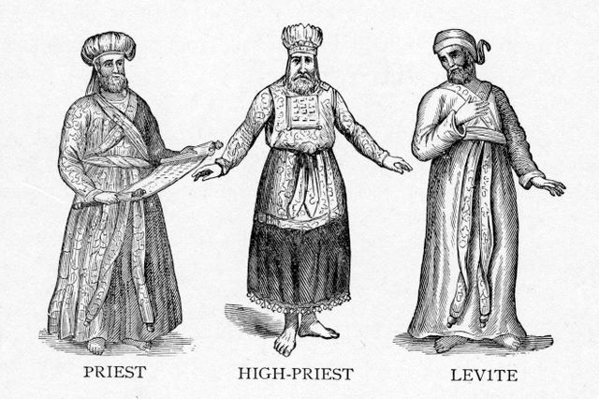
The Levitical Priesthood
Government
Court Policies
Judges
Priesthood
Aaronic Priesthood
Levitical Priesthood
High Priesthood
This Photo by Unknown Author is licensed under CC BY-NC

Slide 4
The Levitical Priesthood
Government
Court Policies
Judges
Priesthood
Aaronic Priesthood
Levitical Priesthood
High Priesthood
Yehovah’s Government
What does it look like?
How is it funded?

Slide 5
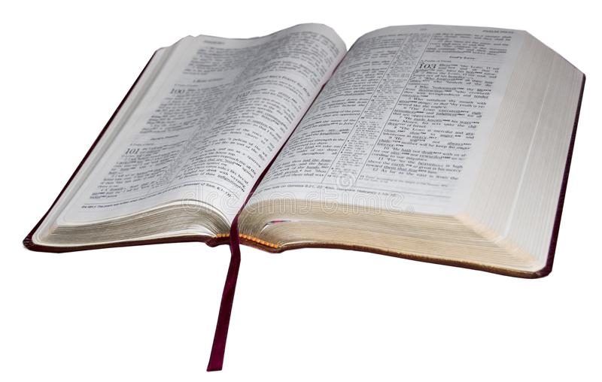
The Law
The law of Yehovah is good for us
Notes:
The law of God is good for us not a danger to us

Slide 6
6:24
Deu 6:24 And יהוה commanded us to do all these laws, to fear יהוה our Elohim, for our good always, to keep us alive, as it is today.
6:25
Deu 6:25 And it is righteousness for us when we guard to do all this command before יהוה our Elohim, as He has commanded us.’

Slide 7
The Law
The Law of Yehovah is good for us
The Law of Yehovah defines righteous living
Notes:
The law of God shows us how to live righteous, it defines our way of living our santification

Slide 8
The Law
The Law of Yehovah is good for us
The Law of Yehovah defines righteous living
The only way to understand Yehovah’s Law is to do Yehovah’s Law

Slide 9
Psa 111:10 The fear of יהוה is the beginning of wisdom, All those doing them have a good understanding. His praise is standing forever.
Notes:
Those doing His laws have understanding and are not being deceived

Slide 10
Jas 1:22 And become doers of the Word, and not hearers only,^{c} deceiving yourselves. Footnote: ^{c}See Mat_7:24-27, Luk_6:46-49, Luk_8:21, Rom_2:13, Heb_4:11, Rev_22:14.
Notes:
If your able to be deceived it’s because you don’t have understanding

Slide 11
The Law
The Law of Yehovah is good for us
The Law of Yehovah defines righteous living
The only way to understand Yehovah’s Law is to do Yehovah’s Law
When studying the Law of Yehovah we error when we treat it as a religion. It is law and needs to be studied as law.
Notes:
His Torah is a book of Laws

Slide 12
The Law
The Law of Yehovah is good for us
The Law of Yehovah defines righteous living
The only way to understand Yehovah’s Law is to do Yehovah’s Law
When studying the Law of Yehovah we error when we treat it as a religion. It is law and needs to be studied as law.
Israel was nation, not a church. We need to compare Israel to other nations. The Law of Yehovah is a National Law.
Notes:
Since I’m from America we will compare Israel to the US and see how we’re doing

Slide 13
The Law
The Law of Yehovah is good for us
The Law of Yehovah defines righteous living
The only way to understand Yehovah’s Law is to do Yehovah’s Law
When studying the Law of Yehovah we error when we treat it as a religion. It is law and needs to be studied as law.
Israel was nation, not a church. We need to compare Israel to other nations. The Law of Yehovah is a national Law.
The Law of Yehovah is like a mirror and should be used to look back at yourselves instead of others.

Slide 14
Jas 1:23 Because if anyone is a hearer of the Word and not a doer, he is like a man who looks at his natural face in a mirror, Jas 1:24 for he looks at himself, and goes away, and immediately forgets what he was like. Jas 1:25 But he that looked into the perfect Torah, that of freedom, and continues in it, not becoming a hearer that forgets, but a doer of work, this one shall be blessed in his doing of the Torah.

Slide 15
Mosaic Law
756 commandments, statutes, and judgements

Slide 16
Mosaic Law
756 commandments, statutes, and judgements
87 Titles of Laws

Slide 17
Mosaic Law
756 commandments, statutes, and judgements
87 Titles of Laws
10 Commandments

Slide 18
Mosaic Law
756 commandments, statutes, and judgements
87 Titles of Laws
10 Commandments
2 Greatest Commandments

Slide 19
Mat 22:37 And יהושע said to him, “ ‘You shall love יהוה your Elohim with all your heart, and with all your being, and with all your mind.’ ^{Deu_6:5.} Mat 22:38 “This is the first and great command. Mat 22:39 “And the second is like it, ‘You shall love your neighbour as yourself.’ ^{Lev_19:18.} Mat 22:40 “On these two commands hang all the Torah and the Prophets.”
Notes:
This should be familiar to everybody as a model of what Yehovah is saying here.

Slide 20
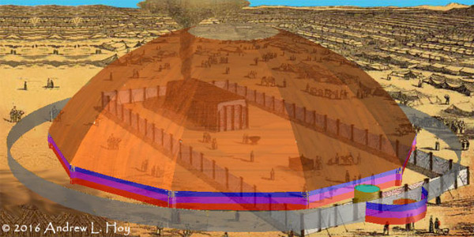
Tabernacle/Temple
Had 3 purposes
Notes:
The Tabernacle had 3 purposes

Slide 21
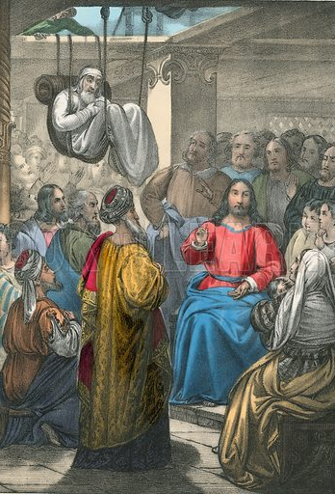
Tabernacle/Temple
3 purposes
Hospital
Sick were brought to the Temple- Leviticus 13:2-59
Notes:
It was the job of the priest to pronounce clean or unclean, diagnose diseases etc

Slide 22
Lev 13:2 “When a man has on the skin of his body a swelling, a scab, or a bright spot, and it shall become on the skin of his body like a leprous infection, then he shall be brought to Aharon the priest or to one of his sons the priests.
Lev 13:3 “And the priest shall look at the infection on the skin of the body. And if the hair on the infection has turned white, and the infection appears to be deeper than the skin of his body, it is a leprous infection. And the priest shall look at him, and pronounce him unclean.
Lev 13:4 “But if the bright spot is white on the skin of his body, and does not appear to be deeper than the skin, and its hair has not turned white, then the priest shall shut up the infected one seven days.
Lev 13:5 “And the priest shall look at him on the seventh day and see, if the infection appears to be as it was, and the infection has not spread on the skin, then the priest shall shut him up another seven days.
Lev 13:6 “And the priest shall look at him again on the seventh day and see, if the infection has darkened, and the infection has not spread on the skin, then the priest shall pronounce him clean. It is a scab, and he shall wash his garments and be clean.

Slide 23
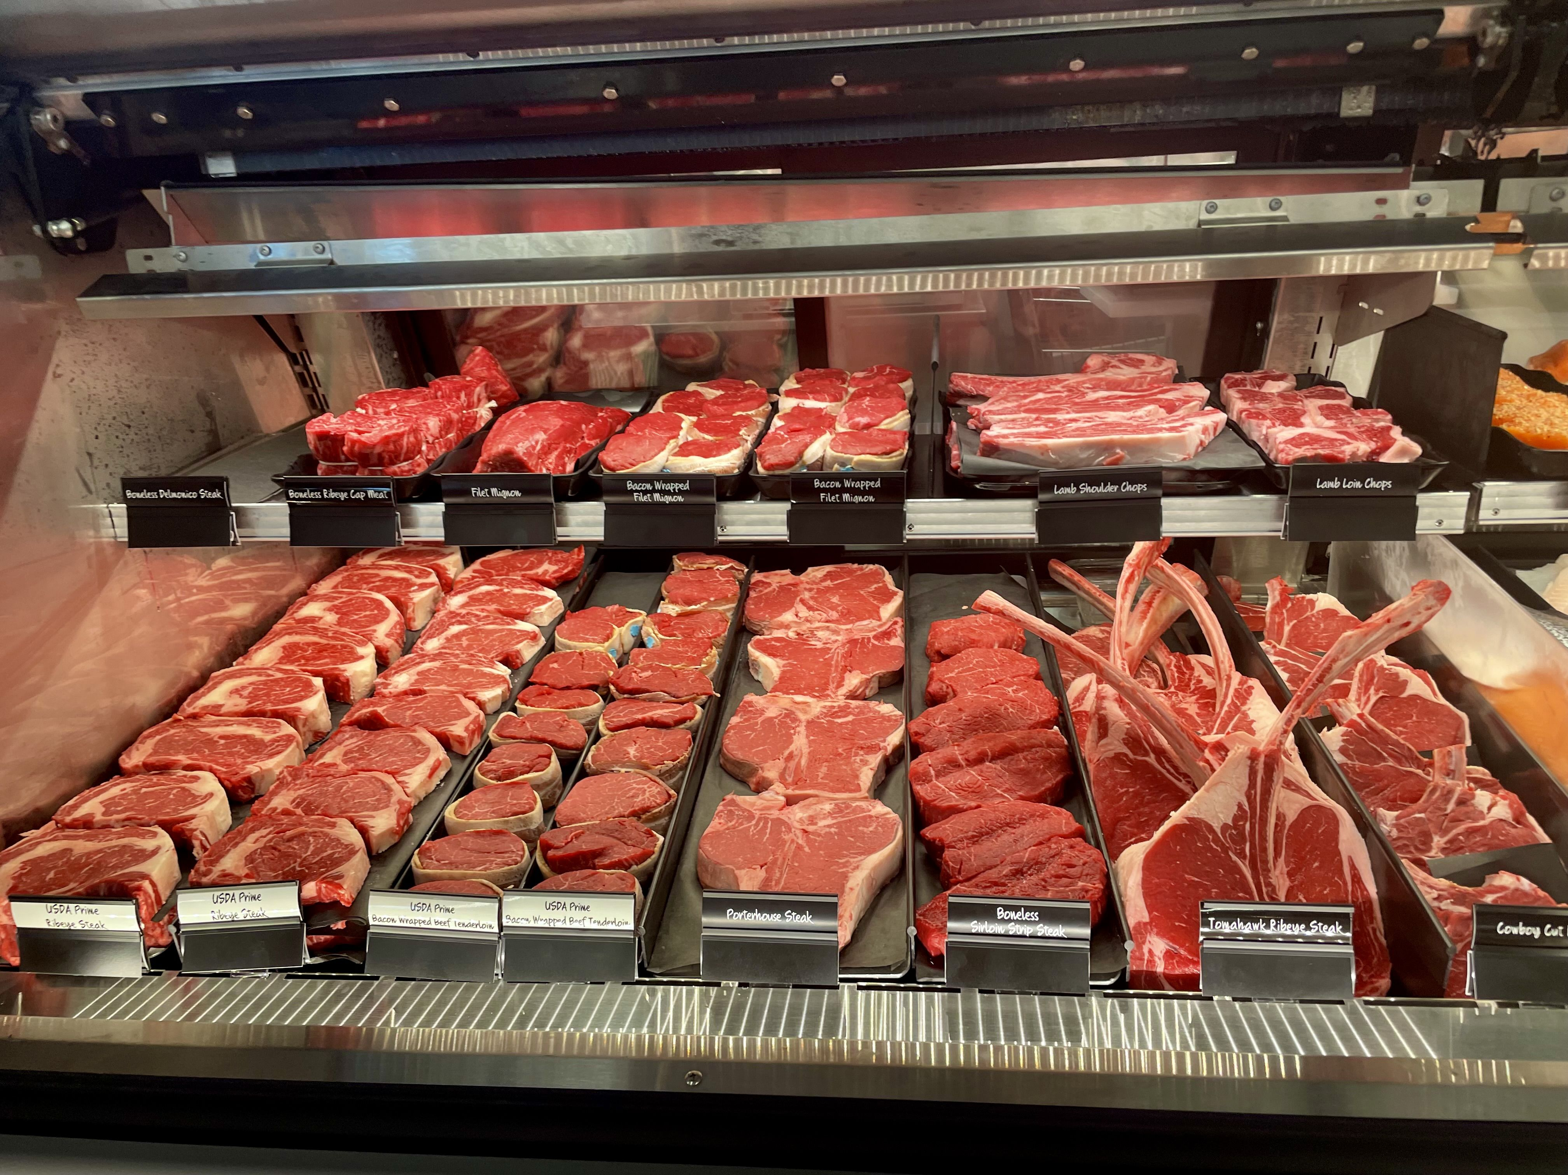
Tabernacle/Temple
3 purposes
Hospital
Sick were brought to the Temple- Leviticus 13:2-6
Food Regulations- Numbers 15:6-7
Peace Offerings- Leviticus 3:17

Slide 24
Num 15:6 Or for a ram you prepare as a grain offering two-tenths of an ěphah of fine flour mixed with one-third of a hin of oil, Num 15:7 and as a drink offering you bring one-third of a hin of wine as a sweet fragrance to יהוה.
Lev 3:17 ‘An everlasting law throughout your generations in all your dwellings: you do not eat any fat or any blood.’ ”
Notes:
These are our butchers who are regulated and follow these rules pretty darn close. That’s why I get the 93/7 ground meat at the store because we aren’t to eat fat.

Slide 25
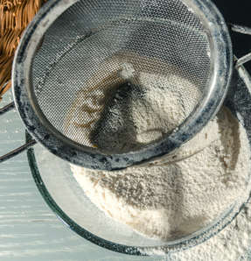
Tabernacle/Temple
3 purposes
Hospital
Sick were brought to the Temple- Leviticus 13:2-6
Food Regulations- Numbers 15:6-7
Peace Offerings- Leviticus 3:17
Meal Offerings- Leviticus 2:1-16
Notes:
The meal offering is what we do here to regulate the wheat to make sure it is proper to sell to the public

Slide 26
Tabernacle/Temple
Hospital
Sick were brought to the Temple- Leviticus 13:2-6
Food Regulations- Numbers 15:6-7
Peace Offerings- Leviticus 3:17
Meal Offerings- Leviticus 2:1-16
Judicial System- Enforcing Yehovah’s Law
Notes:
How do we enforce His laws today, by our judges

Slide 27
Tabernacle/Temple
Hospital
Sick were brought to the Temple- Leviticus 13:2-6
Food Regulations- Numbers 15:6-7
Peace Offerings- Leviticus 3:17
Meal Offerings- Leviticus 2:1-16
Judicial System- Enforcing Yehovah’s Law
Sin Offering- Leviticus 4:2-3
Sins of ignorance. This is a fine

Slide 28
Tabernacle/Temple
Hospital
Sick were brought to the Temple- Leviticus 13:2-6
Food Regulations- Numbers 15:6-7
Peace Offerings- Leviticus 3:17
Meal Offerings- Leviticus 2:1-16
Judicial System- Enforcing Yehovah’s Law
Sin Offering- Leviticus 4:2-3
Sins of ignorance. This is a fine
Trespass Offering- Lev 5:15, 6:2-5
Sins of ignorance and intent. Pay a fine with punitive damages

Slide 29
Lev 5:15 “If anyone commits a breach of faith and sins unintentionally in any of the holy things of Yehovah, he shall bring to Yehovah as his compensation, a ram without blemish out of the flock, valued in silver shekels, according to the shekel of the sanctuary, for a guilt offering.

Slide 30
Lev 6:2 “When any being sins, and committed a trespass against יהוה, and has lied to his neighbour about a deposit, or about a pledge, or about a robbery, or shall extort from his neighbour,
Lev 6:3 or has found what was lost and has lied concerning it, or did swear falsely, so that he sins in regard to any one of all these that a man does,
Lev 6:4 then it shall be, when he sins, and shall be guilty, that he shall return what he took by robbery, or what he has extorted, or the deposit which was deposited with him, or the lost item which he found,
Lev 6:5 or all that about which he swore falsely. He shall repay its total value, add one-fifth more to it, and give it to whom it belongs, on the day of his guilt offering.

Slide 31
Tabernacle/Temple
Hospital
Sick were brought to the Temple- Leviticus 13:2-6
Food Regulations- Numbers 15:6-7
Peace Offerings- Leviticus 3:17
Meal Offerings- Leviticus 2:1-16
Judicial System- Enforcing Yehovah’s Law
Sin Offering- Leviticus 4:2-3
Sins of ignorance. This is a fine
Trespass Offering- Lev 5:15, 6:2-5
Sins of ignorance and intent. Pay a fine with punitive damages
Burnt Offering- Lev 1:6

Slide 32
Lev 1:6 ‘And he shall skin the ascending offering and cut it into its pieces.
Notes:
This is the only sacrifice where you cut the offering in pieces. Doing these were customs used to make covenants. A contract with somebody

Slide 33
was a “custom used in making and confirming covenants; a calf, or some other creature, were cut in pieces, and the parts laid in order, and the covenantees passed between these parts; signifying thereby, that if they did not fulfil the engagements they entered into, they imprecated to be cut to pieces as that creature was.”
John Dill, Exposition of the Whole Bible, Jeremiah 34:18
Notes:
I believe more people would keep their word if we still made contracts this way. This is also known as a Suzerain treaty which we still do today with business deals made with a meal. It sad that we see this as religious instead of what the Scriptures say it is

Slide 34
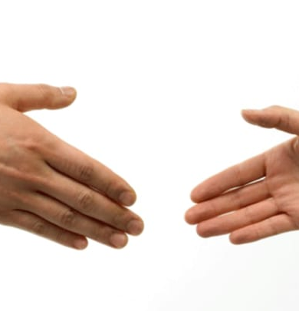
Tabernacle/Temple
Hospital
Sick were brought to the Temple- Leviticus 13:2-6
Food Regulations- Numbers 15:6-7
Peace Offerings- Leviticus 3:17
Meal Offerings- Leviticus 2:1-16
Judicial System- Enforcing Yehovah’s Law
Sin Offering- Leviticus 4:2-3
Sins of ignorance. This is a fine
Trespass Offering- Lev 5:15, 6:2-5
Sins of ignorance and intent. Pay a fine with punitive damages
Burnt Offering- Lev 1:6
Contract Ratification- Notary
Notes:
When you cut in deal with someone they would sometimes cut their hands and shake on it. Sealing the covenant with their blood

Slide 35
Tabernacle/Temple
Judicial System- Enforcing Yehovah’s Law
Government- 9 statutes
Notes:
When you cut in deal with someone they would sometimes cut their hands and shake on it. Sealing the covenant with their blood

Slide 36
Tabernacle/Temple
Judicial System- Enforcing Yehovah’s Law
Government- 9 statutes
You shall appoint judges and officers in all your cities. Deut 16:18
Notes:
If you haven’t noticed we do that in the US

Slide 37
Deu 16:18 “Appoint judges and officers within all your gates, which יהוה your Elohim is giving you, according to your tribes. And they shall judge the people with righteous right-ruling.

Slide 38
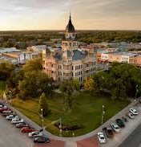
Tabernacle/Temple
Judicial System- Enforcing Yehovah’s Law
Government- 9 statutes
You shall appoint judges and officers in all your cities. Deut 16:18
The Judicial System is to run the land Exodus 18:21-22
Notes:
If you haven’t noticed we do that in the US

Slide 39
Exo 18:21 “But you yourself, seek out from all the people able men, who fear Elohim, men of truth, hating unfair gain. And place these over them to be rulers of thousands, rulers of hundreds, rulers of fifties, and rulers of tens.
Exo 18:22 “And they shall rightly rule the people at all times. And it shall be that they bring every great matter to you, but they themselves rightly rule every small matter. So, make it lighter for yourself, for they shall bear with you.
Notes:
Here is the US we have a God ordained branch of government, another is ok to have and one we have is strictly forbidden! We’ll get to that but it’s the Judicial System that is to run the government.

Slide 40
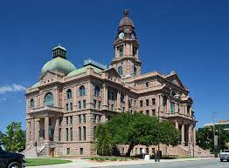
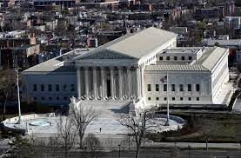
Tabernacle/Temple
Judicial System- Enforcing Yehovah’s Law
Government- 9 statutes
You shall appoint judges and officers in all your cities. Deut 16:18
The Judicial System is to run the land. Ex 18:21-22
Lower courts deal with small matters. Ex 18:22
Higher courts deals with the large matters Ex 18:22
Notes:
Notice that the lower courts were the Levitical priests and the higher courts were the Aaronic priests. That’s basically what we do today

Slide 41
Tabernacle/Temple
Judicial System- Enforcing Yehovah’s Law
Government- 9 statutes
You shall appoint judges and officers in all your cities. Deut 16:18
The Judicial System is to run the land. Ex 18:21-22
Lower courts deal with small matters. Ex 18:22
Higher courts deals with the large matters Ex 18:22
You shall not curse or speak evil of your rulers Ex 22:28
Notes:
We would call this contempt of court today. Try telling a judge where to go if you don’t like his ruling and see what happens to you

Slide 42
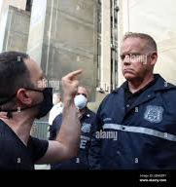
Exo 22:28 “Do not revile an elohim, nor curse a ruler of your people.

Slide 43
Tabernacle/Temple
Congregation of Israel
Congregation of Yehovah
Notes:
We need to be able to know the difference between these 2 groups. One is mentioned many times in Scripture and the other is only a few

Slide 44
Tabernacle/Temple
Congregation of Israel
Represents all Israel
Congregation of Yehovah

Slide 45
Exo 16:1 And they set out from Ělim, and all the congregation of the children of Yisra’ěl came to the Wilderness of Sin, which is between Ělim and Sinai, on the fifteenth day of the second new moon after their going out of the land of Mitsrayim.
Congregation of Israel
Represents all Israel
Who journeyed to the wilderness of sin? Ex 16:1
Congregation of Yehovah

Slide 46
Exo 35:1 And Mosheh assembled all the congregation of the children of Yisra’ěl, and said to them, “These are the Words which יהוה has commanded you to do:
Congregation of Israel
Represents all Israel
Who journeyed to the wilderness of sin?
All Israel
Who was at Mt Sinai? Ex 35:1
All Israel
Congregation of Yehovah

Slide 47
Num 1:2 “Take a census of all the congregation of the children of Yisra’ěl, by their clans, by their fathers’ houses, according to the number of names, every male, head by head,
Congregation of Israel
Represents all Israel
Who journeyed to the wilderness of sin?
All Israel
Who was at Mt Sinai?
All Israel
Who was counted in the poll? Num 1:2
All Israel
Congregation of Yehovah

Slide 48
Num 26:2 “Take a census of all the congregation of the children of Yisra’ěl from twenty years old and above, by their fathers’ houses, everyone going out to the army in Yisra’ěl.”
Congregation of Israel
Represents all Israel
Who journeyed to the wilderness of sin?
All Israel
Who was at Mt Sinai?
All Israel
Who was counted in the poll?
All Israel
Who was able to go to war? Num 26:2
All Israel
Congregation of Yehovah

Slide 49
Tabernacle/Temple
Congregation of Israel
Represents all Israel
Who journeyed to the wilderness of sin?
All Israel
Who was at Mt Sinai?
All Israel
Who was counted in the poll?
All Israel
Who was able to go to war?
All Israel
Congregation of Yehovah
Represents the government
Notes:
They are representing the priesthood. The government or rulers of the congregation

Slide 50
Tabernacle/Temple
Congregation of Israel
Represents all Israel
Who journeyed to the wilderness of sin?
All Israel
Who was at Mt Sinai?
All Israel
Who was counted in the poll?
All Israel
Who was able to go to war?
All Israel
Congregation of Yehovah
Represents the government
Who rebelled against Moses?
Notes:
They was a government takeover, a political dispute. Notice saying congregation of the LORD is the priesthood

Slide 51
Num 16:1 Now Korah,…. took men: Num 16:2 And they rose up before Moses, with certain of the children of Israel, two hundred and fifty princes of the assembly, famous in the congregation, men of renown: Num 16:3 And they gathered themselves together against Moses and against Aaron, and said unto them, Ye take too much upon you, seeing all the congregation are holy, every one of them, and the LORD is among them: wherefore then lift ye up yourselves above the congregation of the LORD?
Congregation of Israel
Represents all Israel
Who journeyed to the wilderness of sin?
All Israel
Who was at Mt Sinai?
All Israel
Who was counted in the poll?
All Israel
Who was able to go to war?
All Israel
Congregation of Yehovah
Represents the government
Who rebelled against Moses?
Rulers of the congregation
Notes:
They was a government takeover, a political dispute. Notice saying congregation of the LORD is the priesthood

Slide 52
Num 16:40 To be a memorial unto the children of Israel, that no stranger, which is not of the seed of Aaron, come near to offer incense before Yehovah; that he be not as Korah, and as his company: as Yehovah said to him by the hand of Moses.
Congregation of Israel
Represents all Israel
Who journeyed to the wilderness of sin?
All Israel
Who was at Mt Sinai?
All Israel
Who was counted in the poll?
All Israel
Who was able to go to war?
All Israel
Congregation of Yehovah
Represents the government
Who rebelled against Moses?
Rulers of the congregation
Korah wanted the priesthood

Slide 53
Tabernacle/Temple
Congregation of Israel
Represents all Israel
Who journeyed to the wilderness of sin?
All Israel
Who was at Mt Sinai?
All Israel
Who was counted in the poll?
All Israel
Who was able to go to war?
All Israel
Congregation of Yehovah
Represents the government
Who rebelled against Moses?
Rulers of the congregation
Korah wanted the priesthood
The Congregation of Yehovah is the government

Slide 54
Exo 27:21 In the tabernacle of the congregation without the vail, which is before the testimony, Aaron and his sons shall order it from evening to morning before the LORD: it shall be a statute for ever unto their generations on the behalf of the children of Israel.
Congregation of Israel
Represents all Israel
Who journeyed to the wilderness of sin?
All Israel
Who was at Mt Sinai?
All Israel
Who was counted in the poll?
All Israel
Who was able to go to war?
All Israel
Congregation of Yehovah
Represents the government
Who rebelled against Moses?
Rulers of the congregation
Korah wanted the priesthood
The Congregation of Yehovah is the government
Levitical and Aaronic priesthood
The government served in the Tabernacle of the Congregation
Notes:
What did they establish. We now have a court room

Slide 55
Tabernacle/Temple
Judicial System- Enforcing Yehovah’s Law
Government- 9 statutes
You shall appoint judges and officers in all your cities. Deut 16:18
The Judicial System is to run the land. Ex 18:21-22
Lower courts deal with small matters. Ex 18:22
Higher courts deals with the large matters Ex 18:22
You shall not curse or speak evil of your rulers Ex 22:28
You shall respect and listen to your rulers Deut 17:12-13
You shall not let a eunuch hold office Deut 23:1

Slide 56
Deu 23:1 He that is wounded in the stones, or hath his privy member cut off, shall not enter into the congregation of Yehovah.

Slide 57
Tabernacle/Temple
Judicial System- Enforcing Yehovah’s Law
Government- 9 statutes
You shall appoint judges and officers in all your cities. Deut 16:18
The Judicial System is to run the land. Ex 18:21-22
Lower courts deal with small matters. Ex 18:22
Higher courts deals with the large matters Ex 18:22
You shall not curse or speak evil of your rulers Ex 22:28
You shall respect and listen to your rulers Deut 17:12-13
You shall not let a eunuch hold office Deut 23:1
You shall not let a mongrel hold office Ex 23:2

Slide 58
Deu 23:2 “No one born of a forbidden union may enter the assembly of Yehovah. Even to the tenth generation, none of his descendants may enter the assembly of Yehovah.

Slide 59
Tabernacle/Temple
Judicial System- Enforcing Yehovah’s Law
Government- 9 statutes
You shall appoint judges and officers in all your cities. Deut 16:18
The Judicial System is to run the land. Ex 18:21-22
Lower courts deal with small matters. Ex 18:22
Higher courts deals with the large matters Ex 18:22
You shall not curse or speak evil of your rulers Ex 22:28
You shall respect and listen to your rulers Deut 17:12-13
You shall not let a eunuch hold office Deut 23:1
You shall not let a mongrel hold office Deut 23:2
You shall not let a foreigner hold office Deut 23:3

Slide 60
Deu 23:3 “No Ammonite or Moabite may enter the assembly of Yehovah. Even to the tenth generation, none of them may enter the assembly of Yehovah forever,

Slide 61
Why these 3 statutes?

Slide 62
Why these 3 statutes?
Eunuch’s can’t be in the assembly
Perhaps men with low testosterone will affect judgement

Slide 63
Why these 3 statutes?
Eunuch’s can’t be in the assembly
Mixed races can’t be in the congregation
This is someone born of mixed heathen race

Slide 64
Why these 3 statutes?
Eunuch’s can’t be in the assembly
Mixed races can’t be in the congregation
This is someone born of mixed heathen race
Foreigners were always allowed in Israel, but had to keep Yehovah’s Law

Slide 65
Exo 12:48 And when a stranger shall sojourn with thee, and will keep the Passover to Yehovah, let all his males be circumcised, and then let him come near and keep it; and he shall be as one that is born in the land: for no uncircumcised person shall eat thereof.

Slide 66
Why these 3 statutes?
Eunuch’s can’t be in the assembly
Mixed races can’t be in the congregation
This is someone born of mixed heathen race
Foreigners were always allowed in Israel, but had to keep Yehovah’s Law
New Testament confirms we are not to be unequally yoked

Slide 67
2Co 6:14 Be ye not unequally yoked together with unbelievers: for what fellowship hath righteousness with unrighteousness? and what communion hath light with darkness?

Slide 68
Why these 3 statutes?
Eunuch’s can’t be in the assembly
Mixed races can’t be in the congregation
This is someone born of mixed heathen race
Foreigners were always allowed in Israel, but had to keep Yehovah’s Law
New Testament confirms we are not to be unequally yoked
Solomon learned the hard way

Slide 69
1Ki 11:4 For it came to pass, when Solomon was old, that his wives turned away his heart after other gods: and his heart was not perfect with Yehovah his God, as was the heart of David his father.
1Ki 11:5 For Solomon went after Ashtoreth the goddess of the Zidonians, and after Milcom the abomination of the Ammonites.
1Ki 11:6 And Solomon did evil in the sight of Yehovah, and went not fully after Yehovah, as did David his father.

Slide 70
Stranger geyr H1616
A guest; by implication a foreigner: -alien, sojourner, stranger.”
Notes:
Let’s look at the word stranger

Slide 71
Exo 12:49 One law shall be to him that is homeborn, and unto the stranger that sojourneth among you.

Slide 72
Stranger ge’yr H1616
A guest; by implication a foreigner: -alien, sojourner, stranger.”
Stranger zu’r H2114
To turn aside, to be a foreigner, stranger, profane; to commit adultery:”
Notes:
To leave the faith

Slide 73
Stranger ge’yr H1616
A guest; by implication a foreigner: -alien, sojourner, stranger.”
Stranger zu’r H2114
To turn aside, to be a foreigner, stranger, profane; to commit adultery:”
Stranger ne’ka’r H5236
Foreign, a foreigner, or heathendom: -alien, strange

Slide 74
Exo 12:43 And Yehovah said to Moses and Aaron, “This is the statute of the Passover: no foreigner shall eat of it,

Slide 75
1Ki 11:1 Now King Solomon loved many foreign women, along with the daughter of Pharaoh: Moabite, Ammonite, Edomite, Sidonian, and Hittite women,
1Ki 11:2 from the nations concerning which Yehovah had said to the people of Israel, “You shall not enter into marriage with them, neither shall they with you, for surely they will turn away your heart after their gods.” Solomon clung to these in love.
Notes:
Yehovah is saying don’t allow these people to be in His government. A stranger has always been welcome into Yehovah’s kingdom no matter the color of your skin you just have to obey His rules. So only certain people are allowed to be in government. Solomon is a perfect example of what happens

Slide 76
Why these 3 statutes?
Eunuch’s can’t be in the assembly
Mixed races can’t be in the congregation
This is someone born of mixed heathen race
Foreigners were always allowed in Israel, but had to keep Yehovah’s Law
New Testament confirms we are not to be unequally yoked
Solomon learned the hard way
Hostile foreigners can’t be in the congregation

Slide 77
Deu 23:3 “No Ammonite or Moabite may enter the assembly of Yehovah. Even to the tenth generation, none of them may enter the assembly of Yehovah forever,
Deu 23:4 because they did not meet you with bread and with water on the way, when you came out of Egypt, and because they hired against you Balaam the son of Beor from Pethor of Mesopotamia, to curse you.

Slide 78
Why these 3 statutes?
Eunuch’s can’t be in the assembly
Mixed races can’t be in the congregation
This is someone born of mixed heathen race
Foreigners were always allowed in Israel, but had to keep Yehovah’s Law
New Testament confirms we are not to be unequally yoked
Solomon learned the hard way
Hostile foreigners can’t be in the congregation
Members of nations who are not allies cannot enter the congregation
Notes:
Now we can see there’s a big difference between the 2 congregations

Slide 79
America:
Sections 5 and 14 of article 7 of the constitution of Mississippi. (1832:) “No person who denies the being of God, or a future state of rewards and punishments, shall hold any office in civil department of this state. .. Religion, morality, and knowledge being necessary to good government. The preservation of liberty, and the happiness of mankind, schools, and the means of education, shall be forever be encouraged in this state.”

Slide 80
America:
Article 22 of the constitution of Delaware, (1776,) which required all officers, besides an oath of allegiance, to make and subscribe the following declaration: “I,. A.B. do profess faith in God the Father, and in Jesus Christ His only Son, and in the Holy Ghost. One God. Blessed for evermore:; and I do acknowledge the Holy Scriptures of the Old and New Testament to be given by divine inspiration.”
Notes:
We had a good foundation but we have gone astray making our own laws

Slide 81
Tabernacle/Temple
Judicial System- Enforcing Yehovah’s Law

Slide 82
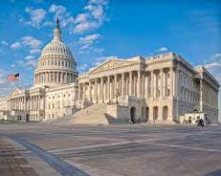
Tabernacle/Temple
Judicial System- Enforcing Yehovah’s Law
Government-
Legislative- Congress

Slide 83
Isa 33:22 For Yehovah is our judge, Yehovah is our lawgiver, Yehovah is our king; he will save us.

Slide 84
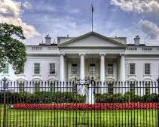
Tabernacle/Temple
Judicial System- Enforcing Yehovah’s Law
Government-
Legislative- Congress
Executive- King

Slide 85
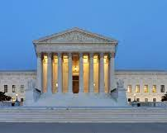
Tabernacle/Temple
Judicial System- Enforcing Yehovah’s Law
Government-
Legislative- Congress
Executive- King
Judicial- Judges

Slide 86
Tabernacle/Temple
Judicial System- Enforcing Yehovah’s Law
Government-
Legislative- Congress
Executive- King
Judicial- Judges
The Truth
Yehovah forbids a legislature

Slide 87
Deu 4:2 “Do not add to the Word which I command you, and do not take away from it,ª so as to guard the commands of יהוה your Elohim which I am commanding you. Footnote: ªSee also Deu_12:32, Pro_30:6, Rev_22:18-19.

Slide 88
Tabernacle/Temple
Judicial System- Enforcing Yehovah’s Law
Government-
Legislative- Congress
Executive- King
Judicial- Judges
The Truth
Yehovah forbids a legislature
A King/President is ok as long as Yehovah chooses

Slide 89
1Sa 8:4 Then all the elders of Israel gathered themselves together, and came to Samuel unto Ramah,
1Sa 8:5 And said unto him, Behold, thou art old, and thy sons walk not in thy ways: now make us a king to judge us like all the nations.
1Sa 8:6 But the thing displeased Samuel, when they said, Give us a king to judge us. And Samuel prayed unto Yehovah.
1Sa 8:7 And Yehovah said unto Samuel, Hearken unto the voice of the people in all that they say unto thee: for they have not rejected thee, but they have rejected me, that I should not reign over them.
Notes:
Just like Israel, America did the same thing and asked for a president and a constitution that makes us think we can change laws

Slide 90
Tabernacle/Temple
Judicial System- Enforcing Yehovah’s Law
Government-
Legislative- Congress
Executive- King
Judicial- Judges
The Truth
Yehovah forbids a legislature
A King/President is ok as long as Yehovah chooses
The Judicial System is Yehovah’s government
It is where justice is given
Notes:
What we sadly practice today is called civil law. It’s supposed to be one law for the judges to rule by

Slide 91
Tabernacle/Temple
Judicial System- Enforcing Yehovah’s Law
Court Policies -20 statutes
You can appeal to higher courts

Slide 92
Exo 18:20 And thou shalt teach them ordinances and laws, and shalt shew them the way wherein they must walk, and the work that they must do.
Exo 18:21 Moreover thou shalt provide out of all the people able men, such as fear God, men of truth, hating covetousness; and place such over them, to be rulers of thousands, and rulers of hundreds, rulers of fifties, and rulers of tens:
Exo 18:22 And let them judge the people at all seasons: and it shall be, that every great matter they shall bring unto thee, but every small matter they shall judge: so shall it be easier for thyself, and they shall bear the burden with thee.
Exo 18:23 If thou shalt do this thing, and God command thee so, then thou shalt be able to endure, and all this people shall also go to their place in peace.
Exo 18:24 So Moses hearkened to the voice of his father in law, and did all that he had said.
Exo 18:25 And Moses chose able men out of all Israel, and made them heads over the people, rulers of thousands, rulers of hundreds, rulers of fifties, and rulers of tens.
Exo 18:26 And they judged the people at all seasons: the hard causes they brought unto Moses, but every small matter they judged themselves.

Slide 93
Tabernacle/Temple
Judicial System- Enforcing Yehovah’s Law
Court Policies -20 statutes
You can appeal to higher courts
There shall be no perjury

Slide 94
Exo 20:16 Thou shalt not bear false witness against thy neighbour.

Slide 95
Tabernacle/Temple
Judicial System- Enforcing Yehovah’s Law
Court Policies -20 statutes
You can appeal to higher courts
There shall be no perjury
An oath of truth shall be given if the matter cannot be resolved

Slide 96
Exo 22:10 If a man deliver unto his neighbour an ass, or an ox, or a sheep, or any beast, to keep; and it die, or be hurt, or driven away, no man seeing it:
Exo 22:11 Then shall an oath of Yehovah be between them both, that he hath not put his hand unto his neighbour's goods; and the owner of it shall accept thereof, and he shall not make it good.

Slide 97
Tabernacle/Temple
Judicial System- Enforcing Yehovah’s Law
Court Policies -20 statutes
You can appeal to higher courts
There shall be no perjury
An oath of truth shall be given if the matter cannot be resolved
Courts will carry out the law for both plaintiff and defendant

Slide 98
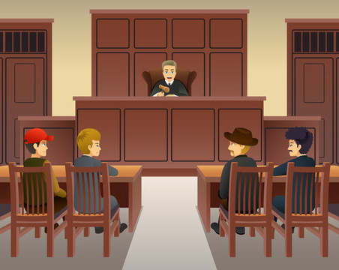
Exo 22:9 For all manner of trespass, whether it be for ox, for ass, for sheep, for raiment, or for any manner of lost thing, which another challengeth to be his, the cause of both parties shall come before the judges; and whom the judges shall condemn, he shall pay double unto his neighbour.

Slide 99
Tabernacle/Temple
Judicial System- Enforcing Yehovah’s Law
Court Policies -20 statutes
You can appeal to higher courts
There shall be no perjury
An oath of truth shall be given if the matter cannot be resolved
Courts will carry out the law for both plaintiff and defendant
Property rights are decided by the courts

Slide 100
Exo 22:9 For all manner of trespass, whether it be for ox, for ass, for sheep, for raiment, or for any manner of lost thing, which another challengeth to be his, the cause of both parties shall come before the judges; and whom the judges shall condemn, he shall pay double unto his neighbour.

Slide 101
Tabernacle/Temple
Judicial System- Enforcing Yehovah’s Law
Court Policies -20 statutes
You can appeal to higher courts
There shall be no perjury
An oath of truth shall be given if the matter cannot be resolved
Courts will carry out the law for both plaintiff and defendant
Property rights are decided by the courts
There shall be no mob punishment

Slide 102
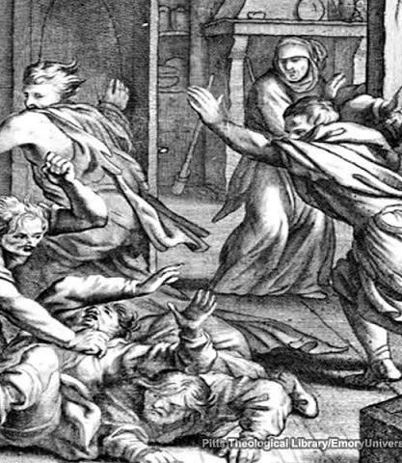
Exo 23:1 Thou shalt not raise a false report: put not thine hand with the wicked to be an unrighteous witness.
Exo 23:2 Thou shalt not follow a multitude to do evil; neither shalt thou speak in a cause to decline after many to wrest judgment:

Slide 103
Tabernacle/Temple
Judicial System- Enforcing Yehovah’s Law
Court Policies -20 statutes
You can appeal to higher courts
There shall be no perjury
An oath of truth shall be given if the matter cannot be resolved
Courts will carry out the law for both plaintiff and defendant
Property rights are decided by the courts
There shall be no mob punishment
All with evidence of knowledge must testify

Slide 104
Lev 5:1 And if a soul sin, and hear the voice of swearing, and is a witness, whether he hath seen or known of it; if he do not utter it, then he shall bear his iniquity.

Slide 105
Tabernacle/Temple
Judicial System- Enforcing Yehovah’s Law
Court Policies -20 statutes
You can appeal to higher courts
There shall be no perjury
An oath of truth shall be given if the matter cannot be resolved
Courts will carry out the law for both plaintiff and defendant
Property rights are decided by the courts
There shall be no mob punishment
All who evidence of knowledge must testify
The guilty can be placed in ward until sentencing

Slide 106
Lev 24:11 And the Israelitish woman's son blasphemed the name of Yehovah, and cursed. And they brought him unto Moses: (and his mother's name was Shelomith, the daughter of Dibri, of the tribe of Dan:)
Lev 24:12 And they put him in ward, that the mind of Yehovah might be shewed them.

Slide 107
Tabernacle/Temple
Judicial System- Enforcing Yehovah’s Law
Court Policies -20 statutes
You can appeal to higher courts
There shall be no perjury
An oath of truth shall be given if the matter cannot be resolved
Courts will carry out the law for both plaintiff and defendant
Property rights are decided by the courts
There shall be no mob punishment
All who evidence of knowledge must testify
The guilty can be placed in ward until sentencing
The congregation/jury of the people will judge criminal cases

Slide 108
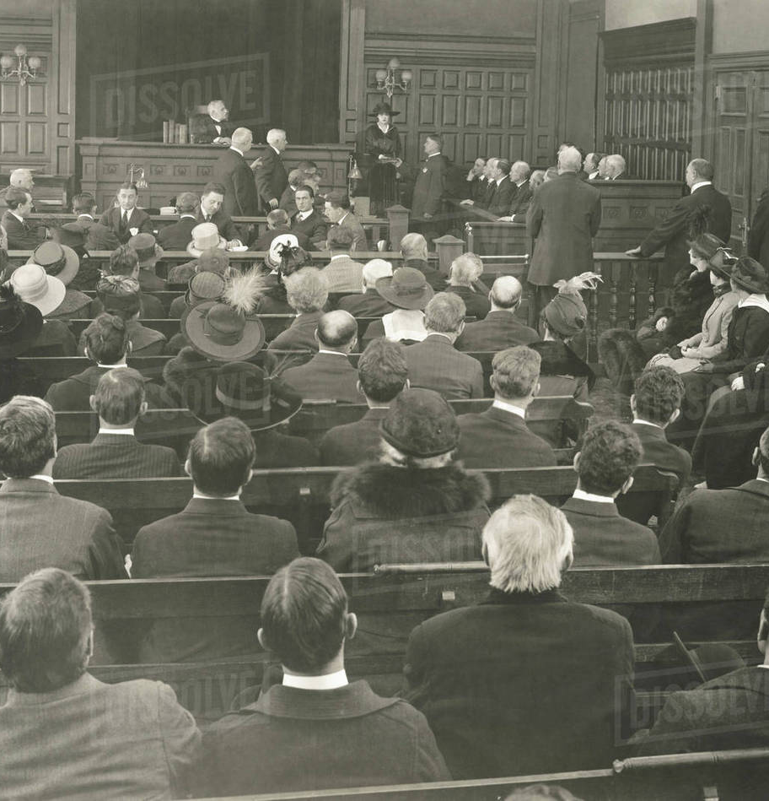
Num 35:12 And they shall be unto you cities for refuge from the avenger; that the manslayer die not, until he stand before the congregation in judgment.

Slide 109
Tabernacle/Temple
Judicial System- Enforcing Yehovah’s Law
Court Policies -20 statutes
You can appeal to higher courts
There shall be no perjury
An oath of truth shall be given if the matter cannot be resolved
Courts will carry out the law for both plaintiff and defendant
Property rights are decided by the courts
There shall be no mob punishment
All who evidence of knowledge must testify
The guilty can be placed in ward until sentencing
The congregation/jury of the people will judge criminal cases
The witness shall be first to lay hands on the guilty

Slide 110
Deu 17:6 At the mouth of two witnesses, or three witnesses, shall he that is worthy of death be put to death; but at the mouth of one witness he shall not be put to death.
Deu 17:7 The hands of the witnesses shall be first upon him to put him to death, and afterward the hands of all the people. So thou shalt put the evil away from among you.

Slide 111
Tabernacle/Temple
Judicial System- Enforcing Yehovah’s Law
Court Policies -20 statutes
Punishment can be executed by the men of the city

Slide 112
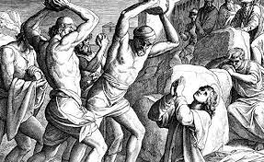
Deu 17:7 The hands of the witnesses shall be first upon him to put him to death, and afterward the hands of all the people. So thou shalt put the evil away from among you.

Slide 113
Tabernacle/Temple
Judicial System- Enforcing Yehovah’s Law
Court Policies -20 statutes
Punishment can be executed by the men of the city
Act according to the rules of the judges

Slide 114
Deu 17:10 And thou shalt do according to the sentence, which they of that place which Yehovah shall choose shall shew thee; and thou shalt observe to do according to all that they inform thee:
Deu 17:11 According to the sentence of the law which they shall teach thee, and according to the judgment which they shall tell thee, thou shalt do: thou shalt not decline from the sentence which they shall shew thee, to the right hand, nor to the left.

Slide 115
Tabernacle/Temple
Judicial System- Enforcing Yehovah’s Law
Court Policies -20 statutes
Punishment can be executed by the men of the city
Act according to the rules of the judges
Our MESSIAH provided an example

Slide 116
Mat 23:1 Then spake Yeshua to the multitude, and to his disciples,
Mat 23:2 Saying, The scribes and the Pharisees sit in Moses' seat:
Mat 23:3 All therefore whatsoever they bid you observe, that observe and do; but do not ye after their works: for they say, and do not.

Slide 117
Tabernacle/Temple
Judicial System- Enforcing Yehovah’s Law
Court Policies -20 statutes
Punishment can be executed by the men of the city
Act according to the rules of the judges
There is no contempt of court

Slide 118
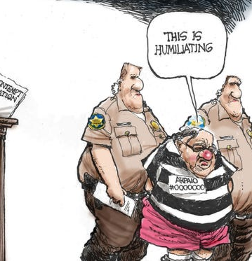
Deu 17:12 And the man that will do presumptuously, and will not hearken unto the priest that standeth to minister there before Yehovah thy Elohim, or unto the judge, even that man shall die: and thou shalt put away the evil from Israel.
Deu 17:13 And all the people shall hear, and fear, and do no more presumptuously.

Slide 119
Tabernacle/Temple
Judicial System- Enforcing Yehovah’s Law
Court Policies -20 statutes
Punishment can be executed by the men of the city
Act according to the rules of the judges
There is no contempt of court
No pity is to be given in the act of punishment

Slide 120
Deu 19:13 Thine eye shall not pity him, but thou shalt put away the guilt of innocent blood from Israel, that it may go well with thee.
Deu 19:21 And thine eye shall not pity; but life shall go for life, eye for eye, tooth for tooth, hand for hand, foot for foot.

Slide 121
Tabernacle/Temple
Judicial System- Enforcing Yehovah’s Law
Court Policies -20 statutes
Punishment can be executed by the men of the city
Act according to the rules of the judges
There is no contempt of court
No pity is to be given in the act of punishment
All testimony is at the mouth of 2 to 3 witnesses

Slide 122
Deu 19:15 One witness shall not rise up against a man for any iniquity, or for any sin, in any sin that he sinneth: at the mouth of two witnesses, or at the mouth of three witnesses, shall the matter be established.

Slide 123
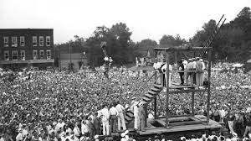
Tabernacle/Temple
Judicial System- Enforcing Yehovah’s Law
Court Policies -20 statutes
Punishment can be executed by the men of the city
Act according to the rules of the judges
There is no contempt of court
No pity is to be given in the act of punishment
All testimony is at the mouth of 2 to 3 witnesses
Punishments are to be public

Slide 124
Deu 17:13 And all the people shall hear, and fear, and do no more presumptuously.

Slide 125
Tabernacle/Temple
Judicial System- Enforcing Yehovah’s Law
Court Policies -20 statutes
Punishment can be executed by the men of the city
Act according to the rules of the judges
There is no contempt of court
No pity is to be given in the act of punishment
All testimony is at the mouth of 2 to 3 witnesses
Punishments are to be public
The body of him who is hanged shall not be overnight. He needs to be buried that day

Slide 126
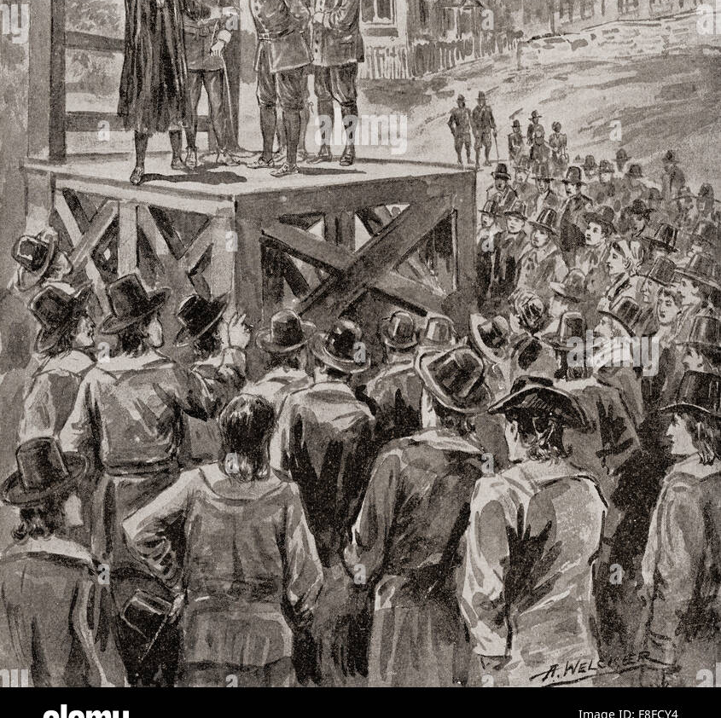
Deu 21:22 And if a man have committed a sin worthy of death, and he be to be put to death, and thou hang him on a tree:
Deu 21:23 His body shall not remain all night upon the tree, but thou shalt in any wise bury him that day; (for he that is hanged is accursed of Yehovah;) that thy land be not defiled, which Yehovah your Elohim giveth thee for an inheritance.

Slide 127
Tabernacle/Temple
Judicial System- Enforcing Yehovah’s Law
Court Policies -20 statutes
Punishment can be executed by the men of the city
Act according to the rules of the judges
There is no contempt of court
No pity is to be given in the act of punishment
All testimony is at the mouth of 2 to 3 witnesses
Punishments are to be public
The body of him who is hanged shall not be overnight. He needs to be buried that day
Each man shall pay for his own sins

Slide 128
Deu 24:16 The fathers shall not be put to death for the children, neither shall the children be put to death for the fathers: every man shall be put to death for his own sin.

Slide 129
Tabernacle/Temple
Judicial System- Enforcing Yehovah’s Law
Court Policies -20 statutes
Punishment can be executed by the men of the city
Act according to the rules of the judges
There is no contempt of court
No pity is to be given in the act of punishment
All testimony is at the mouth of 2 to 3 witnesses
Punishments are to be public
The body of him who is hanged shall not be overnight. He needs to be buried that day
Each man shall pay for his own sins
The aim of the judgements should be to justify the righteous and condemn the wicked

Slide 130
Deu 25:1 If there be a controversy between men, and they come unto judgment, that the judges may judge them; then they shall justify the righteous, and condemn the wicked.
Notes:
Justice system

Slide 131
Tabernacle/Temple
Judicial System- Enforcing Yehovah’s Law
Court Policies -20 statutes
Punishment can be executed by the men of the city
Act according to the rules of the judges
There is no contempt of court
No pity is to be given in the act of punishment
All testimony is at the mouth of 2 to 3 witnesses
Punishments are to be public
The body of him who is hanged shall not be overnight. He needs to be buried that day
Each man shall pay for his own sins
The aim of the judgements should be to justify the righteous and condemn the wicked
A sentence is to be executed speedily

Slide 132
Deu 25:2 And it shall be, if the wicked man be worthy to be beaten, that the judge shall cause him to lie down, and to be beaten before his face, according to his fault, by a certain number.
Deu 25:3 Forty stripes he may give him, and not exceed: lest, if he should exceed, and beat him above these with many stripes, then thy brother should seem vile unto thee.

Slide 133
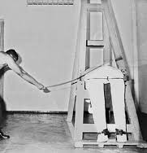
Ezr 7:26 And whosoever will not do the law of Yehovah, and the law of the king, let judgment be executed speedily upon him, whether it be unto death, or to banishment, or to confiscation of goods, or to imprisonment.

Slide 134
Tabernacle/Temple
Judicial System- Enforcing Yehovah’s Law
Judges
Shall judge according to the statutes and judgements of Yehovah
Notes:
Plumb line

Slide 135
Exo 18:16 When they have a matter, they come unto me; and I judge between one and another, and I do make them know the statutes of Yehovah, and his laws.

Slide 136
Tabernacle/Temple
Judicial System- Enforcing Yehovah’s Law
Judges
Shall judge according to the statutes and judgements of Yehovah
Shall teach the law

Slide 137
Ezr 7:25 And thou, Ezra, after the wisdom of Yehovah, that is in thine hand, set magistrates and judges, which may judge all the people that are beyond the river, all such as know the laws of Yehovah; and teach ye them that know them not.
Notes:
We call this a court opinion

Slide 138
Tabernacle/Temple
Judicial System- Enforcing Yehovah’s Law
Judges
Shall judge according to the statutes and judgements of Yehovah
Shall teach the law
Are to be men of truth, hating covetousness

Slide 139
Exo 18:21 Moreover thou shalt provide out of all the people able men, such as fear God, men of truth, hating covetousness; and place such over them, to be rulers of thousands, and rulers of hundreds, rulers of fifties, and rulers of tens:
Exo 18:22 And let them judge the people at all seasons: and it shall be, that every great matter they shall bring unto thee, but every small matter they shall judge: so shall it be easier for thyself, and they shall bear the burden with thee.

Slide 140
Tabernacle/Temple
Judicial System- Enforcing Yehovah’s Law
Judges
Shall judge according to the statutes and judgements of Yehovah
Shall teach the law
Are to be men of truth, hating covetousness
They are to be appointed

Slide 141
Deu 1:13 Take you wise men, and understanding, and known among your tribes, and I will make them rulers over you.
Deu 1:14 And ye answered me, and said, The thing which thou hast spoken is good for us to do.
Deu 1:15 So I took the chief of your tribes, wise men, and known, and made them heads over you, captains over thousands, and captains over hundreds, and captains over fifties, and captains over tens, and officers among your tribes.

Slide 142
Tabernacle/Temple
Judicial System- Enforcing Yehovah’s Law
Judges
Shall judge according to the statutes and judgements of Yehovah
Shall teach the law
Are to be men of truth, hating covetousness
They are to be appointed
Shall judge the people at all times

Slide 143
Exo 18:21 Moreover thou shalt provide out of all the people able men, such as fear God, men of truth, hating covetousness; and place such over them, to be rulers of thousands, and rulers of hundreds, rulers of fifties, and rulers of tens:
Exo 18:22 And let them judge the people at all seasons: and it shall be, that every great matter they shall bring unto thee, but every small matter they shall judge: so shall it be easier for thyself, and they shall bear the burden with thee.

Slide 144
Tabernacle/Temple
Judicial System- Enforcing Yehovah’s Law
Judges
Shall judge according to the statutes and judgements of Yehovah
Shall teach the law
Are to be men of truth, hating covetousness
They are to be appointed
Shall judge the people at all times
Must not have mercy for the poor at trial time

Slide 145
Exo 23:2 Thou shalt not follow a multitude to do evil; neither shalt thou speak in a cause to decline after many to wrest judgment:
Exo 23:3 Neither shalt thou countenance a poor man in his cause.

Slide 146
Tabernacle/Temple
Judicial System- Enforcing Yehovah’s Law
Judges
Shall judge according to the statutes and judgements of Yehovah
Shall teach the law
Are to be men of truth, hating covetousness
They are to be appointed
Shall judge the people at all times
Must not have mercy for the poor at trial time
Shall judge the poor and needy righteously

Slide 147
Exo 23:6 Thou shalt not wrest the judgment of thy poor in his cause.

Slide 148
Tabernacle/Temple
Judicial System- Enforcing Yehovah’s Law
Judges
Shall judge according to the statutes and judgements of Yehovah
Shall teach the law
Are to be men of truth, hating covetousness
They are to be appointed
Shall judge the people at all times
Must not have mercy for the poor at trial time
Shall judge then poor and needy righteously
Must not take bribes

Slide 149
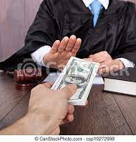
Exo 23:8 And thou shalt take no gift: for the gift blindeth the wise, and perverteth the words of the righteous.

Slide 150
Tabernacle/Temple
Judicial System- Enforcing Yehovah’s Law
Judges
Shall judge according to the statutes and judgements of Yehovah
Shall teach the law
Are to be men of truth, hating covetousness
They are to be appointed
Shall judge the people at all times
Must not have mercy for the poor at trial time
Shall judge then poor and needy righteously
Must not take bribes
They are to know the Laws of Yehovah

Slide 151
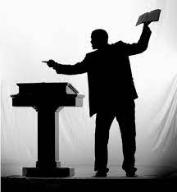
Lev 10:11 And that ye may teach the children of Israel all the statutes which Yehovah hath spoken unto them by the hand of Moses.
Ezr 7:25 And thou, Ezra, after the wisdom of thy God, that is in thine hand, set magistrates and judges, which may judge all the people that are beyond the river, all such as know the laws of Yehovah; and teach ye them that know them not.
Ezr 7:26 And whosoever will not do the law of Yehovah, and the law of the king, let judgment be executed speedily upon him, whether it be unto death, or to banishment, or to confiscation of goods, or to imprisonment.

Slide 152
Tabernacle/Temple
Judicial System- Enforcing Yehovah’s Law
Judges
Shall be no respecter of persons

Slide 153
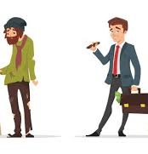
Lev 19:15 Ye shall do no unrighteousness in judgment: thou shalt not respect the person of the poor, nor honour the person of the mighty: but in righteousness shalt thou judge thy neighbour.

Slide 154
Tabernacle/Temple
Judicial System- Enforcing Yehovah’s Law
Judges
Shall be no respecter of persons
They are to judge righteously

Slide 155
Lev 19:15 Ye shall do no unrighteousness in judgment: thou shalt not respect the person of the poor, nor honour the person of the mighty: but in righteousness shalt thou judge thy neighbour.

Slide 156
Tabernacle/Temple
Judicial System- Enforcing Yehovah’s Law
Judges
Shall be no respecter of persons
They are to judge righteously
They shall not fear men in judgement

Slide 157
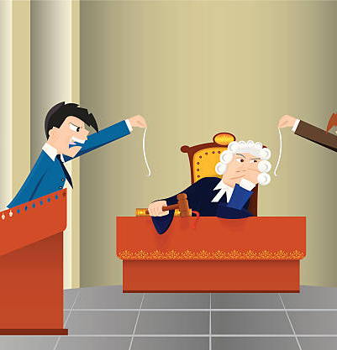
Deu 1:17 Ye shall not respect persons in judgment; but ye shall hear the small as well as the great; ye shall not be afraid of the face of man; for the judgment is God's: and the cause that is too hard for you, bring it unto me, and I will hear it.

Slide 158
Tabernacle/Temple
Judicial System- Enforcing Yehovah’s Law
Judges
Shall be no respecter of persons
They are to judge righteously
They shall not fear men in judgement
They shall make diligent investigations in all cases

Slide 159
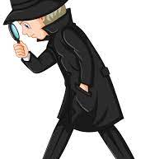
Deu 13:14 Then shalt thou enquire, and make search, and ask diligently; and, behold, if it be truth, and the thing certain, that such abomination is wrought among you;
Deu 13:15 Thou shalt surely smite the inhabitants of that city with the edge of the sword, destroying it utterly, and all that is therein, and the cattle thereof, with the edge of the sword.

Slide 160
Tabernacle/Temple
Judicial System- Enforcing Yehovah’s Law
Judges
Shall be no respecter of persons
They are to judge righteously
They shall not fear men in judgement
They shall make diligent investigations in all cases
They must not pervert cases involving foreigners or orphans

Slide 161
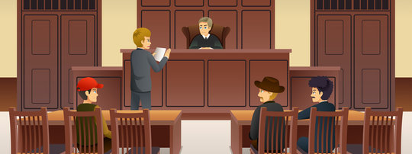
Deu 24:17 Thou shalt not pervert the judgment of the stranger, nor of the fatherless; nor take a widow's raiment to pledge:

Slide 162
Tabernacle/Temple
Judicial System- Enforcing Yehovah’s Law
Judges
Shall be no respecter of persons
They are to judge righteously
They shall not fear men in judgement
They shall make diligent investigations in all cases
They must not pervert cases involving foreigners or orphans
Judges are established by Yehovah

Slide 163
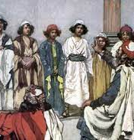
Jdg 2:16 Nevertheless Yehovah raised up judges, which delivered them out of the hand of those that spoiled them.
Jdg 2:17 And yet they would not hearken unto their judges, but they went a whoring after other gods, and bowed themselves unto them: they turned quickly out of the way which their fathers walked in, obeying the commandments of Yehovah ; but they did not so.
Jdg 2:18 And when Yehovah raised them up judges, then Yehovah was with the judge, and delivered them out of the hand of their enemies all the days of the judge: for it repented Yehovah because of their groanings by reason of them that oppressed them and vexed them.

Slide 164
Tabernacle/Temple
Judicial System- Enforcing Yehovah’s Law
This government consists of the Levitical and Aaronic Priesthood

Slide 165
Tabernacle/Temple
Judicial System- Enforcing Yehovah’s Law
Priesthood
Aaronic Priesthood

Slide 166
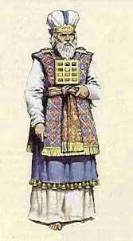
Exo 27:21 In the tabernacle of the congregation without the vail, which is before the testimony, Aaron and his sons shall order it from evening to morning before Yehovah: it shall be a statute for ever unto their generations on the behalf of the children of Israel.

Slide 167
Tabernacle/Temple
Judicial System- Enforcing Yehovah’s Law
Priesthood
Aaronic Priesthood
Comes from Aaron
Levitical Priesthood
Rest of the family of Levi

Slide 168
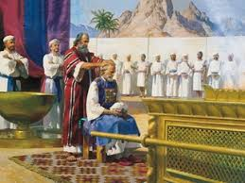
Num 1:50 But thou shalt appoint the Levites over the tabernacle of testimony, and over all the vessels thereof, and over all things that belong to it: they shall bear the tabernacle, and all the vessels thereof; and they shall minister unto it, and shall encamp round about the tabernacle.
Num 1:53 But the Levites shall pitch round about the tabernacle of testimony, that there be no wrath upon the congregation of the children of Israel: and the Levites shall keep the charge of the tabernacle of testimony.

Slide 169
Tabernacle/Temple
Judicial System- Enforcing Yehovah’s Law
Priesthood
Aaronic Priesthood
Federal Courts
Levitical Priesthood
Lower Courts spread throughout the land
High Priest
Succession from Aaron
Notes:
The Levites were the lower courts and Aaron had the federal/upper courts

Slide 170
Exo 30:10 And Aaron shall make an atonement upon the horns of it once in a year with the blood of the sin offering of atonements: once in the year shall he make atonement upon it throughout your generations: it is most holy unto Yehovah.

Slide 171
Tabernacle/Temple
Judicial System- Enforcing Yehovah’s Law
Priesthood
Aaronic Priesthood- 22 statutes
Aaron and sons shall hold office of Priest
Notes:
So the Aaronic priest worked the Holy Place and the high priest worked the Holy of Holies while the Levites had the rest of the duties

Slide 172
Exo 29:9 And thou shalt gird them with girdles, Aaron and his sons, and put the bonnets on them: and the priest's office shall be theirs for a perpetual statute: and thou shalt consecrate Aaron and his sons.

Slide 173
Tabernacle/Temple
Judicial System- Enforcing Yehovah’s Law
Priesthood
Aaronic Priesthood- 22 statutes
Aaron and sons shall hold office of Priest
Priest shall keep charge of the Tabernacle
Notes:
So the Aaronic priest worked the Holy Place and the high priest worked the Holy of Holies while the Levites had the rest of the duties

Slide 174
Exo 27:21 In the tabernacle of the congregation without the vail, which is before the testimony, Aaron and his sons shall order it from evening to morning before Yehovah: it shall be a statute for ever unto their generations on the behalf of the children of Israel.

Slide 175
Tabernacle/Temple
Judicial System- Enforcing Yehovah’s Law
Priesthood
Aaronic Priesthood- 22 statutes
Aaron and sons shall hold office of Priest
Priest shall keep charge of the Tabernacle
Priest must wear priestly garments

Slide 176
Exo 28:1 And take thou unto thee Aaron thy brother, and his sons with him, from among the children of Israel, that he may minister unto me in the priest's office, even Aaron, Nadab and Abihu, Eleazar and Ithamar, Aaron's sons.
Exo 28:2 And thou shalt make holy garments for Aaron and thy brother for glory and for beauty.
Exo 28:3 And thou shalt speak unto all that are wise hearted, whom I have filled with the spirit of wisdom, that they may make Aaron's garments to consecrate him, that he may minister unto me in the priest's office.

Slide 177
Tabernacle/Temple
Judicial System- Enforcing Yehovah’s Law
Priesthood
Aaronic Priesthood- 22 statutes
Aaron and sons shall hold office of Priest
Priest shall keep charge of the Tabernacle
Priest must wear priestly garments
Garments contain a breastplate, ephod, robe, broidered coat, mitre and girdle

Slide 178
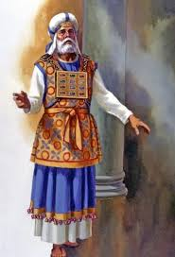
Exo 28:4 And these are the garments which they shall make; a breastplate, and an ephod, and a robe, and a broidered coat, a mitre, and a girdle: and they shall make holy garments for Aaron thy brother, and his sons, that he may minister unto me in the priest's office.
Exo 28:5 And they shall take gold, and blue, and purple, and scarlet, and fine linen.

Slide 179
Tabernacle/Temple
Judicial System- Enforcing Yehovah’s Law
Priesthood
Aaronic Priesthood- 22 statutes
Aaron and sons shall hold office of Priest
Priest shall keep charge of the Tabernacle
Priest must wear priestly garments
Garments contain a breastplate, ephod, robe, broidered coat, mitre and girdle
The ephod shall be made of gold with blue, purple and scarlet of fine twined linen
The girdle shall be made of gold with blue, purple and scarlet of fine twined linen
The names of the twelve tribes shall be on the 2 onyx stones set in gold on the ephod

Slide 180
Exo 28:9 And thou shalt take two onyx stones, and grave on them the names of the children of Israel:
Exo 28:10 Six of their names on one stone, and the other six names of the rest on the other stone, according to their birth.
Exo 28:11 With the work of an engraver in stone, like the engravings of a signet, shalt thou engrave the two stones with the names of the children of Israel: thou shalt make them to be set in ouches of gold.
Exo 28:12 And thou shalt put the two stones upon the shoulders of the ephod for stones of memorial unto the children of Israel: and Aaron shall bear their names before the LORD upon his two shoulders for a memorial.

Slide 181
Tabernacle/Temple
Judicial System- Enforcing Yehovah’s Law
Priesthood
Offerings- All of Leviticus chapter 8
Sin Offering
One young bullock
Burnt Offering
One ram
Wave Offering
Unleavened Bread, unleavened cakes, oiled bread, wafer, and right shoulder
New priests are to be anointed, consecrated, and sanctified for seven days

Slide 182
Exo 29:33 And they shall eat those things wherewith the atonement was made, to consecrate and to sanctify them: but a stranger shall not eat thereof, because they are holy.
Exo 29:34 And if ought of the flesh of the consecrations, or of the bread, remain unto the morning, then thou shalt burn the remainder with fire: it shall not be eaten, because it is holy.
Exo 29:35 And thus shalt thou do unto Aaron, and to his sons, according to all things which I have commanded thee: seven days shalt thou consecrate them.
Exo 29:36 And thou shalt offer every day a bullock for a sin offering for atonement: and thou shalt cleanse the altar, when thou hast made an atonement for it, and thou shalt anoint it, to sanctify it.
Exo 29:37 Seven days thou shalt make an atonement for the altar, and sanctify it; and it shall be an altar most holy: whatsoever toucheth the altar shall be holy.

Slide 183
Tabernacle/Temple
Judicial System- Enforcing Yehovah’s Law
Priesthood
Offerings- All of Leviticus chapter 8
Sin Offering
One young bullock
Burnt Offering
One ram
Wave Offering
Unleavened Bread, unleavened cakes, oiled bread, wafer, and right shoulder
New priests are to be anointed, consecrated, and sanctified for seven days
Wash before service

Slide 184
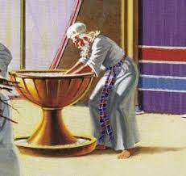
Exo 30:18 Thou shalt also make a laver of brass, and his foot also of brass, to wash withal: and thou shalt put it between the tabernacle of the congregation and the altar, and thou shalt put water therein.
Exo 30:19 For Aaron and his sons shall wash their hands and their feet thereat:
Exo 30:20 When they go into the tabernacle of the congregation, they shall wash with water, that they die not; or when they come near to the altar to minister, to burn offering made by fire unto Yehovah:
Exo 30:21 So they shall wash their hands and their feet, that they die not: and it shall be a statute for ever to them, even to him and to his seed throughout their generations.
Notes:
Don’t you think it’s important for the butcher or doctor to wash after the service they just performed so they don’t die?

Slide 185
Tabernacle/Temple
Judicial System- Enforcing Yehovah’s Law
Priesthood
Offerings- All of Leviticus chapter 8
Sin Offering
One young bullock
Burnt Offering
One ram
Wave Offering
Unleavened Bread, unleavened cakes, oiled bread, wafer, and right shoulder
New priests are to be anointed, consecrated, and sanctified for seven days
Wash before service
Not to drink alcohol before service

Slide 186
Lev 10:9 Do not drink wine nor strong drink, thou, nor thy sons with thee, when ye go into the tabernacle of the congregation, lest ye die: it shall be a statute for ever throughout your generations:
Notes:
I think you want your judge or doctor sober when doing his job

Slide 187
Tabernacle/Temple
Judicial System- Enforcing Yehovah’s Law
Priesthood
Offerings- All of Leviticus chapter 8
Sin Offering
One young bullock
Burnt Offering
One ram
Wave Offering
Unleavened Bread, unleavened cakes, oiled bread, wafer, and right shoulder
New priests are to be anointed, consecrated, and sanctified for seven days
Wash before service
Not to drink alcohol before service
Priests may not defile themselves by visiting the dead unless they are family

Slide 188
Lev 21:1 And Yehovah said unto Moses, Speak unto the priests the sons of Aaron, and say unto them, There shall none be defiled for the dead among his people:
Lev 21:2 But for his kin, that is near unto him, that is, for his mother, and for his father, and for his son, and for his daughter, and for his brother,
Lev 21:3 And for his sister a virgin, that is nigh unto him, which hath had no husband; for her may he be defiled.
Lev 21:4 But he shall not defile himself, being a chief man among his people, to profane himself.

Slide 189
Tabernacle/Temple
Judicial System- Enforcing Yehovah’s Law
Aaronic Priesthood
Must not shave their heads, the corner of beards, cut their flesh
Notes:
I think Yehovah just wants us to look like Him. We’re made in His image are we not?!

Slide 190
Lev 21:5 They shall not make baldness upon their head, neither shall they shave off the corner of their beard, nor make any cuttings in their flesh.

Slide 191
Tabernacle/Temple
Judicial System- Enforcing Yehovah’s Law
Aaronic Priesthood
Must not shave their heads, the corner of beards, cut their flesh
May not marry a prostitute
Notes:
To much drama to be able to perform duties

Slide 192
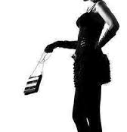
Lev 21:7 They shall not take a wife that is a whore, or profane; neither shall they take a woman put away from her husband: for he is holy unto his God.

Slide 193
Tabernacle/Temple
Judicial System- Enforcing Yehovah’s Law
Aaronic Priesthood
Must not shave their heads, the corner of beards, cut their flesh
May not marry a prostitute
May not marry a widow or divorced woman

Slide 194
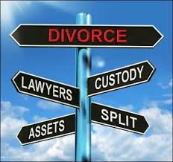
Lev 21:7 They shall not take a wife that is a whore, or profane; neither shall they take a woman put away from her husband: for he is holy unto his God.

Slide 195
Tabernacle/Temple
Judicial System- Enforcing Yehovah’s Law
Aaronic Priesthood
Must not shave their heads, the corner of beards, cut their flesh
May not marry a prostitute
May not marry a widow or divorced woman
Must marry a virgin from Israel

Slide 196
Lev 21:13 And he shall take a wife in her virginity.

Slide 197
Tabernacle/Temple
Judicial System- Enforcing Yehovah’s Law
Aaronic Priesthood
Must not shave their heads, the corner of beards, cut their flesh
May not marry a prostitute
May not marry a widow or divorced woman
Must marry a virgin from Israel
These are all distractions to service
Notes:
I come from a split family and man the drama

Slide 198
Tabernacle/Temple
Judicial System- Enforcing Yehovah’s Law
Aaronic Priesthood
Must not shave their heads, the corner of beards, cut their flesh
May not marry a prostitute
May not marry a widow or divorced woman
Must marry a virgin from Israel
These are all distractions to service
New Testament has similar requirements
Notes:
I come from a split family and man the drama

Slide 199
1Ti 3:2 A bishop then must be blameless, the husband of one wife, vigilant, sober, of good behaviour, given to hospitality, apt to teach;
1Ti 3:3 Not given to wine, no striker, not greedy of filthy lucre; but patient, not a brawler, not covetous;
1Ti 3:4 One that ruleth well his own house, having his children in subjection with all gravity;
1Ti 3:5 (For if a man know not how to rule his own house, how shall he take care of the church of God?)
1Ti 3:6 Not a novice, lest being lifted up with pride he fall into the condemnation of the devil.
1Ti 3:7 Moreover he must have a good report of them which are without; lest he fall into reproach and the snare of the devil.

Slide 200
Tabernacle/Temple
Judicial System- Enforcing Yehovah’s Law
Aaronic Priesthood
Must not shave their heads, the corner of beards, cut their flesh
May not marry a prostitute
May not marry a widow or divorced woman
Must marry a virgin from Israel
Must have a perfect genealogy

Slide 201
Lev 21:15 Neither shall he profane his seed among his people: for I Yehovah do sanctify him.

Slide 202
Tabernacle/Temple
Judicial System- Enforcing Yehovah’s Law
Aaronic Priesthood
Must not shave their heads, the corner of beards, cut their flesh
May not marry a prostitute
May not marry a widow or divorced woman
Must marry a virgin from Israel
Must have a perfect genealogy
May not serve with a blemish

Slide 203
Lev 21:17 Speak unto Aaron, saying, Whosoever he be of thy seed in their generations that hath any blemish, let him not approach to offer the bread of his God.
Lev 21:18 For whatsoever man he be that hath a blemish, he shall not approach: a blind man, or a lame, or he that hath a flat nose, or any thing superfluous,
Lev 21:19 Or a man that is brokenfooted, or brokenhanded,
Lev 21:20 Or crookbackt, or a dwarf, or that hath a blemish in his eye, or be scurvy, or scabbed, or hath his stones broken;
Lev 21:21 No man that hath a blemish of the seed of Aaron the priest shall come nigh to offer the offerings of the LORD made by fire: he hath a blemish; he shall not come nigh to offer the bread of his God.
Lev 21:22 He shall eat the bread of his God, both of the most holy, and of the holy.
Lev 21:23 Only he shall not go in unto the vail, nor come nigh unto the altar, because he hath a blemish; that he profane not my sanctuaries: for I Yehovah do sanctify them.
Notes:
Yehovah doesn’t hate these people, they just can’t fulfill certain duties that’s needed for service

Slide 204
Tabernacle/Temple
Judicial System- Enforcing Yehovah’s Law
Blemishes: Job of the priests- butcher, investigate crime, diagnose the sick, etc.

Slide 205
Tabernacle/Temple
Judicial System- Enforcing Yehovah’s Law
Blemishes: Job of the priests- butcher, investigate crime, diagnose the sick, etc.
Hard to butcher an animal if…

Slide 206
Tabernacle/Temple
Judicial System- Enforcing Yehovah’s Law
Blemishes: Job of the priests- butcher, investigate crime, diagnose the sick, etc.
Hard to butcher an animal if…
You are missing a leg -lame
You have deformed body parts -superfluous
You have a broken foot, hand, or back
Small in stature -dwarf

Slide 207
Tabernacle/Temple
Judicial System- Enforcing Yehovah’s Law
Blemishes: Job of the priests- butcher, investigate crime, diagnose the sick, etc.
Hard to butcher an animal if…
You are missing a leg -lame
You have deformed body parts -superfluous
You have a broken foot, hand, or back
Small in stature -dwarf
Hard to investigate crime if…

Slide 208
Tabernacle/Temple
Judicial System- Enforcing Yehovah’s Law
Blemishes: Job of the priests- butcher, investigate crime, diagnose the sick, etc.
Hard to butcher an animal if…
You are missing a leg -lame
You have deformed body parts -superfluous
You have a broken foot, hand, or back
Small in stature -dwarf
Hard to investigate crime if…
You can’t see -blind
You can’t smell -flat nose

Slide 209
Tabernacle/Temple
Judicial System- Enforcing Yehovah’s Law
Blemishes: Job of the priests- butcher, investigate crime, diagnose the sick, etc.
Hard to butcher an animal if…
You are missing a leg -lame
You have deformed body parts -superfluous
You have a broken foot, hand, or back
Small in stature -dwarf
Hard to investigate crime if…
You can’t see -blind
You can’t smell -flat nose
Hard to diagnose the sick if…

Slide 210
Tabernacle/Temple
Judicial System- Enforcing Yehovah’s Law
Blemishes: Job of the priests- butcher, investigate crime, diagnose the sick, etc.
Hard to butcher an animal if…
You are missing a leg -lame
You have deformed body parts -superfluous
You have a broken foot, hand, or back
Small in stature -dwarf
Hard to investigate crime if…
You can’t see -blind
You can’t smell -flat nose
Hard to diagnose the sick if…
Your sick yourself, scurry or scabbed. All sick were to avoid service

Slide 211
Tabernacle/Temple
Judicial System- Enforcing Yehovah’s Law
Blemishes: Job of the priests- butcher, investigate crime, diagnose the sick, etc.
Hard to butcher an animal if…
You are missing a leg -lame
You have deformed body parts -superfluous
You have a broken foot, hand, or back
Small in stature -dwarf
Hard to investigate crime if…
You can’t see -blind
You can’t smell -flat nose
Hard to diagnose the sick if…
Your sick yourself scurry or scabbed. All sick were to avoid service
Broken stones- lack of testosterone might hinder judgement

Slide 212
Tabernacle/Temple
Judicial System- Enforcing Yehovah’s Law
Blemishes: Job of the priests- butcher, investigate crime, diagnose the sick, etc.
Hard to butcher an animal if…
You are missing a leg -lame
You have deformed body parts -superfluous
You have a broken foot, hand, or back
Small in stature -dwarf
Hard to investigate crime if…
You can’t see -blind
You can’t smell -flat nose
Hard to diagnose the sick if…
Your sick yourself scurry or scabbed. All sick were to avoid service
Broken stones- lack of testosterone might hinder judgement
Yehovah isn’t prejudice this is just reality. They couldn’t serve in the government but are still part of Israel

Slide 213
Tabernacle/Temple
Judicial System- Enforcing Yehovah’s Law
Aaronic Priesthood
Must not shave their heads, the corner of beards, cut their flesh
May not marry a prostitute
May not marry a widow or divorced woman
Must marry a virgin from Israel
Must have a perfect genealogy
May not serve with a blemish
Unclean priests may not serve in the Tabernacle

Slide 214
Lev 22:2 Speak unto Aaron and to his sons, that they separate themselves from the holy things of the children of Israel, and that they profane not my holy name in those things which they hallow unto me: I am Yehovah.
Lev 22:3 Say unto them, Whosoever he be of all your seed among your generations, that goeth unto the holy things, which the children of Israel hallow unto Yehovah, having his uncleanness upon him, that soul shall be cut off from my presence: I am Yehovah.
Lev 22:4 What man soever of the seed of Aaron is a leper, or hath a running issue; he shall not eat of the holy things, until he be clean. And whoso toucheth any thing that is unclean by the dead, or a man whose seed goeth from him;
Lev 22:5 Or whosoever toucheth any creeping thing, whereby he may be made unclean, or a man of whom he may take uncleanness, whatsoever uncleanness he hath;

Slide 215
Tabernacle/Temple
Judicial System- Enforcing Yehovah’s Law
Aaronic Priesthood
Must not shave their heads, the corner of beards, cut their flesh
May not marry a prostitute
May not marry a widow or divorced woman
Must marry a virgin from Israel
Must have a perfect genealogy
May not serve with a blemish
Unclean priests may not serve in the Tabernacle
Unclean priests must wash and wait for evening before returning to service

Slide 216
Lev 22:6 The soul which hath touched any such shall be unclean until even, and shall not eat of the holy things, unless he wash his flesh with water.
Lev 22:7 And when the sun is down, he shall be clean, and shall afterward eat of the holy things; because it is his food.

Slide 217
Tabernacle/Temple
Judicial System- Enforcing Yehovah’s Law
Aaronic Priesthood
Must not shave their heads, the corner of beards, cut their flesh
May not marry a prostitute
May not marry a widow or divorced woman
Must marry a virgin from Israel
Must have a perfect genealogy
May not serve with a blemish
Unclean priests may not serve in the Tabernacle
Unclean priests must wash and wait for evening before returning to service
The priest must bless the nation

Slide 218
Num 6:23 “Speak to Aharon and his sons, saying, ‘This is how you bless the children of Yisra’ěl. Say to them:
Num 6:24 “יהוה bless you and guard you;
Num 6:25 יהוה make His face shine upon you, and show favour to you;
Num 6:26 יהוה lift up His face upon you, and give you peace.” ’
Num 6:27 “Thus they shall put My Name on the children of Yisra’ěl, and I Myself shall bless them.”

Slide 219
Tabernacle/Temple
Judicial System- Enforcing Yehovah’s Law
Aaronic Priesthood
Must not shave their heads, the corner of beards, cut their flesh
May not marry a prostitute
May not marry a widow or divorced woman
Must marry a virgin from Israel
Must have a perfect genealogy
May not serve with a blemish
Unclean priests may not serve in the Tabernacle
Unclean priests must wash and wait for evening before returning to service
The priest must bless the nation
Priests are to perform services at the alter in the sanctuary

Slide 220
Num 18:7 “But you and your sons with you are to guard your priesthood for all matters at the slaughter-place and behind the veil, and you shall serve. I have given you the priesthood as a gift for service, but the stranger who comes near is put to death.”

Slide 221
Tabernacle/Temple
Judicial System- Enforcing Yehovah’s Law
Aaronic Priesthood
Must not shave their heads, the corner of beards, cut their flesh
May not marry a prostitute
May not marry a widow or divorced woman
Must marry a virgin from Israel
Must have a perfect genealogy
May not serve with a blemish
Unclean priests may not serve in the Tabernacle
Unclean priests must wash and wait for evening before returning to service
The priest must bless the nation
Priests are to perform services at the alter in the sanctuary
A stranger/foreigner who serves shall be put to death

Slide 222
Num 3:10 “And appoint Aharon and his sons, and they shall guard their priesthood. And the stranger who comes near shall be put to death.”

Slide 223
Stranger ge’yr H1616
A guest; by implication a foreigner: -alien, sojourner, stranger.”
Stranger zu’r H2114
To turn aside, to be a foreigner, stranger, profane; to commit adultery:”
Stranger ne’ka’r H5236
Foreign, a foreigner, or heathendom: -alien, strange

Slide 224
Tabernacle/Temple
Judicial System- Enforcing Yehovah’s Law
Aaronic Priesthood
Must not shave their heads, the corner of beards, cut their flesh
May not marry a prostitute
May not marry a widow or divorced woman
Must marry a virgin from Israel
Must have a perfect genealogy
May not serve with a blemish
Unclean priests may not serve in the Tabernacle
Unclean priests must wash and wait for evening before returning to service
The priest must bless the nation
Priests are to perform services at the alter in the sanctuary
A stranger/foreigner who serves shall be put to death
Priests are to teach the law of Yehovah

Slide 225
Lev 10:8 And יהוה spoke to Aharon, saying,
Lev 10:9 “Do not drink wine or strong drink, you, nor your sons with you, when you go into the Tent of Appointment, lest you die – a law forever throughout your generations,
Lev 10:10 so as to make a distinction between the set-apart and the profane, and between the unclean and the clean,
Lev 10:11 and to teach the children of Yisra’ěl all the laws which יהוה has spoken to them by the hand of Mosheh.”

Slide 226
Tabernacle/Temple
Judicial System- Enforcing Yehovah’s Law
Levitical Priesthood

Slide 227
Tabernacle/Temple
Judicial System- Enforcing Yehovah’s Law
Levitical Priesthood
Levites must work in the Tabernacle

Slide 228
Num 1:49 “Only the tribe of Lěwi you do not register, nor take a census of them among the children of Yisra’ěl.
Num 1:50 “Instead, appoint the Lěwites over the Dwelling Place of the Witness, over all its furnishings, and over all that belongs to it. They bear the Dwelling Place and all its furnishings, and they attend to it, and camp around the Dwelling Place.

Slide 229
Tabernacle/Temple
Judicial System- Enforcing Yehovah’s Law
Levitical Priesthood
Levites must work in the Tabernacle
Maraite Levites are responsible to move the tabernacle poles, boards, sockets, pillars and bars

Slide 230
Num 3:36 And the appointed duty of the children of Merari was the boards of the Dwelling Place, and its bars, and its columns, and its sockets, and its utensils, and all its service,

Slide 231
Tabernacle/Temple
Judicial System- Enforcing Yehovah’s Law
Levitical Priesthood
Levites must work in the Tabernacle
Maraite Levites are responsible to move the Tabernacle poles, boards, sockets, pillars and bars
Kohath Levites are responsible to move the ark and furniture of the Tabernacle

Slide 232
Num 4:4 “This is the service of the sons of Kohath in the Tent of Appointment, the most set-apart matters:
Num 4:5 “At the breaking of camp, Aharon and his sons shall come, and they shall take down the covering veil and cover the ark of the Witness with it,
Num 4:6 and shall put on it a covering of fine leather, and spread over that an all-blue wrapper, and shall insert its poles.
Num 4:7 “And on the table of showbread they shall spread a blue wrapper, and shall put on it the dishes, and the ladles, and the bowls, and the jars for pouring, and the showbread on it.
Num 4:8 “And they shall spread over them a scarlet wrapper, and cover the same with a covering of fine leather, and shall insert its poles,
Num 4:9 and shall take a blue wrapper and cover the lampstand of the light, with its lamps, and its snuffers, and its trays, and all its oil vessels, by which they serve it.
Num 4:10 “And they shall put it with all its utensils in a covering of fine leather, and put it on a bar.
Num 4:11 “And over the golden slaughter-place they shall spread a blue wrapper, and cover it with a covering of fine leather, and shall insert its poles,
Num 4:12 and shall take all the utensils of service with which they serve in the set-apart place, and shall put them in a blue wrapper, cover them with a covering of fine leather, and put them on a bar,

Slide 233
Tabernacle/Temple
Judicial System- Enforcing Yehovah’s Law
Levitical Priesthood
Levites must work in the Tabernacle
Maraite Levites are responsible to move the Tabernacle poles, boards, sockets, pillars and bars
Kohath Levites are responsible to move the ark and furniture of the Tabernacle
Gershonite Levites are responsible to move the Tabernacle covers, curtains, screens, and cords

Slide 234
Num 4:24 “This is the service of the clans of the Gěrshonites, in serving and in bearing burdens:
Num 4:25 “And they shall bear the curtains of the Dwelling Place and the Tent of Appointment with its covering, the covering of fine leather that is on it, the covering for the door of the Tent of Appointment,
Num 4:26 and the screens of the courtyard and the covering for the door of the gate of the courtyard, which is around the Dwelling Place and slaughter-place, and their cords, all the equipment for their service and all that is made for them – so shall they serve.

Slide 235
Tabernacle/Temple
Judicial System- Enforcing Yehovah’s Law
Levitical Priesthood
Levites must work in the Tabernacle
Maraite Levites are responsible to move the Tabernacle poles, boards, sockets, pillars and bars
Kohath Levites are responsible to move the ark and furniture of the Tabernacle
Gershonite Levites are responsible to move the Tabernacle covers, curtains, screens, and cords
Levites are given cities within each tribe and their surrounding suburbs

Slide 236
Num 35:1 And Yehovah spake unto Moses in the plains of Moab by Jordan near Jericho, saying,
Num 35:2 Command the children of Israel, that they give unto the Levites of the inheritance of their possession cities to dwell in; and ye shall give also unto the Levites suburbs for the cities round about them.

Slide 237
Tabernacle/Temple
Judicial System- Enforcing Yehovah’s Law
Levitical Priesthood
Levites must work in the Tabernacle
Maraite Levites are responsible to move the Tabernacle poles, boards, sockets, pillars and bars
Kohath Levites are responsible to move the ark and furniture of the Tabernacle
Gershonite Levites are responsible to move the Tabernacle covers, curtains, screens, and cords
Levites are given cities within each tribe and their surrounding suburbs
These are the lower courts

Slide 238
Tabernacle/Temple
Judicial System- Enforcing Yehovah’s Law
Levitical Priesthood
Levites must work in the Tabernacle
Maraite Levites are responsible to move the Tabernacle poles, boards, sockets, pillars and bars
Kohath Levites are responsible to move the ark and furniture of the Tabernacle
Gershonite Levites are responsible to move the Tabernacle covers, curtains, screens, and cords
Levites are given cities within each tribe and their surrounding suburbs
Levites shall judge between the people

Slide 239
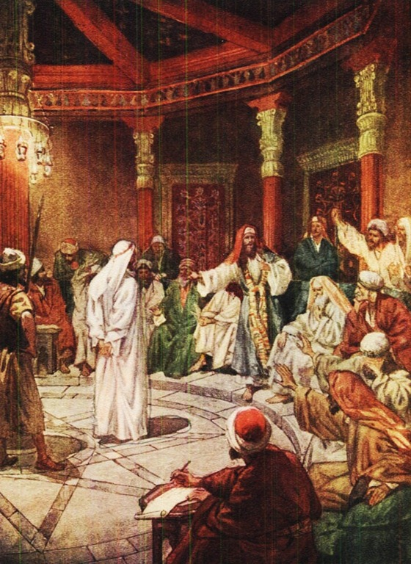
Deu 17:9 And thou shalt come unto the priests the Levites, and unto the judge that shall be in those days, and enquire; and they shall shew thee the sentence of judgment:
Deu 17:10 And thou shalt do according to the sentence, which they of that place which Yehovah shall choose shall shew thee; and thou shalt observe to do according to all that they inform thee:

Slide 240
Tabernacle/Temple
Judicial System- Enforcing Yehovah’s Law
Levitical Priesthood
Levites must work in the Tabernacle
Maraite Levites are responsible to move the Tabernacle poles, boards, sockets, pillars and bars
Kohath Levites are responsible to move the ark and furniture of the Tabernacle
Gershonite Levites are responsible to move the Tabernacle covers, curtains, screens, and cords
Levites are given cities within each tribe and their surrounding suburbs
Levites shall judge between the people
Levites are to posses the written law of Yehovah

Slide 241
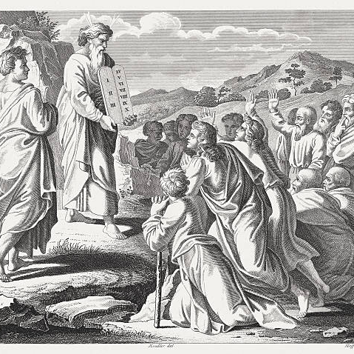
Deu 31:9 And Moses wrote this law, and delivered it unto the priests the sons of Levi, which bare the ark of the covenant of Yehovah, and unto all the elders of Israel.

Slide 242
Tabernacle/Temple
Judicial System- Enforcing Yehovah’s Law
Levitical Priesthood
Levites must work in the Tabernacle
Maraite Levites are responsible to move the Tabernacle poles, boards, sockets, pillars and bars
Kohath Levites are responsible to move the ark and furniture of the Tabernacle
Gershonite Levites are responsible to move the Tabernacle covers, curtains, screens, and cords
Levites are given cities within each tribe and their surrounding suburbs
Levites shall judge between the people
Levites are to posses the written law of Yehovah
Levites are to start service at the age of 20

Slide 243
1Ch 23:24 These were the sons of Levi after the house of their fathers; even the chief of the fathers, as they were counted by number of names by their polls, that did the work for the service of the house of Yehovah, from the age of twenty years and upward.

Slide 244
Tabernacle/Temple
Judicial System- Enforcing Yehovah’s Law
High Priest
Keeps charge of the Holy of Holies

Slide 245
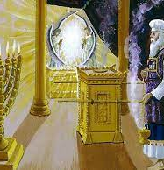
Exo 30:10 And Aaron shall make an atonement upon the horns of it once in a year with the blood of the sin offering of atonements: once in the year shall he make atonement upon it throughout your generations:

Slide 246
Tabernacle/Temple
Judicial System- Enforcing Yehovah’s Law
High Priest
Keeps charge of the Holy of Holies
Offers gifts and sacrifices on the alter

Slide 247
Lev 9:7 And Moses said unto Aaron, Go unto the altar, and offer thy sin offering, and thy burnt offering, and make an atonement for thyself, and for the people: and offer the offering of the people, and make an atonement for them;

Slide 248
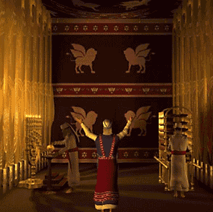
Tabernacle/Temple
Judicial System- Enforcing Yehovah’s Law
High Priest
Keeps charge of the Holy of Holies
Offers gifts and sacrifices on the alter
Cleanses the Tabernacle

Slide 249
Lev 16:16 And he shall make an atonement for the holy place, because of the uncleanness of the children of Israel, and because of their transgressions in all their sins: and so shall he do for the tabernacle of the congregation, that remaineth among them in the midst of their uncleanness.

Slide 250
Tabernacle/Temple
Judicial System- Enforcing Yehovah’s Law
High Priest
Keeps charge of the Holy of Holies
Offers gifts and sacrifices on the alter
Cleanses the Tabernacle
Must not enter the Holy of Holies discriminately

Slide 251
Lev 16:2 And the LORD said unto Moses, Speak unto Aaron thy brother, that he come not at all times into the holy place within the vail before the mercy seat, which is upon the ark; that he die not: for I will appear in the cloud upon the mercy seat.

Slide 252
Tabernacle/Temple
Judicial System- Enforcing Yehovah’s Law
High Priest
Keeps charge of the Holy of Holies
Offers gifts and sacrifices on the alter
Cleanses the Tabernacle
Must not enter the Holy of Holies discriminately
Shall not uncover his head
Shall not tear his clothes

Slide 253
Lev 21:9 And the daughter of any priest, if she profane herself by playing the whore, she profaneth her father: she shall be burnt with fire.
Lev 21:10 And he that is the high priest among his brethren, upon whose head the anointing oil was poured, and that is consecrated to put on the garments, shall not uncover his head, nor rend his clothes;

Slide 254
Tabernacle/Temple
Judicial System- Enforcing Yehovah’s Law
High Priest
Keeps charge of the Holy of Holies
Offers gifts and sacrifices on the alter
Cleanses the Tabernacle
Must not enter the Holy of Holies discriminately
Shall not uncover his head
Shall not tear his clothes
Rueben tore his clothes Gen 37:29
David tore his clothes 2 Sam 1:11

Slide 255
Lev 10:6 And Moses said to Aaron and to Eleazar and Ithamar his sons, “Do not let the hair of your heads hang loose, and do not tear your clothes, lest you die, and wrath come upon all the congregation; but let your brothers, the whole house of Israel, bewail the burning that the LORD has kindled.

Slide 256
Tabernacle/Temple
Judicial System- Enforcing Yehovah’s Law
High Priest
Keeps charge of the Holy of Holies
Offers gifts and sacrifices on the alter
Cleanses the Tabernacle
Must not enter the Holy of Holies discriminately
Shall not uncover his head
Shall not tear his clothes
Must not defile himself with a dead body

Slide 257
Lev 21:11 Neither shall he go in to any dead body, nor defile himself for his father, or for his mother;

Slide 258
Tabernacle/Temple
Judicial System- Enforcing Yehovah’s Law
High Priest
Keeps charge of the Holy of Holies
Offers gifts and sacrifices on the alter
Cleanses the Tabernacle
Must not enter the Holy of Holies discriminately
Shall not uncover his head
Shall not tear his clothes
Must not defile himself with a dead body
Must marry a virgin

Slide 259
Lev 21:13 And he shall take a wife in her virginity.

Slide 260
Tabernacle/Temple
Judicial System- Enforcing Yehovah’s Law
High Priest
Must marry a virgin
Must not marry a widow
Must not marry a divorcee
Must not marry a pagan woman
Must not marry a prostitute
Must marry from his own nation
Must preserve genealogy
Consecrates the Priests

Slide 261
Num 8:10 And thou shalt bring the Levites before Yehovah: and the children of Israel shall put their hands upon the Levites:
Num 8:11 And Aaron shall offer the Levites before Yehovah for an offering of the children of Israel, that they may execute the service of Yehovah.
Num 8:12 And the Levites shall lay their hands upon the heads of the bullocks: and thou shalt offer the one for a sin offering, and the other for a burnt offering, unto the LORD, to make an atonement for the Levites.
Num 8:13 And thou shalt set the Levites before Aaron, and before his sons, and offer them for an offering unto Yehovah.
Num 8:14 Thus shalt thou separate the Levites from among the children of Israel: and the Levites shall be mine.
Num 8:15 And after that shall the Levites go in to do the service of the tabernacle of the congregation: and thou shalt cleanse them, and offer them for an offering.

Slide 262
Tabernacle/Temple
Judicial System- Enforcing Yehovah’s Law
High Priest
Must marry a virgin
Must not marry a widow
Must not marry a divorcee
Must not marry a pagan woman
Must not marry a prostitute
Must marry from his own nation
Must preserve genealogy
Consecrates the Priests
Anoints kings

Slide 263
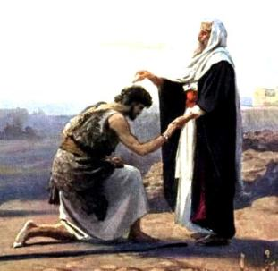
1Ki 1:33 The king also said unto them, Take with you the servants of your lord, and cause Solomon my son to ride upon mine own mule, and bring him down to Gihon:
1Ki 1:34 And let Zadok the priest and Nathan the prophet anoint him there king over Israel: and blow ye with the trumpet, and say, God save king Solomon.

Slide 264
Tabernacle/Temple
Judicial System- Enforcing Yehovah’s Law
High Priest
Must marry a virgin
Must not marry a widow
Must not marry a divorcee
Must not marry a pagan woman
Must not marry a prostitute
Must marry from his own nation
Must preserve genealogy
Consecrates the Priests
Anoints kings
Who administers the Presidents Oath of Office?

Slide 265
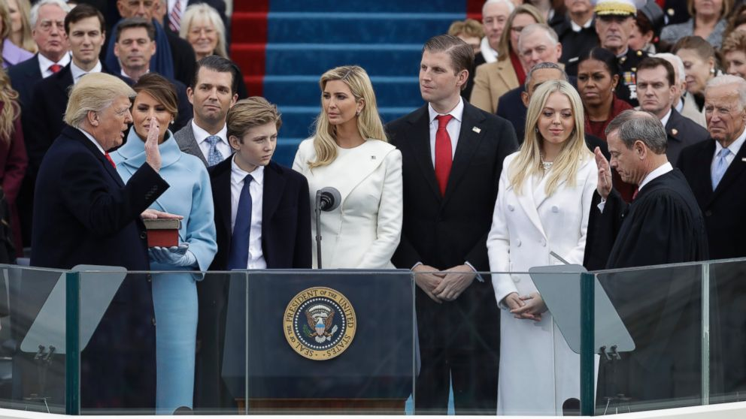
Tabernacle/Temple
Judicial System- Enforcing Yehovah’s Law
High Priest
Must marry a virgin
Must not marry a widiw
Must not marry a divorcee
Must not marry a pagan woman
Must not marry a prostitute
Must marry from his own nation
Must preserve genealogy
Consecrates the Priests
Anoints kings
Who administers the Presidents Oath of Office?
Chief Justice of the Supreme Court

Slide 266
Tabernacle/Temple
Judicial System- Enforcing Yehovah’s Law
How do you become a priest?
You were born into it
Consecrated at the age of 20
Nazarite Vow

Slide 267
Tabernacle/Temple
Judicial System- Enforcing Yehovah’s Law
How do you become a priest?
You were born into it
Consecrated at the age of 20
Nazarite Vow
Holy, or set apart, unto Yehovah

Slide 268
Num 6:8 All the days of his separation he is holy unto Yehovah.

Slide 269
Tabernacle/Temple
Judicial System- Enforcing Yehovah’s Law
Nazarite Vow

Slide 270
Tabernacle/Temple
Judicial System- Enforcing Yehovah’s Law
Nazarite Vow
A vow to serve in the priesthood

Slide 271
Tabernacle/Temple
Judicial System- Enforcing Yehovah’s Law
Nazarite Vow
A vow to serve in the priesthood
Was a temporary service

Slide 272
Tabernacle/Temple
Judicial System- Enforcing Yehovah’s Law
Nazarite Vow
A vow to serve in the priesthood
Was a temporary service
In America we still do the same

Slide 273
Tabernacle/Temple
Judicial System- Enforcing Yehovah’s Law
Nazarite Vow
A vow to serve in the priesthood
Was a temporary service
In America we still do the same
Oath of Office

Slide 274
Tabernacle/Temple
Judicial System- Enforcing Yehovah’s Law
Nazarite Vow
A vow to serve in the priesthood
Was a temporary service
In America we still do the same
Oath of Office
Usually it is temporary (4 year term, 8 year term.)

Slide 275
Tabernacle/Temple
Judicial System- Enforcing Yehovah’s Law
Nazarite Vow -Num 6:1-21
You shall abstain from all alcohol during the vow
You shall not cut your hair during the vow
You shall not touch a dead body during the vow
Broken vow- shave your head the same day and purify yourself according to the law
Upon completion you shall make your offerings at the door of the Taberncle
Upon completion you shall shave your head at the door of the Tabernacle along with your peace offerings

Slide 276
Tabernacle/Temple
Judicial System- Enforcing Yehovah’s Law
How is the Judicial system funded?

Slide 277
Tabernacle/Temple
Judicial System- Enforcing Yehovah’s Law
How is the Judicial system funded?
First Tithe

Slide 278
Tabernacle/Temple
Judicial System- Enforcing Yehovah’s Law
How is the Judicial system funded?
First Tithe
Firstfruits

Slide 279
Tabernacle/Temple
Judicial System- Enforcing Yehovah’s Law
How is the Judicial system funded?
First Tithe
Firstfruits
Firstborn

Slide 280
Tabernacle/Temple
Judicial System- Enforcing Yehovah’s Law
How is the Judicial system funded?
First Tithe
Firstfruits
Firstborn
Head Tax

Slide 281
Tabernacle/Temple
Judicial System- Enforcing Yehovah’s Law
Three Tithes
“Besides those two tithes , which I have said you are to pay every year, the one for the Levites, the other for the Festivals, you are to bring every third year tithe to be distributed to those that want, to women that are widows, and to children that are orphans.”
Josephus, Antiquities of the Jews, Book 4 chapter 8 verses 22-23

Slide 282
Tabernacle/Temple
Judicial System- Enforcing Yehovah’s Law
Tithing: ma’aser- a tenth part

Slide 283
Tabernacle/Temple
Judicial System- Enforcing Yehovah’s Law
Tithing: ma’aser- a tenth part
Yehovah’s financial plan

Slide 284
Tabernacle/Temple
Judicial System- Enforcing Yehovah’s Law
Tithing: ma’aser- a tenth part
Yehovah’s financial plan
1st Tithe- pays for government services

Slide 285
Tabernacle/Temple
Judicial System- Enforcing Yehovah’s Law
Tithing: ma’aser- a tenth part
Yehovah’s financial plan
1st Tithe- pays for government services
2nd Tithe- pays for vacation time

Slide 286
Tabernacle/Temple
Judicial System- Enforcing Yehovah’s Law
Tithing: ma’aser- a tenth part
Yehovah’s financial plan
1st Tithe- pays for government services
2nd Tithe- pays for vacation time
3rd Tithe- pays for workfare

Slide 287
Tabernacle/Temple
Judicial System- Enforcing Yehovah’s Law
First Tithe -7 statutes

Slide 288
Tabernacle/Temple
Judicial System- Enforcing Yehovah’s Law
First Tithe -7 statutes
Tithes are given to the Levites

Slide 289
Num 18:21 And, behold, I have given the children of Levi all the tenth in Israel for an inheritance, for their service which they serve, even the service of the tabernacle of the congregation.

Slide 290
Tabernacle/Temple
Judicial System- Enforcing Yehovah’s Law
First Tithe -7 statutes
Tithes are given to the Levites
A tenth part of all your produce is given

Slide 291
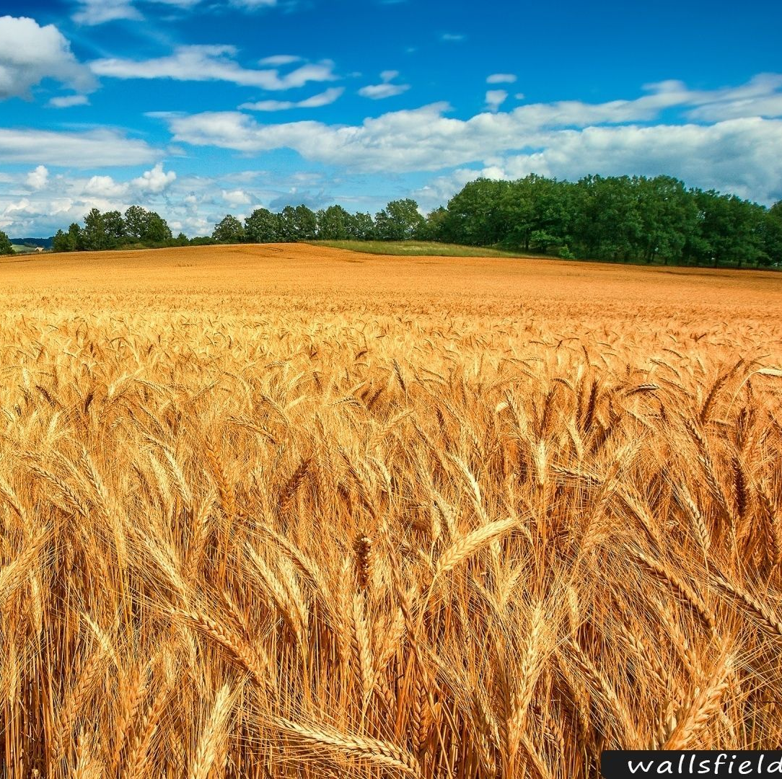
Lev 27:30 And all the tithe of the land, whether of the seed of the land, or of the fruit of the tree, is Yehovah’s: it is holy unto Yehovah.

Slide 292
Tabernacle/Temple
Judicial System- Enforcing Yehovah’s Law
First Tithe -7 statutes
Tithes are given to the Levites
A tenth part of all your produce is given
A tenth part of all your animals is given

Slide 293
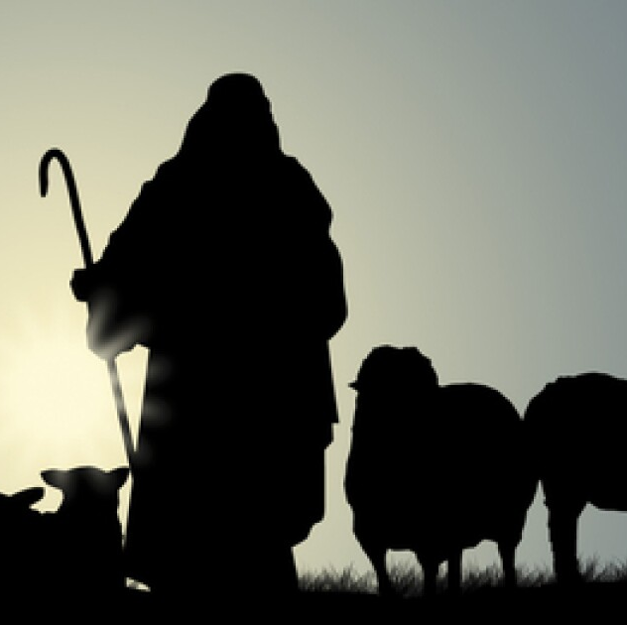
Lev 27:32 And concerning the tithe of the herd, or of the flock, even of whatsoever passeth under the rod, the tenth shall be holy unto Yehovah.

Slide 294
Tabernacle/Temple
Judicial System- Enforcing Yehovah’s Law
First Tithe -7 statutes
Tithes are given to the Levites
A tenth part of all your produce is given
A tenth part of all your animals is given
Only the Priests shall eat the tithe

Slide 295
Lev 22:10 There shall no stranger eat of the holy thing: a sojourner of the priest, or an hired servant, shall not eat of the holy thing.

Slide 296
Tabernacle/Temple
Judicial System- Enforcing Yehovah’s Law
First Tithe -7 statutes
Tithes are given to the Levites
A tenth part of all your produce is given
A tenth part of all your animals is given
Only the Priests shall eat the tithe
If a man wishes to redeem part of his tithe he shall add a fifth part to it

Slide 297
Tabernacle/Temple
Judicial System- Enforcing Yehovah’s Law
First Tithe -7 statutes
Tithes are given to the Levites
A tenth part of all your produce is given
A tenth part of all your animals is given
Only the Priests shall eat the tithe
If a man wishes to redeem part of his tithe he shall add a fifth part to it
If you eat the tithe accidently you shall give one fifth more to the tithe

Slide 298
Lev 27:31 And if a man will at all redeem ought of his tithes, he shall add thereto the fifth part thereof.

Slide 299
Tabernacle/Temple
Judicial System- Enforcing Yehovah’s Law
First Tithe -7 statutes
Tithes are given to the Levites
A tenth part of all your produce is given
A tenth part of all your animals is given
Only the Priests shall eat the tithe
If a man wishes to redeem part of his tithe he shall add a fifth part to it
If you eat the tithe accidently you shall give one fifth more to the tithe

Slide 300
Tabernacle/Temple
Judicial System- Enforcing Yehovah’s Law
First Tithe -7 statutes
Tithes are given to the Levites
A tenth part of all your produce is given
A tenth part of all your animals is given
Only the Priests shall eat the tithe
If a man wishes to redeem part of his tithe he shall add a fifth part to it
If you eat the tithe accidently you shall give one fifth more to the tithe
Pass your animals under the rod to determine the tithe. The tenth is the tithe
The Levites are to give a tenth of the tithes to the Aaronic Priesthood

Slide 301
Num 18:26 Thus speak unto the Levites, and say unto them, When ye take of the children of Israel the tithes which I have given you from them for your inheritance, then ye shall offer up an heave offering of it for Yehovah, even a tenth part of the tithe.
Num 18:27 And this your heave offering shall be reckoned unto you, as though it were the corn of the threshingfloor, and as the fulness of the winepress.
Num 18:28 Thus ye also shall offer an heave offering unto Yehovah of all your tithes, which ye receive of the children of Israel; and ye shall give thereof Yehovah’s heave offering to Aaron the priest.

Slide 302
Tabernacle/Temple
Judicial System- Enforcing Yehovah’s Law
First Tithe -7 statutes
Tithes are given to the Levites
A tenth part of all your produce is given
A tenth part of all your animals is given
Only the Priests shall eat the tithe
If a man wishes to redeem part of his tithe he shall add a fifth part to it
If you eat the tithe accidently you shall give one fifth more to the tithe
Pass your animals under the rod to determine the tithe. The tenth is the tithe
The Levites are to give a tenth of the tithes to the Aaronic Priesthood
Our State Courts give ten percent to the Federal Courts

Slide 303
Luk 18:12 I fast twice a week; I give tithes of all that I get.’
Mat 23:23 “Woe to you, scribes and Pharisees, hypocrites! For you tithe mint and dill and cumin, and have neglected the weightier matters of the law: justice and mercy and faithfulness. These you ought to have done, without neglecting the others.

Slide 304
Tabernacle/Temple
Tithing
Property Tax
Heaven and earth and all there in belongs to Yehovah
Crops
Animals
Property- (Gen 14:20)

Slide 305
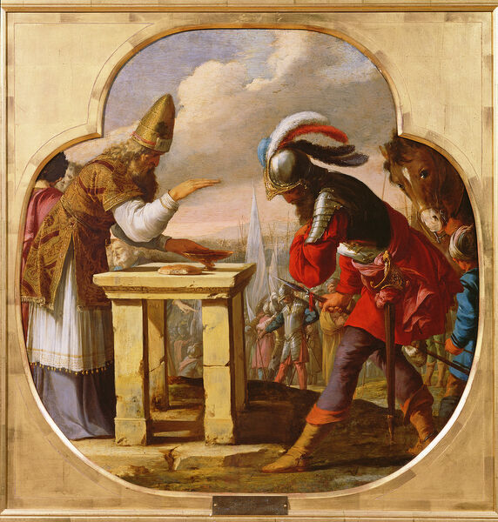
Gen 14:20 and blessed be EL Most High, who has delivered your enemies into your hand!” And Abram gave him a tenth of everything.

Slide 306
Tabernacle/Temple
Tithing
Property Tax- meaning any income
Heaven and earth and all there in belongs to Yehovah
Crops
Animals
Property
Goes to the Levites- Judicial System

Slide 307
Tabernacle/Temple
Judicial System- Enforcing Yehovah’s Law
Firstfruits -5 statutes

Slide 308
Tabernacle/Temple
Judicial System- Enforcing Yehovah’s Law
Firstfruits -5 statutes
All firstfruits of your crops shall be offered to Yehovah

Slide 309
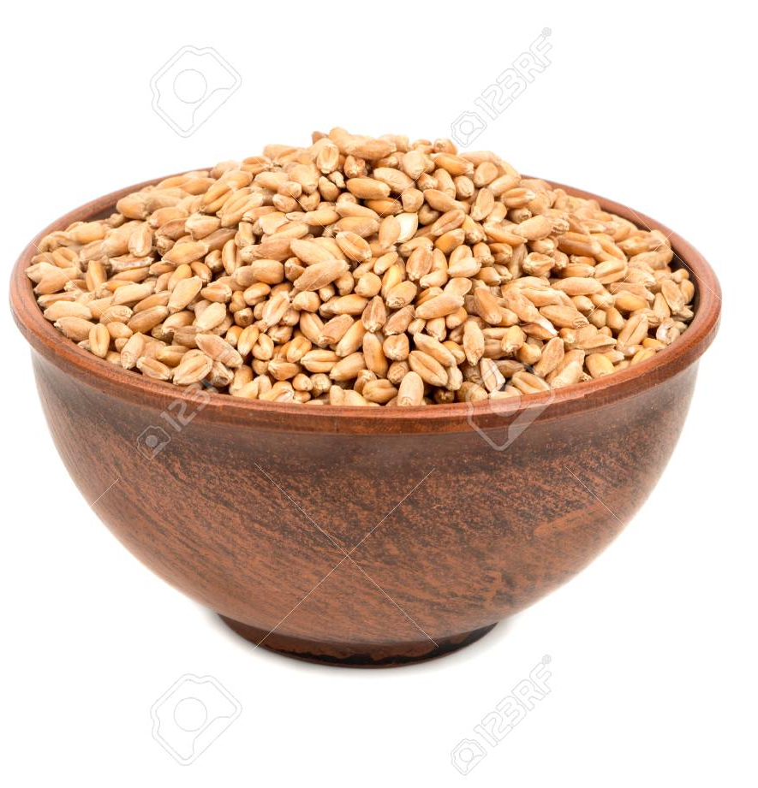
Exo 23:19 “The best of the firstfruits of your ground you shall bring into the house of Yehovah your God.

Slide 310
Tabernacle/Temple
Judicial System- Enforcing Yehovah’s Law
Firstfruits -5 statutes
All firstfruits of your crops shall be offered to Yehovah
The firstfruits of your offering shall not be burnt on the altar

Slide 311
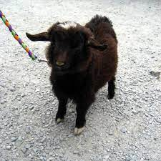
Lev 2:12 As an offering of firstfruits you may bring them to Yehovah, but they shall not be offered on the altar for a pleasing aroma.

Slide 312
Tabernacle/Temple
Judicial System- Enforcing Yehovah’s Law
Firstfruits -5 statutes
All firstfruits of your crops shall be offered to Yehovah
The firstfruits of your offering shall not be burnt on the altar
The firstfruits are for heave and wave offerings as payment to the priests

Slide 313
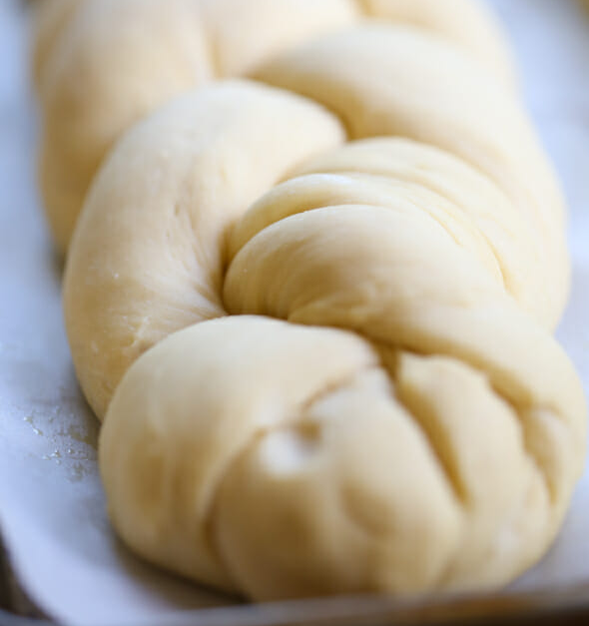
Num 15:20 Of the first of your dough you shall present a loaf as a contribution; like a contribution from the threshing floor, so shall you present it.

Slide 314
Tabernacle/Temple
Judicial System- Enforcing Yehovah’s Law
Firstfruits -5 statutes
All firstfruits of your crops shall be offered to Yehovah
The firstfruits of your offering shall not be burnt on the altar
The firstfruits are for heave and wave offerings as payment to the priests
You shall not eat of your crops until the firstfruits have been offered

Slide 315
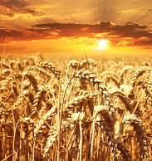
Lev 23:14 And you shall eat neither bread nor grain parched or fresh until this same day, until you have brought the offering of Yehovah: it is a statute forever throughout your generations in all your dwellings.

Slide 316
Tabernacle/Temple
Judicial System- Enforcing Yehovah’s Law
Firstfruits -5 statutes
All firstfruits of your crops shall be offered to Yehovah
The firstfruits of your offering shall not be burnt on the altar
The firstfruits are for heave and wave offerings as payment to the priests
You shall not eat of your crops until the firstfruits have been offered
You shall give the first shearing of sheep to the Priest

Slide 317
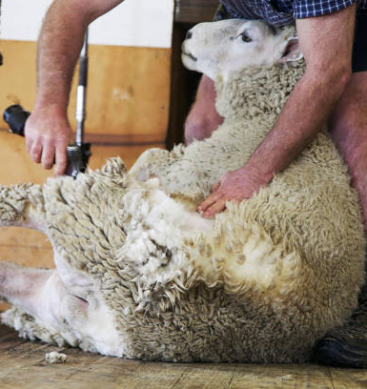
Deu 18:4 The firstfruits of your grain, of your wine and of your oil, and the first fleece of your sheep, you shall give him.

Slide 318
Tabernacle/Temple
Judicial System- Enforcing Yehovah’s Law
Firstborn -8 statutes

Slide 319
Tabernacle/Temple
Judicial System- Enforcing Yehovah’s Law
Firstborn -8 statutes
Firstborn are to be set apart for Yehovah

Slide 320
Exo 13:2 “Consecrate to me all the firstborn. Whatever is the first to open the womb among the people of Israel, both of man and of beast, is mine.”

Slide 321
Tabernacle/Temple
Judicial System- Enforcing Yehovah’s Law
Firstborn -8 statutes
Firstborn are to be set apart for Yehovah
Did Yehovah change this statute and now the Levites are to be accepted as the firstborn?
Most likely because they stood with Moses after the golden calf idolatry

Slide 322
Num 3:12 “Behold, I have taken the Levites from among the people of Israel instead of every firstborn who opens the womb among the people of Israel. The Levites shall be mine,

Slide 323
Tabernacle/Temple
Judicial System- Enforcing Yehovah’s Law
Firstborn -8 statutes
Firstborn are to be set apart for Yehovah
First born males of men are redeemed

Slide 324
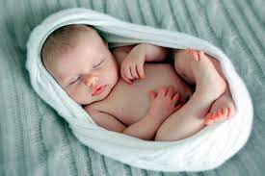
Exo 13:13 Every firstborn of a donkey you shall redeem with a lamb, or if you will not redeem it you shall break its neck. Every firstborn of man among your sons you shall redeem.

Slide 325
Tabernacle/Temple
Judicial System- Enforcing Yehovah’s Law
Firstborn -8 statutes
Firstborn are to be set apart for Yehovah
First born males of men are redeemed
Unclean animals first born are to be redeemed with a lamb

Slide 326
Exo 13:13 Every firstborn of a donkey you shall redeem with a lamb

Slide 327
Tabernacle/Temple
Judicial System- Enforcing Yehovah’s Law
Firstborn -8 statutes
Firstborn are to be set apart for Yehovah
First born males of men are redeemed
Unclean animals first born are to be redeemed with a lamb
The unclean animals neck is to be broken if the owner doesn’t redeem it

Slide 328
Exo 13:13 Every firstborn of a donkey you shall redeem with a lamb, or if you will not redeem it you shall break its neck.

Slide 329
Tabernacle/Temple
Judicial System- Enforcing Yehovah’s Law
Firstborn -8 statutes
Firstborn are to be set apart for Yehovah
First born males of men are redeemed
Unclean animals first born are to be redeemed with a lamb
The unclean animals neck is to be broken if the owner doesn’t redeem it
Redemption price is 5 shekels

Slide 330
Num 18:16 And their redemption price (at a month old you shall redeem them) you shall fix at five shekels in silver, according to the shekel of the sanctuary, which is twenty gerahs.

Slide 331
Tabernacle/Temple
Judicial System- Enforcing Yehovah’s Law
Firstborn -8 statutes
Firstborn are to be set apart for Yehovah
First born males of men are redeemed
Unclean animals first born are to be redeemed with a lamb
The unclean animals neck is to be broken if the owner doesn’t redeem it
Redemption price is 5 shekels
First born clean animals are not to be redeemed

Slide 332
Num 18:17 But the firstborn of a cow, or the firstborn of a sheep, or the firstborn of a goat, you shall not redeem; they are holy. You shall sprinkle their blood on the altar and shall burn their fat as a food offering, with a pleasing aroma to Yehovah.

Slide 333
Tabernacle/Temple
Judicial System- Enforcing Yehovah’s Law
Firstborn -8 statutes
Firstborn are to be set apart for Yehovah
First born males of men are redeemed
Unclean animals first born are to be redeemed with a lamb
The unclean animals neck is to be broken if the owner doesn’t redeem it
Redemption price is 5 shekels
First born clean animals are not to be redeemed
First born clean animals are offered

Slide 334
Num 18:17 But the firstborn of a cow, or the firstborn of a sheep, or the firstborn of a goat, you shall not redeem; they are holy. You shall sprinkle their blood on the altar and shall burn their fat as a food offering, with a pleasing aroma to Yehovah.

Slide 335
Tabernacle/Temple
Judicial System- Enforcing Yehovah’s Law
Firstborn -8 statutes
Firstborn are to be set apart for Yehovah
First born males of men are redeemed
Unclean animals first born are to be redeemed with a lamb
The unclean animals neck is to be broken if the owner doesn’t redeem it
Redemption price is 5 shekels
First born clean animals are not to be redeemed
First born clean animals are offered
You must make the redemption with in one month

Slide 336
Num 18:16 And those that are to be redeemed from a month old shalt thou redeem, according to thine estimation, for the money of five shekels, after the shekel of the sanctuary, which is twenty gerahs.

Slide 337
Tabernacle/Temple
Judicial System- Enforcing Yehovah’s Law
Head Tax -4 statutes

Slide 338
Tabernacle/Temple
Judicial System- Enforcing Yehovah’s Law
Head Tax -4 statutes
Annual payment of a fixed flat weight of half shekel- ½ ounce silver

Slide 339
Exo 30:13 Each one who is numbered in the census shall give this: half a shekel according to the shekel of the sanctuary (the shekel is twenty gerahs), half a shekel as an offering to Yehovah.

Slide 340
Tabernacle/Temple
Judicial System- Enforcing Yehovah’s Law
Head Tax -4 statutes
Annual payment of a fixed flat weight of half shekel- ½ ounce silver
This was always measured by Tabernacle/Temple weights

Slide 341
Exo 30:13 Each one who is numbered in the census shall give this: half a shekel according to the shekel of the sanctuary (the shekel is twenty gerahs), half a shekel as an offering to Yehovah.

Slide 342
Tabernacle/Temple
Judicial System- Enforcing Yehovah’s Law
Head Tax -4 statutes
Annual payment of a fixed flat weight of half shekel- ½ ounce silver
This was always measured by Tabernacle/Temple weights
Every male age 20 or older has to pay

Slide 343
Exo 30:14 Everyone who is numbered in the census, from twenty years old and upward, shall give Yehovah’s offering.

Slide 344
Tabernacle/Temple
Judicial System- Enforcing Yehovah’s Law
Head Tax -4 statutes
Annual payment of a fixed flat weight of half shekel- ½ ounce silver
This was always measured by Tabernacle/Temple weights
Every male age 20 or older has to pay
Used for repair and service to the Tabernacle/Temple

Slide 345
Exo 30:16 You shall take the atonement money from the people of Israel and shall give it for the service of the tent of meeting, that it may bring the people of Israel to remembrance before Yehovah, so as to make atonement for your lives.”

Slide 346
2Ch 24:5 And he gathered the priests and the Levites, and said to them, “Go out to the cities of Juḏah, and gather from all Yisra’ěl silver to repair the House of your Elohim from year to year, and see that you hurry the matter.” But the Levites did not hurry it.
Neh 10:32 And we imposed commands on ourselves, to give from ourselves yearly one-third of a shekel for the service of the House of our Elohim:

Slide 347
Tabernacle/Temple
Judicial System- Enforcing Yehovah’s Law
Funding the Levites

Slide 348
Tabernacle/Temple
Judicial System- Enforcing Yehovah’s Law
Funding the Levites
First Tithe- 10% of all property

Slide 349
Tabernacle/Temple
Judicial System- Enforcing Yehovah’s Law
Funding the Levites
First Tithe- 10% of all property
First Fruits- first harvest of crops

Slide 350
Tabernacle/Temple
Judicial System- Enforcing Yehovah’s Law
Funding the Levites
First Tithe- 10% of all property
First Fruits- first harvest of crops
First born- firstborn males of all

Slide 351
Tabernacle/Temple
Judicial System- Enforcing Yehovah’s Law
Funding the Levites
First Tithe- 10% of all property
First Fruits- first harvest of crops
First born- firstborn males of all
Head Tax- for Tabernacle and Temple repairs

Slide 352
Tabernacle/Temple
Judicial System- Enforcing Yehovah’s Law
Kings -6 statutes

Slide 353
Tabernacle/Temple
Judicial System- Enforcing Yehovah’s Law
Kings -6 statutes
Yehovah will choose

Slide 354
Deu 17:14 “When you come to the land which יהוה your Elohim is giving you, and shall possess it and shall dwell in it, and you shall say, ‘Let me set a sovereign over me like all the nations that are around me,’
Deu 17:15 you shall certainly set a sovereign over you whom יהוה your Elohim shall choose. Set a sovereign over you from among your brothers, you are not allowed to set a foreigner over you, who is not your brother.

Slide 355
Tabernacle/Temple
Judicial System- Enforcing Yehovah’s Law
Kings -6 statutes
Yehovah will choose
The king shall be from your brethren

Slide 356
Deu 17:15 you shall certainly set a sovereign over you whom יהוה your Elohim shall choose. Set a sovereign over you from among your brothers, you are not allowed to set a foreigner over you, who is not your brother.

Slide 357
Tabernacle/Temple
Judicial System- Enforcing Yehovah’s Law
Kings -6 statutes
Yehovah will choose
The king shall be from your brethren
The king shall not multiply horses to himself

Slide 358
Deu 17:16 “Only, he is not to increase horses for himself, nor cause the people to return to Mitsrayim to increase horses, for יהוה has said to you, ‘Do not return that way again.’

Slide 359
Tabernacle/Temple
Judicial System- Enforcing Yehovah’s Law
Kings -6 statutes
Yehovah will choose
The king shall be from your brethren
The king shall not multiply horses to himself
The king shall not multiply wives to himself

Slide 360
Deu 17:17 “And he is not to increase wives for himself, lest his heart turn away, nor is he to greatly increase silver and gold for himself.

Slide 361
Tabernacle/Temple
Judicial System- Enforcing Yehovah’s Law
Kings -6 statutes
Yehovah will choose
The king shall be from your brethren
The king shall not multiply horses to himself
The king shall not multiply wives to himself
The king shall not multiply gold and silver to himself

Slide 362
Deu 17:17 “And he is not to increase wives for himself, lest his heart turn away, nor is he to greatly increase silver and gold for himself.

Slide 363
Tabernacle/Temple
Judicial System- Enforcing Yehovah’s Law
Kings -6 statutes
Yehovah will choose
The king shall be from your brethren
The king shall not multiply horses to himself
The king shall not multiply wives to himself
The king shall not multiply gold and silver to himself
The king shall write a copy of Yehovah’s law for himself and read daily to learn to fear Him

Slide 364
Deu 17:18 “And it shall be, when he sits on the throne of his reign, that he shall write for himself a copy of this Torah in a book, from the one before the priests, the Levites.
Deu 17:19 “And it shall be with him, and he shall read it all the days of his life, so that he learns to fear יהוה his Elohim and guard all the Words of this Torah and these laws, to do them,

Slide 365
Spirit of the Law Today
Temple Advancements
Tabernacle- it was for a small civilization on the move

Slide 366
Spirit of the Law Today
Temple Advancements
Tabernacle- for a small civilization on the move
Solomon’s Temple- was for a permanent civilization settled in the land

Slide 367
Spirit of the Law Today
Temple Advancements
Tabernacle- for a small civilization on the move
Solomon’s Temple- was for a permanent civilization settled in the land
Had many chambers

Slide 368
1Ch 9:26 For these Levites, the four chief porters, were in their set office, and were over the chambers and treasuries of the house of God.

Slide 369
Spirit of the Law Today
Temple Advancements
Tabernacle- for a small civilization on the move
Solomon’s Temple- was for a permanent civilization settled in the land
Had many chambers
Had many High Places

Slide 370
1Sa 7:15 Samuel judged Israel all the days of his life.
1Sa 7:16 And he went on a circuit year by year to Bethel, Gilgal, and Mizpah. And he judged Israel in all these places.
1Sa 7:17 Then he would return to Ramah, for his home was there, and there also he judged Israel. And he built there an altar to Yehovah.

Slide 371
1Sa 9:14 So they went up to the city. As they were entering the city, they saw Samuel coming out toward them on his way up to the high place.

Slide 372
1Ki 3:2 The people were sacrificing at the high places, however, because no house had yet been built for the name of Yehovah.

Slide 373
1Ki 19:10 He said, “I have been very jealous for Yehovah, Elohim of hosts. For the people of Israel have forsaken your covenant, thrown down your altars, and killed your prophets with the sword, and I, even I only, am left, and they seek my life, to take it away.”
This Photo by Unknown Author is licensed under CC BY-SA-NC

Slide 374
Spirit of the Law Today
Temple Advancements
Tabernacle- for a small civilization on the move
Solomon’s Temple- was for a permanent civilization settled in the land
Had many chambers
Had many High Places
United States Temple- Supreme Court
Has many chambers
Has many His Places- Lower Courts
This Photo by Unknown Author is licensed under CC BY-NC

Slide 375
Deu 12:20 “When יהוה your Elohim enlarges your border as He has promised you, and you say, ‘Let me eat meat,’ because you long to eat meat, you eat as much meat as your being desires.
Deu 12:21 “When the place where יהוה your Elohim chooses to put His Name is too far from you, then you shall slaughter from your herd and from your flock which יהוה has given you, as I have commanded you, and you shall eat within your gates as much as your being desires.

Slide 376
Spirit of the Law Today
Temple Advancements
Tabernacle- for a small civilization on the move
Solomon’s Temple- was for a permanent civilization settled in the land
Had many chambers
Had many High Places
United States Temple- Supreme Court
Has many chambers
Has many His Places
America is an extension of Israel

Slide 377
Spirit of the Law Today
Hebrews 7-10
Heb 7:12 For the priesthood being changed, of necessity there takes place a change of law also.
Notes:
Was the Law changed?

Slide 378
Mal 3:6 “For I am יהוה, I shall not change,ª and you, O sons of Ya‛aqoḇ, shall not come to an end.
Heb 13:8 יהושע Messiah is the same yesterday, and today, and forever.

Slide 379
Spirit of the Law Today
Priest
Judges

Slide 380
Spirit of the Law Today
The Judicial System
The Police
Crimes
Criminals
Courthouse
Courtroom
The Judge
The Bench
Lawyers
Pleas
Court Costs
Fines
The Levitical Priesthood
The High Priest’s Servants
Sins
Sinners
Temple
The Holy Place
The High Priest
Alter
Intercessors
Prayers
Heave Offerings
Sacrifices

Slide 381
Spirit of the Law Today
We have many doctrines of the law still used today

Slide 382
Spirit of the Law Today
We have many other doctrines of the law still used today that come from the Scriptures
Contempt of Court- Ex 22:28 Acts 23:2-5
Stare Decisis- Mal 3:6 Heb 13:8
Due Process- Ezra 7:26
Burden of Proof- Num 5-6
Bribery- Ex 23:8
Perjury- Ex 20:16
Innocent until proven guilty- Deut 17:6-7
Acts of God Lev 26:14-43
Damages- Lev 4-5
Freedom of Contract- Deut 23:21-23
Ignorance of the Law- Lev 4:13-21
Negligence- Ex 21:33-34
Accessory before and after the fact Eze 18:13

Slide 383
Spirit of the Law Today
What about today?
Yehovah was building a nation

Slide 384
Spirit of the Law Today
What about today?
Yehovah was building a nation
Tabernacle
Center of the camp
Where city business took place

Slide 385
Spirit of the Law Today
What about today?
Yehovah was building a nation
Tabernacle
Center of the city
Where city business took place
Courthouse
Center of the city
Where city business takes place

Slide 386
Spirit of the Law Today
In America:
We do the Levitical Priesthood
We call it the Judicial System
This Photo by Unknown Author is licensed under CC BY-NC

Slide 387
Spirit of the Law Today
In America:
We do the Levitical Priesthood
We call it the Judicial System
We have a Temple here
We call it the Supreme Court
This Photo by Unknown Author is licensed under CC BY-NC

Slide 388
Spirit of the Law Today
In America:
We do the Levitical Priesthood
We call it the Judicial System
We have a Temple here
We call it the Supreme Court
We follow the Torah
We call it the Common Law
This Photo by Unknown Author is licensed under CC BY-NC-ND

Slide 389
Spirit of the Law Today
In America:
We do the Levitical Priesthood
We call it the Judicial System
We have a Temple here
We call it the Supreme Court
We follow the Torah
We call it the Common Law
We left Yehovah’s Law
We now practice the Civil Law
Notes:
Separation of church and state

